Slide 1
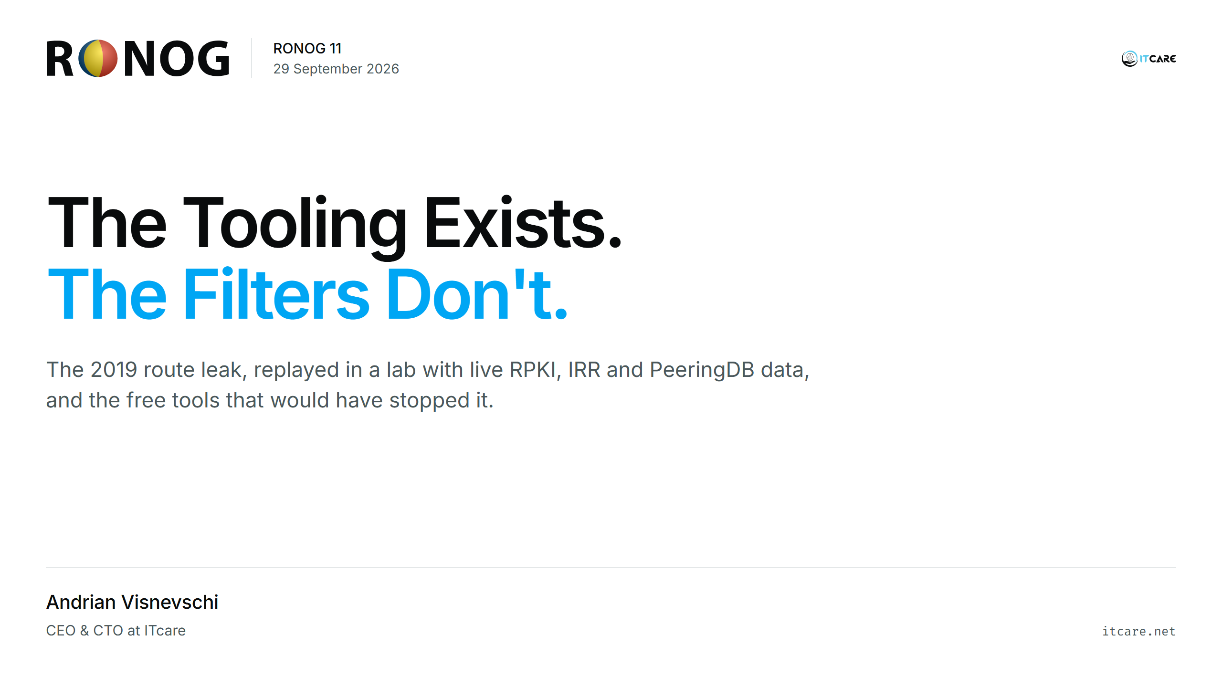
Notes:
(0:30) I run a small network, AS31252. Everything I show today ran in a lab this week, with real routing data.

Slide 2
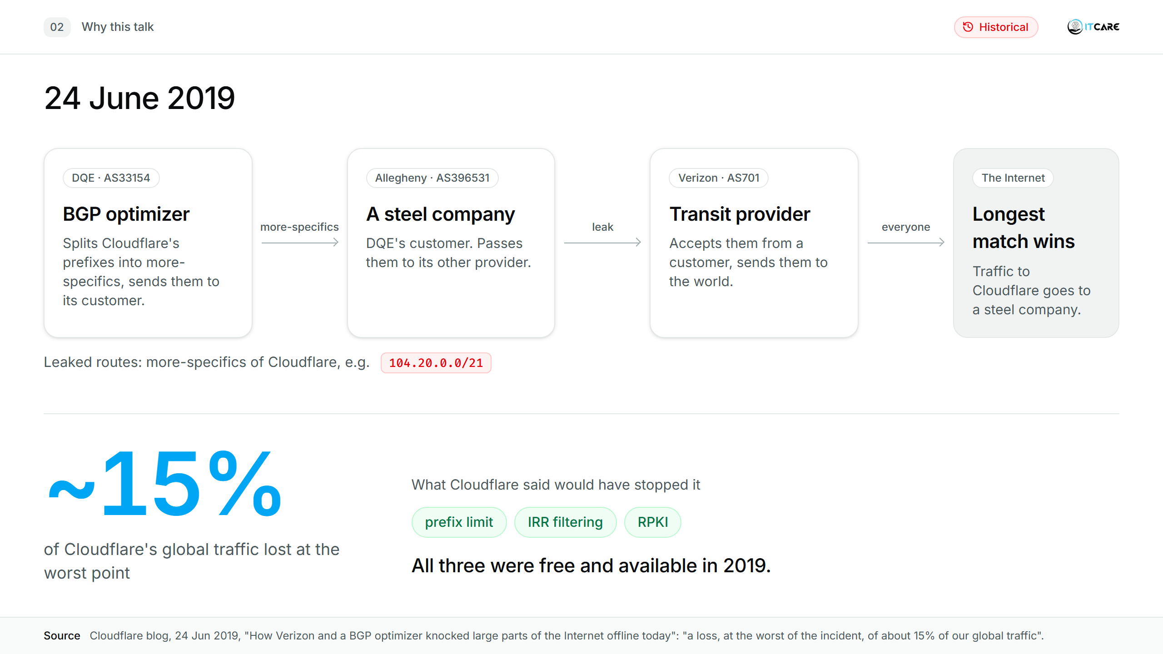
Notes:
(1:30) DQE ran a BGP optimizer that split Cloudflare's prefixes into more-specifics. They went to DQE's customer Allegheny, a steel company, which passed them to its other provider, Verizon. Verizon accepted them from a customer and sent them to the world. Cloudflare named three things that would have stopped it: a prefix limit, IRR filtering, RPKI. All three were free and available in 2019.
Source: https://blog.cloudflare.com/how-verizon-and-a-bgp-optimizer-knocked-large-parts-of-the-internet-offline-today/

Slide 3
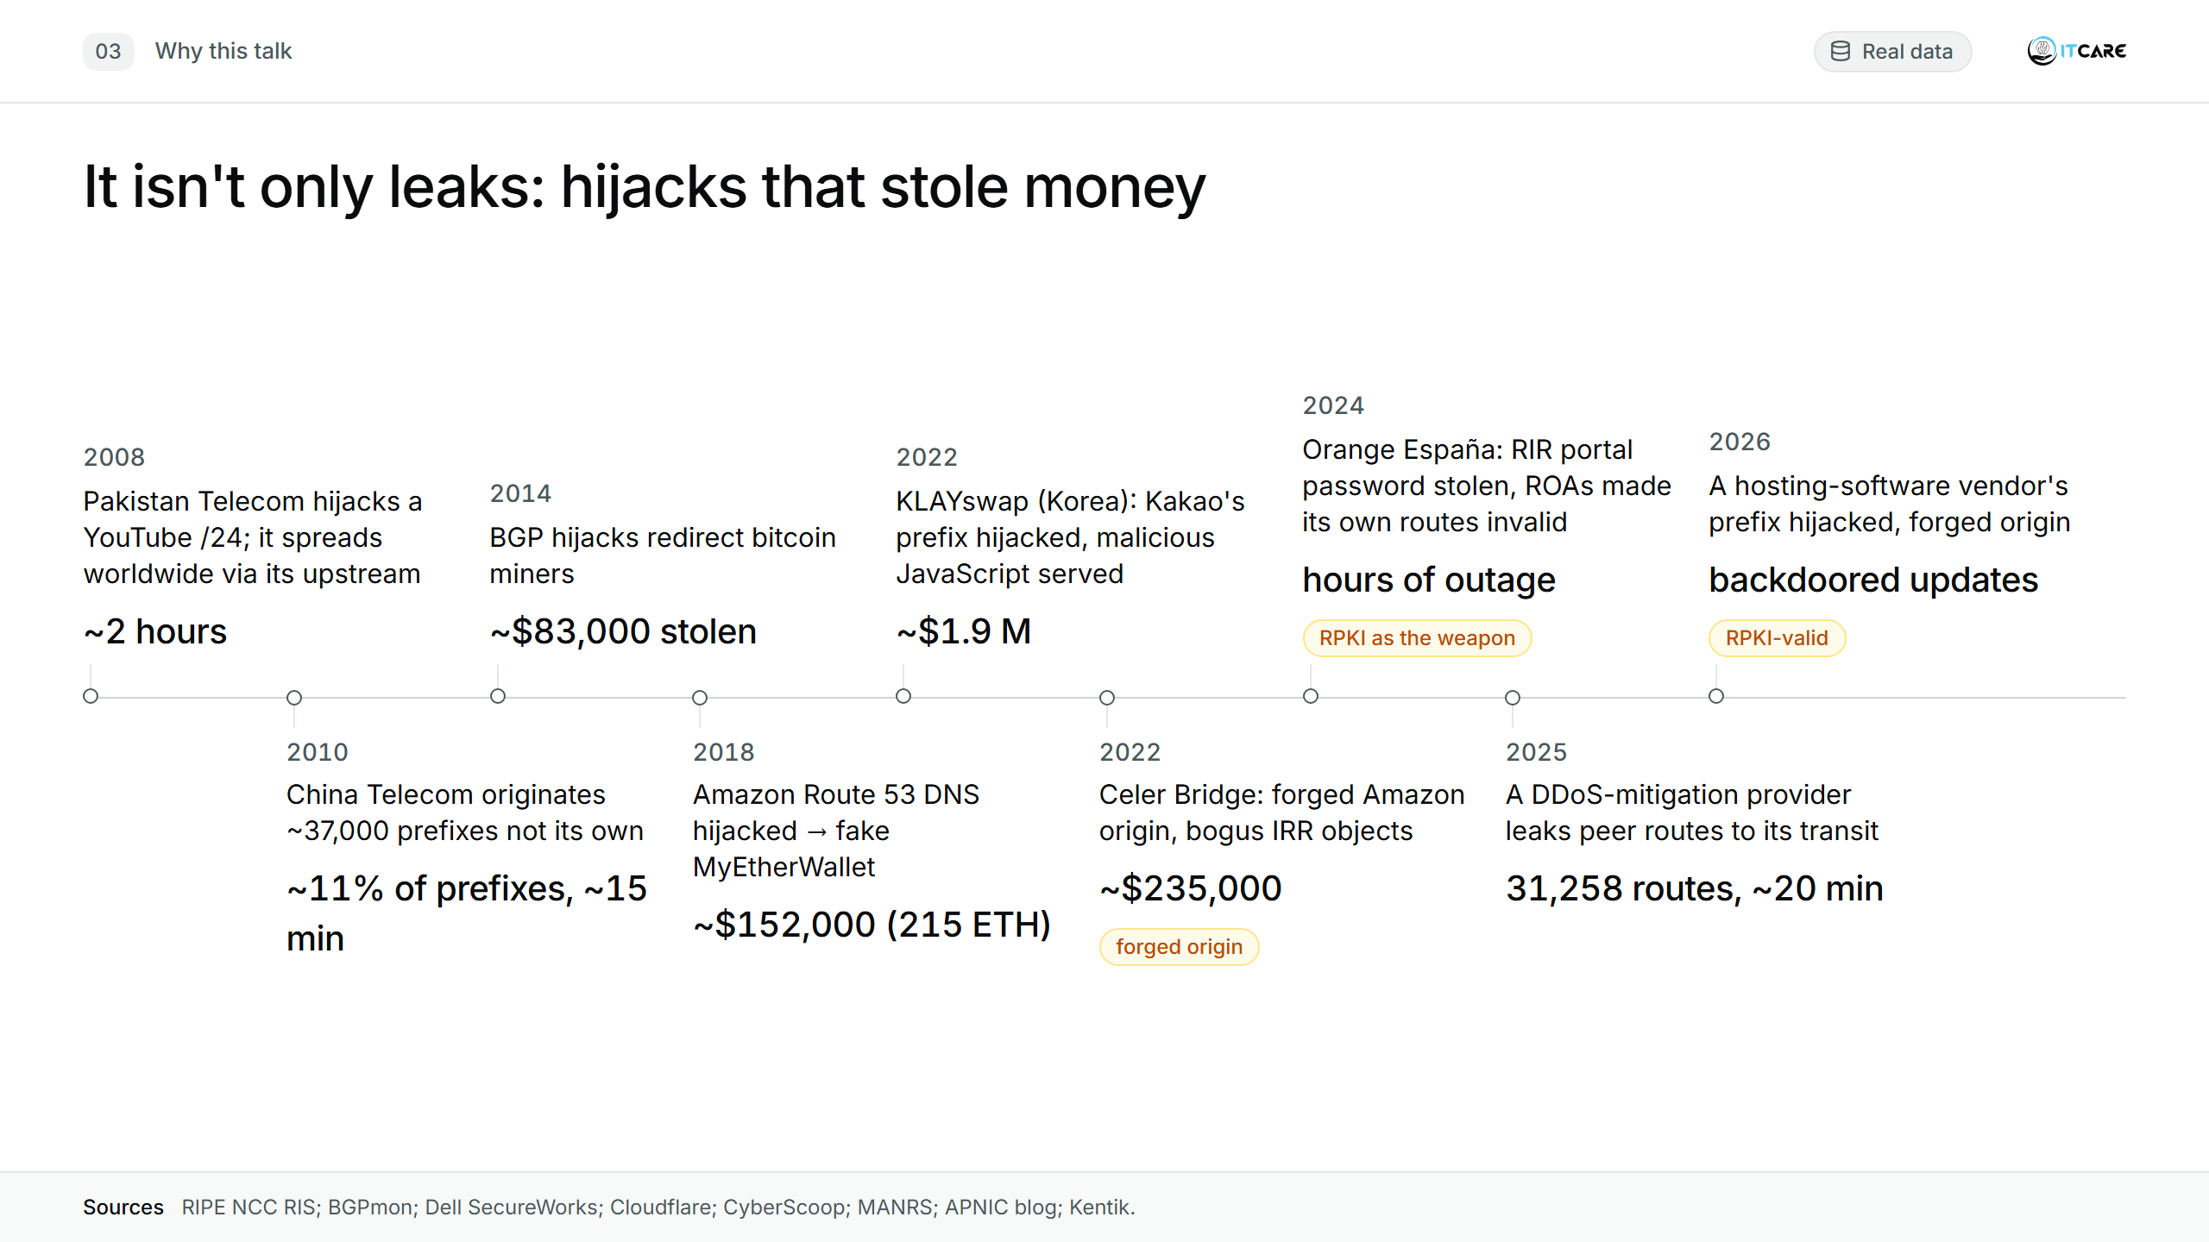
Notes:
(2:00, the longest slide) Not every incident is an accident. Several were used to steal money: point a DNS or web prefix somewhere else and you control what users download. Three quick stories.
2018, MyEtherWallet. Attackers announced more-specifics of Amazon Route 53's DNS address space through a small US ISP, and big networks accepted them. For about two hours, anyone asking "where is myetherwallet.com?" got the attacker's DNS answer: a phishing copy of the site. It had a self-signed certificate; users who clicked through the browser warning had their wallets emptied. About 215 ETH, roughly $152,000.
2022, KLAYswap, a Korean crypto exchange. Its web page loaded a JavaScript library from Kakao, the big Korean platform. The attacker hijacked the prefix of the server hosting that script and served a modified version: every transaction the user approved sent tokens to the attacker. They even got a valid TLS certificate while holding the prefix, so there was no browser warning. The exchange itself was never touched. About $1.9 million.
2022, Celer Bridge, another crypto service, hosted on Amazon. This one was prepared: the attacker created bogus IRR objects so their upstream's filters would accept the route, and forged the path so it looked like it came from Amazon's own AS. ROV said valid. Malicious JavaScript again, about three hours, about $235,000.
Two points for later: in 2022 and in August 2026 the attacker forged the origin AS, so ROV alone did not help; that is what ASPA is for. And in 2024 RPKI itself was the weapon, through a stolen password: turn on 2FA on your RIR account.
[Sources for Q&A:]
2008 YouTube: https://www.ripe.net/about-us/news/youtube-hijacking-a-ripe-ncc-ris-case-study
2010 China Telecom: https://www.bgpmon.net/chinese-isp-hijacked-10-of-the-internet/ (the often-quoted "15%" is a share of routes, not traffic)
2014 bitcoin: https://www.sophos.com/en-us/research/bgp-hijacking-for-cryptocurrency-profit
2018 Route 53 / MyEtherWallet: https://blog.cloudflare.com/bgp-leaks-and-crypto-currencies/ ; https://cyberscoop.com/ether-dns-bgp-amazon-route-53-heist/
2022 KLAYswap: https://manrs.org/2022/02/klayswap-another-bgp-hijack-targeting-crypto-wallets/
2022 Celer Bridge: https://blog.apnic.net/2022/11/07/what-can-be-learned-from-bgp-hijacks-targeting-cryptocurrency-services/
2024 Orange España: https://www.kentik.com/blog/digging-into-the-orange-espana-hack/
2025 DDoS-mitigation leak: https://www.kentik.com/blog/beyond-their-intended-scope-ddos-mitigation-leak/
2026 hosting-vendor hijack: https://blog.apnic.net/2026/09/22/latest-bgp-hijack-targets-hosting-software-vendor/

Slide 4
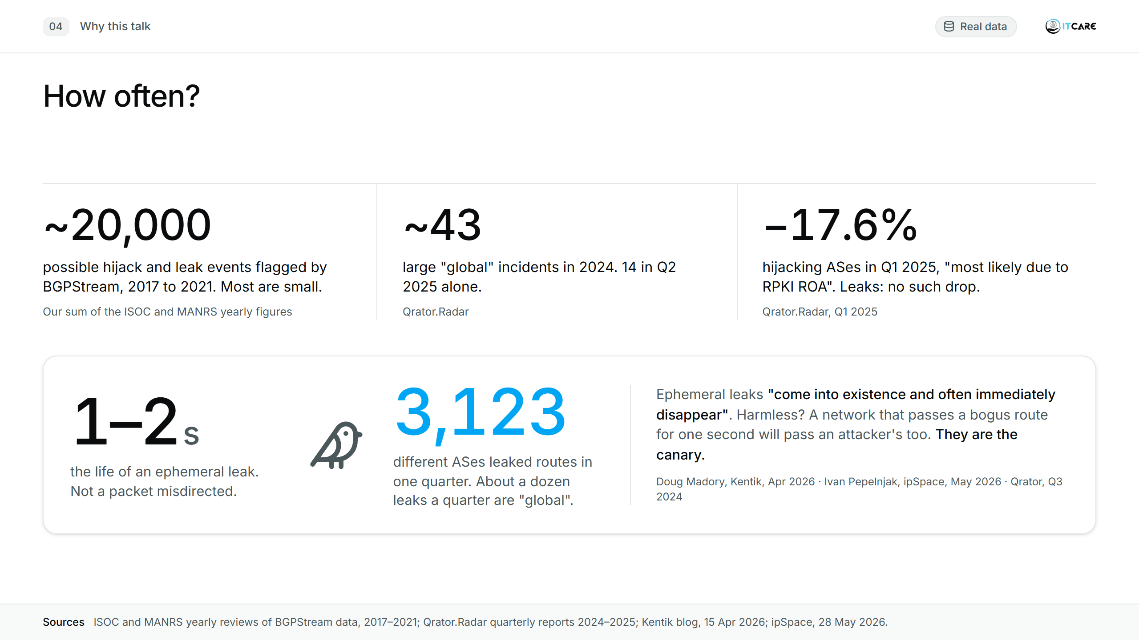
Notes:
(0:45) Counting depends on who counts, but the order of magnitude is clear: thousands of small events a year and several big ones a month. The good news: hijacks are falling where RPKI is deployed. Qrator: "The number of autonomous systems responsible for BGP hijacks dropped by 17.6% compared to Q1 2024." Leaks are not falling: -1.6% over the same year, because ROV does not see leaks. And most leaks you never notice. Doug Madory calls them ephemeral leaks: a route leaks during normal BGP convergence and disappears a second later, not a single packet misdirected. Harmless, you'd think. But as Ivan Pepelnjak put it, they show the network has no policy stopping it: if it passes a bogus route for one second when nothing better is around, it will pass an attacker's route too. They are the canary. Thousands of networks leak every quarter.
[Madory's examples are hand-picked; "perhaps most" is his judgement, not a measurement. Say "short-lived hijacks", never "ephemeral hijacks".]
BGPStream via ISOC/MANRS: 2017 https://www.internetsociety.org/blog/2018/01/14000-incidents-2017-routing-security-year-review/ ; 2018 https://manrs.org/2019/02/routing-security-getting-better-but-no-reason-to-rest/ ; 2019–2020 https://blog.apnic.net/2021/02/05/bgp-rpki-and-manrs-2020-in-review/ ; 2021 https://manrs.org/2022/02/bgp-security-in-2021/
Qrator: https://qrator.net/blog/details/q1-2025-ddos-bots-and-bgp-incidents-statistics-and ; https://qrator.net/blog/details/q3-2025-ddos-bad-bots-and-bgp-incidents-statistics ; Q3 2024: https://blog.qrator.net/en/q3-2024-ddos-bots-and-bgp-incidents-statistics-and_209/
Madory: https://www.kentik.com/blog/ephemeral-leaks-and-automated-bgp-route-leak-detection/
Pepelnjak: https://blog.ipspace.net/2026/05/worth-reading-ephemeral-bgp-leaks/

Slide 5
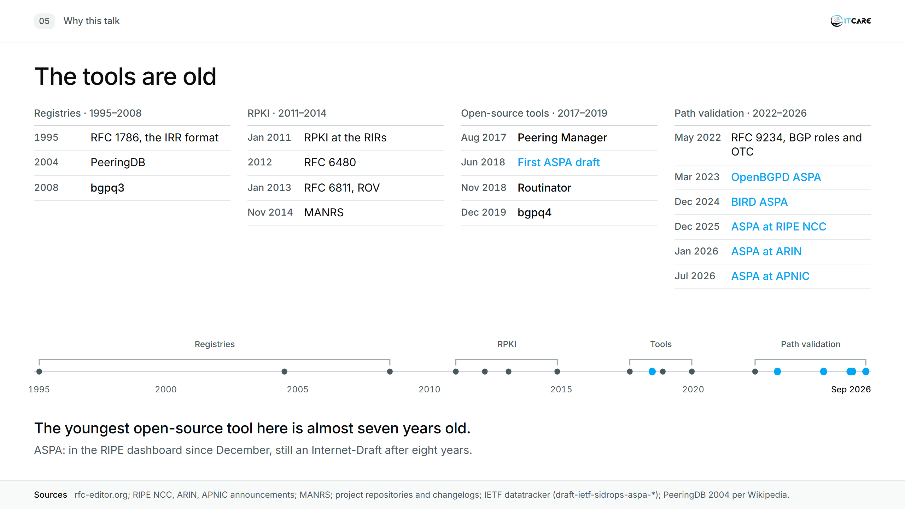
Notes:
(1:00) Everything I use today has been free for years; the youngest open-source tool here is seven years old. ASPA is the new one: in the RIPE dashboard since December, and still an Internet-Draft after eight years.
[Dates: RFC 1786 Mar 1995; RFC 6480 Feb 2012; RFC 6811 Jan 2013; RFC 9234 May 2022. RIPE NCC RPKI Jan 2011; ARIN RPKI 17 Sep 2012. MANRS 6 Nov 2014. bgpq3 changelog from 2008; bgpq4 fork 14 Dec 2019. Routinator 0.1.0 Nov 2018. Peering Manager repo Aug 2017. First ASPA draft 28 Jun 2018. OpenBGPD 7.8 ASPA Mar 2023; BIRD 2.16 ASPA Dec 2024. ASPA at RIPE NCC 15 Dec 2025; ARIN 20 Jan 2026; APNIC July 2026. PeeringDB 2004: Wikipedia, no primary source found.]

Slide 6
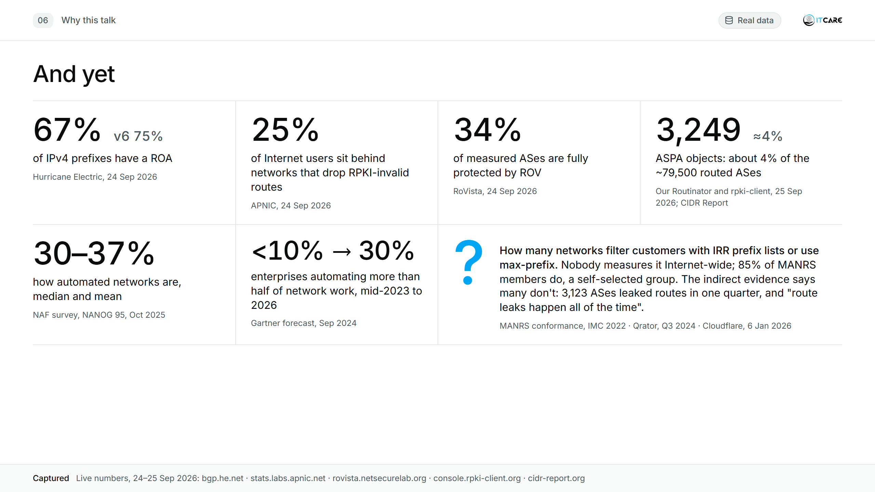
Notes:
(1:15) Two thirds of the address space is signed, but only a third of networks act on it. Half of the defence is published and not used. And the most basic question, "do you filter your customers?", has no global answer at all, except the one the ephemeral leaks give us every day.
[Click] Show of hands: who drops RPKI-invalid? Who filters customers from IRR? Who has an ASPA object?
[Before the talk: re-check on 28 September: HE ROA coverage, APNIC ROV, RoVista, ASPA count (rpki-client console), CIDR Report AS count.]
HE: 67.34% IPv4, 74.94% IPv6 (https://bgp.he.net/report/rpki_and_aspa). APNIC: 25.16% of users (https://stats.labs.apnic.net/rpki/XA). RoVista: 34.40% (https://rovista.netsecurelab.org/). ASPA: 3,249 objects (https://console.rpki-client.org/); HE 3,242 records, 3.30% of 88,291 ASNs; CIDR Report 79,485 ASes.
NAF 2025 State of Network Automation (NANOG 95): mean 37.45%, median 30%. Gartner via Network World, 18 Sep 2024: "from less than 10% in mid-2023 to 30% by 2026" (forecast).
MANRS: 84.9% of MANRS ASes conform to the filtering action (IMC 2022; APNIC blog 14 Feb 2023). Cloudflare, 6 Jan 2026: https://blog.cloudflare.com/bgp-route-leak-venezuela/

Slide 7
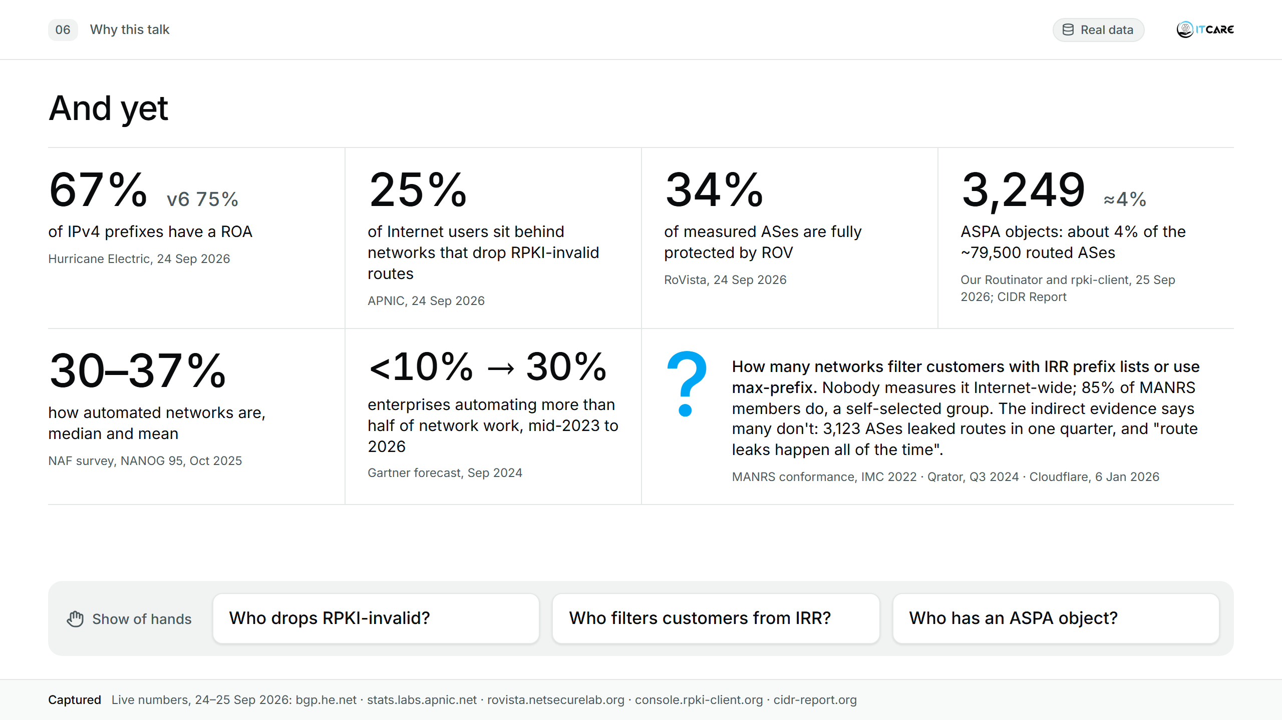
Notes:
(1:15) Two thirds of the address space is signed, but only a third of networks act on it. Half of the defence is published and not used. And the most basic question, "do you filter your customers?", has no global answer at all, except the one the ephemeral leaks give us every day.
[Click] Show of hands: who drops RPKI-invalid? Who filters customers from IRR? Who has an ASPA object?
[Before the talk: re-check on 28 September: HE ROA coverage, APNIC ROV, RoVista, ASPA count (rpki-client console), CIDR Report AS count.]
HE: 67.34% IPv4, 74.94% IPv6 (https://bgp.he.net/report/rpki_and_aspa). APNIC: 25.16% of users (https://stats.labs.apnic.net/rpki/XA). RoVista: 34.40% (https://rovista.netsecurelab.org/). ASPA: 3,249 objects (https://console.rpki-client.org/); HE 3,242 records, 3.30% of 88,291 ASNs; CIDR Report 79,485 ASes.
NAF 2025 State of Network Automation (NANOG 95): mean 37.45%, median 30%. Gartner via Network World, 18 Sep 2024: "from less than 10% in mid-2023 to 30% by 2026" (forecast).
MANRS: 84.9% of MANRS ASes conform to the filtering action (IMC 2022; APNIC blog 14 Feb 2023). Cloudflare, 6 Jan 2026: https://blog.cloudflare.com/bgp-route-leak-venezuela/

Slide 8
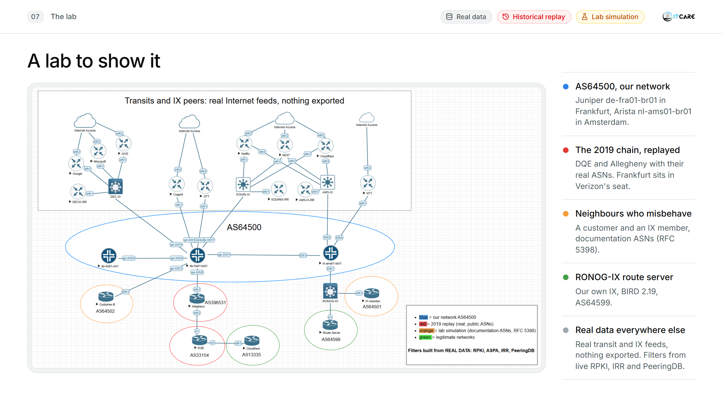
Notes:
(1:00) Two real vendor routers are "our network" AS64500: a Juniper in Frankfurt, an Arista in Amsterdam. Bottom middle, in red: the 2019 chain replayed with the real ASNs; Frankfurt sits in Verizon's seat. Orange: a customer and an IX member that misbehave, using documentation ASNs, so nobody in this room is on a slide. Green: a route server for our own "RONOG-IX". The filters are built from real data: live RPKI, live IRR, live PeeringDB.

Slide 9
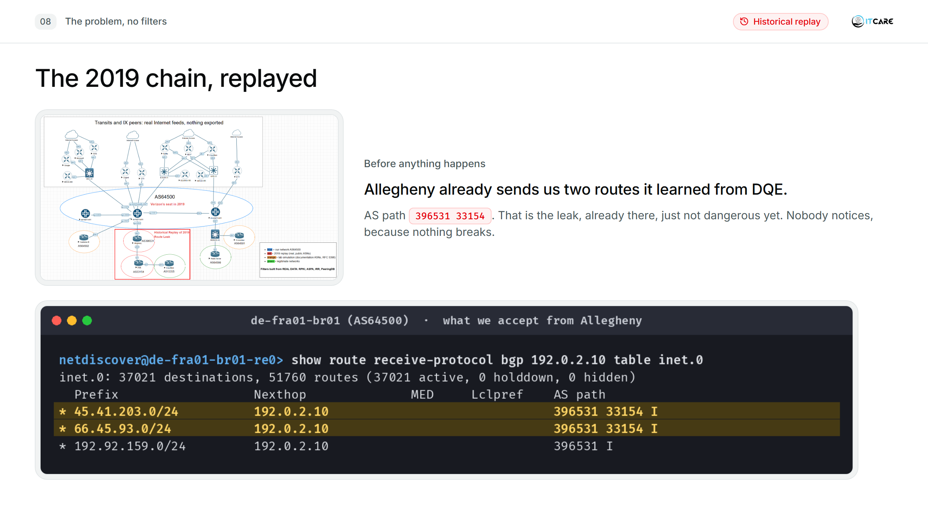
Notes:
(0:45) Before anything happens, look: Allegheny already sends us two routes it learned from DQE. That is the leak, already there, just not dangerous yet. Nobody notices, because nothing breaks.

Slide 10
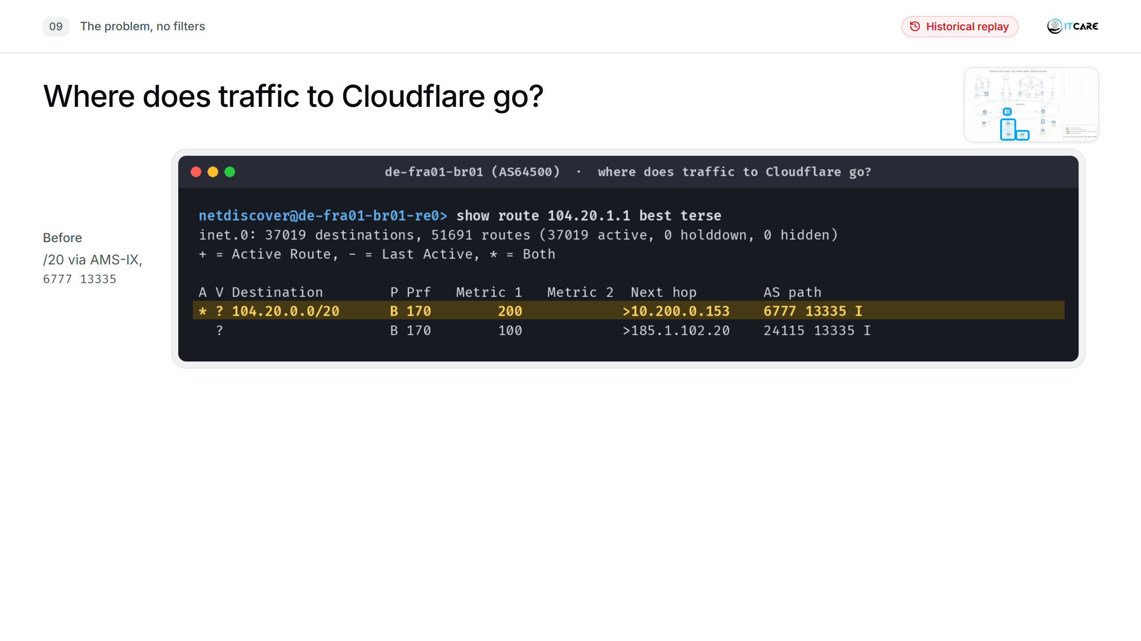
Notes:
(1:15) I switch on DQE's optimizer, with the two /21s from Cloudflare's post. Before: 104.20.1.1 goes to Cloudflare over AMS-IX. [click] After: to a steel company. Longest match wins, and nothing in our config says otherwise.
[If asked why it won: longest match. The /21 is more specific than Cloudflare's /20, so it wins before BGP compares any attribute. It would most likely win an equal-prefix contest too: it came from a customer, and like almost every operator we give customer routes a higher local-pref (300) than peering or transit. Local-pref only decides between paths for the same prefix. Once one border router accepts it, iBGP carries it through the whole AS: Amsterdam has it too (screenshots 1-05, 1-06).]

Slide 11
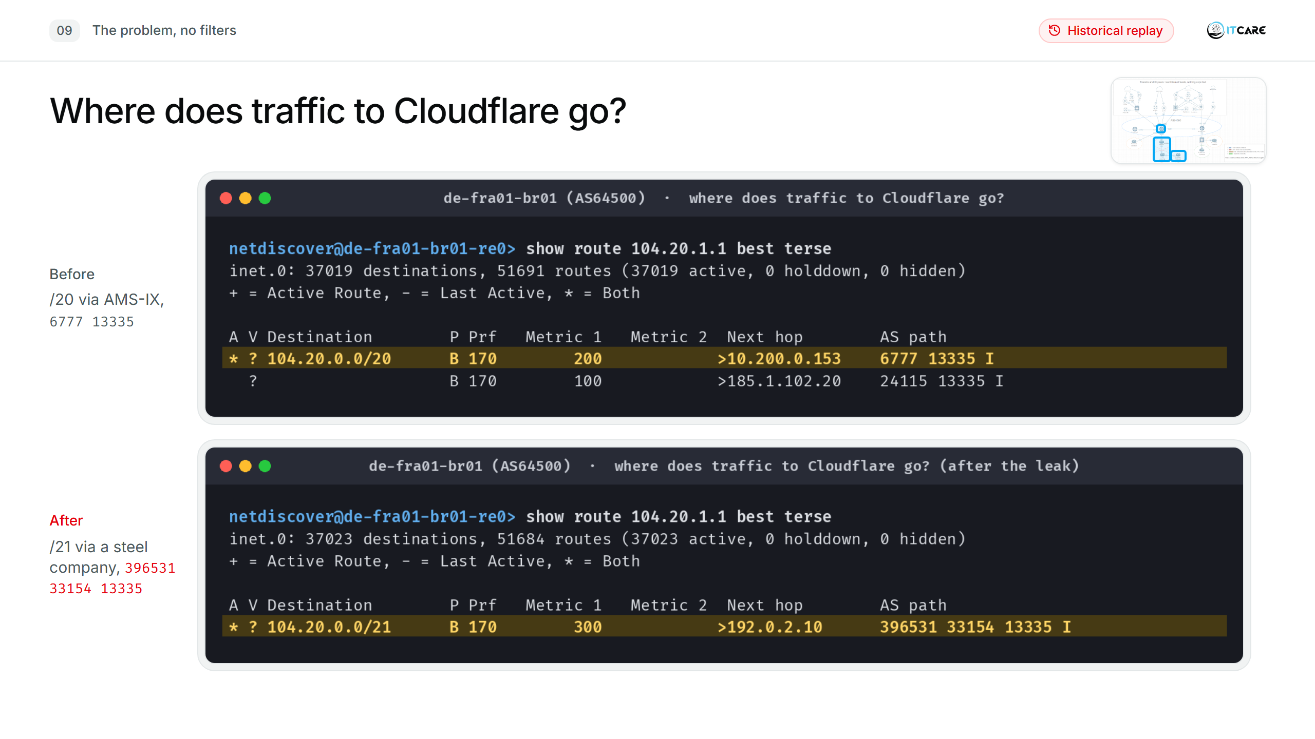
Notes:
(1:15) I switch on DQE's optimizer, with the two /21s from Cloudflare's post. Before: 104.20.1.1 goes to Cloudflare over AMS-IX. [click] After: to a steel company. Longest match wins, and nothing in our config says otherwise.
[If asked why it won: longest match. The /21 is more specific than Cloudflare's /20, so it wins before BGP compares any attribute. It would most likely win an equal-prefix contest too: it came from a customer, and like almost every operator we give customer routes a higher local-pref (300) than peering or transit. Local-pref only decides between paths for the same prefix. Once one border router accepts it, iBGP carries it through the whole AS: Amsterdam has it too (screenshots 1-05, 1-06).]

Slide 12
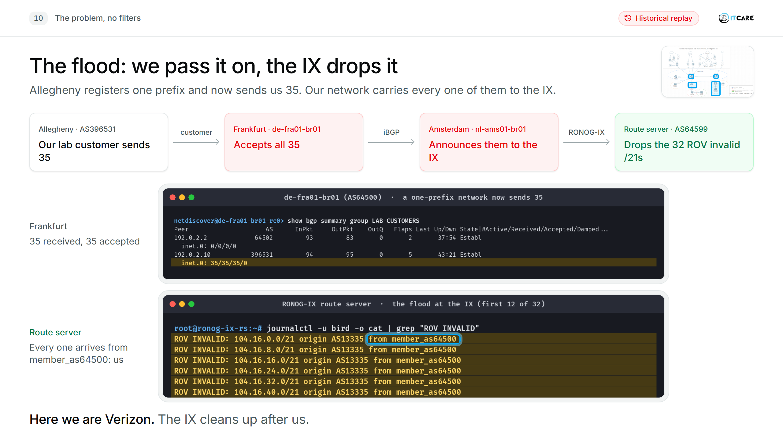
Notes:
(0:45) Watch where these routes go. Allegheny, our lab customer, registers exactly one prefix and now sends us 35. Frankfurt accepts all 35: no prefix limit, no IRR filter. iBGP carries them to Amsterdam, and Amsterdam announces them to the RONOG-IX route server like any other customer route. So here we are Verizon: we are the network passing the leak on. The route server does ROV, sees the leaked /21s are invalid, and drops them before any other member gets them. Look at the log: every one of them came from member_as64500. That's us. The IX cleans up after us. And the reverse holds: when the IX filters for us, we're only as safe as its config, and a bilateral peer or a PNI has no route server at all.
[Backup for "did any of this leave the lab?": slide B1, 1-15-nothing-left-the-lab (0 routes to transit during the flood).]
[If the Arista advertised-routes capture exists (1-09d-ams-advertises-to-ix), it belongs on this slide: Amsterdam sending the /21s to the route server.]

Slide 13
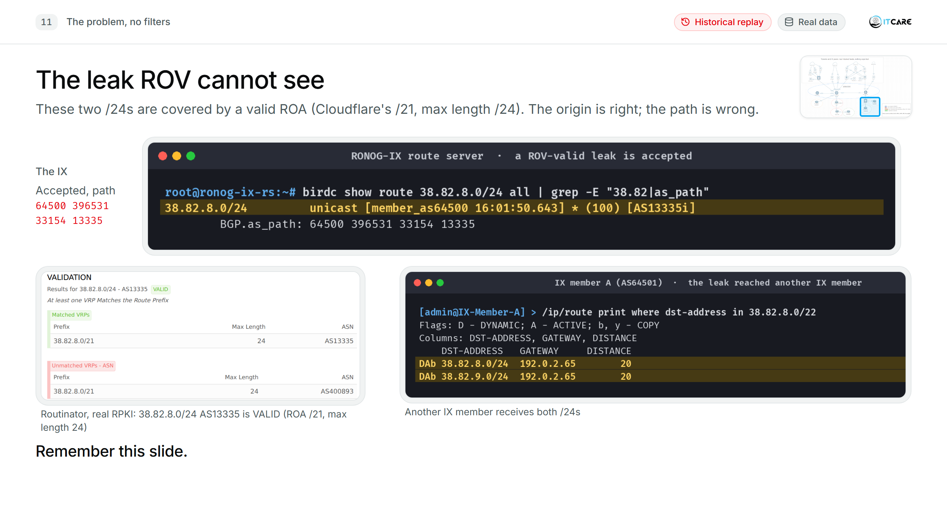
Notes:
(0:45) These two /24s are covered by a valid ROA: Cloudflare's /21, max length /24. The origin is right; the path is wrong. ROV passes them, the IX passes them, and another IX member receives them. Remember this slide.

Slide 14
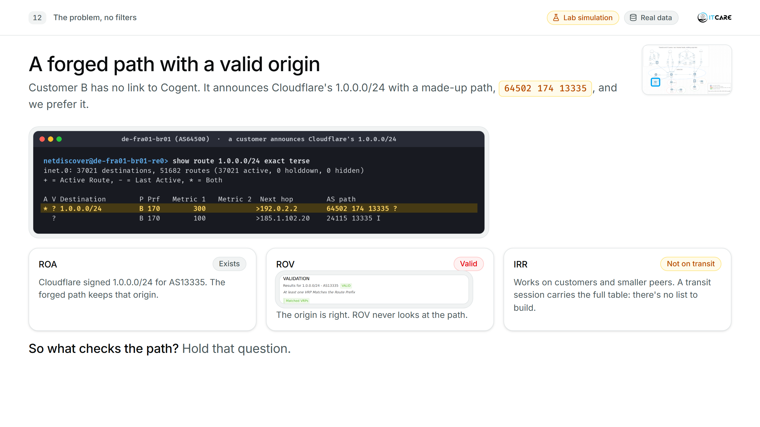
Notes:
(0:50) Our customer, Customer B, announces Cloudflare's 1.0.0.0/24, with a path that says "Customer B, Cogent, Cloudflare". It's forged. And we prefer it: it's a customer route, local-pref 300 against 100 for the real one. Is there a ROA? Yes, Cloudflare signed 1.0.0.0/24. Does ROV help? No: the origin is Cloudflare, so ROV says valid; ROV never looks at the path. IRR? On a customer session, yes, and on smaller peers. But the same forged path can arrive over a transit session carrying the full table, where there's no prefix list to build. That's Celer Bridge in 2022 and the hosting-software vendor in August, from slide 3. So what checks the path? Hold that question.
[Leak or hijack, if asked: in the lab it is a hijack. Customer B is connected only to us and never received 1.0.0.0/24 from Cogent; it invented the path, keeping Cloudflare as the origin so ROV passes it (a forged-origin hijack, like Celer Bridge). A route leak would be Customer B passing on a route it really learned from Cogent. On the wire, from our router, the two look identical, and ASPA rejects both: Cogent has no providers, so it cannot have sent the route up to Customer B.]
[Do not reveal ASPA here; it is the fix on slide 24. Screenshots 1-11b / 1-11c (ASPA INVALID, Cogent's AS0 object) moved there.]

Slide 15
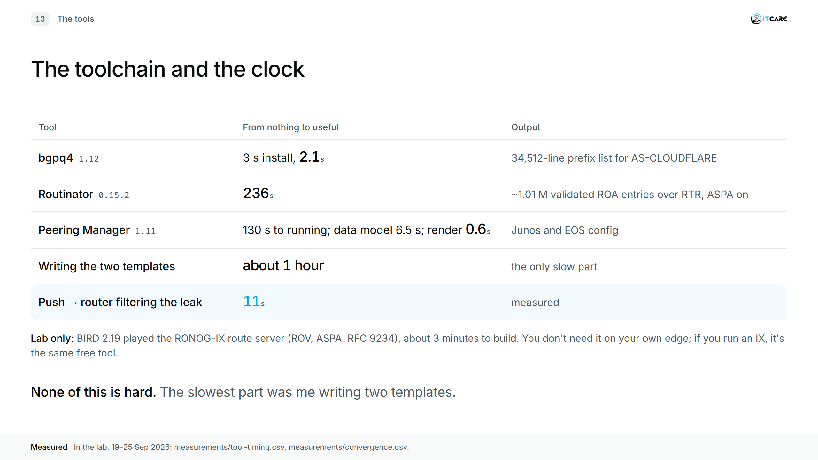
Notes:
(1:00) None of this is hard. The slowest part was me writing two templates, and I'll show you the bugs I made.
[BIRD is not in the table on purpose: it only plays the IX route server in the lab. Your own routers do ROV and IRR themselves. Mention it for the IX operators in the room: the same free route server does ROV, ASPA and RFC 9234.]

Slide 16
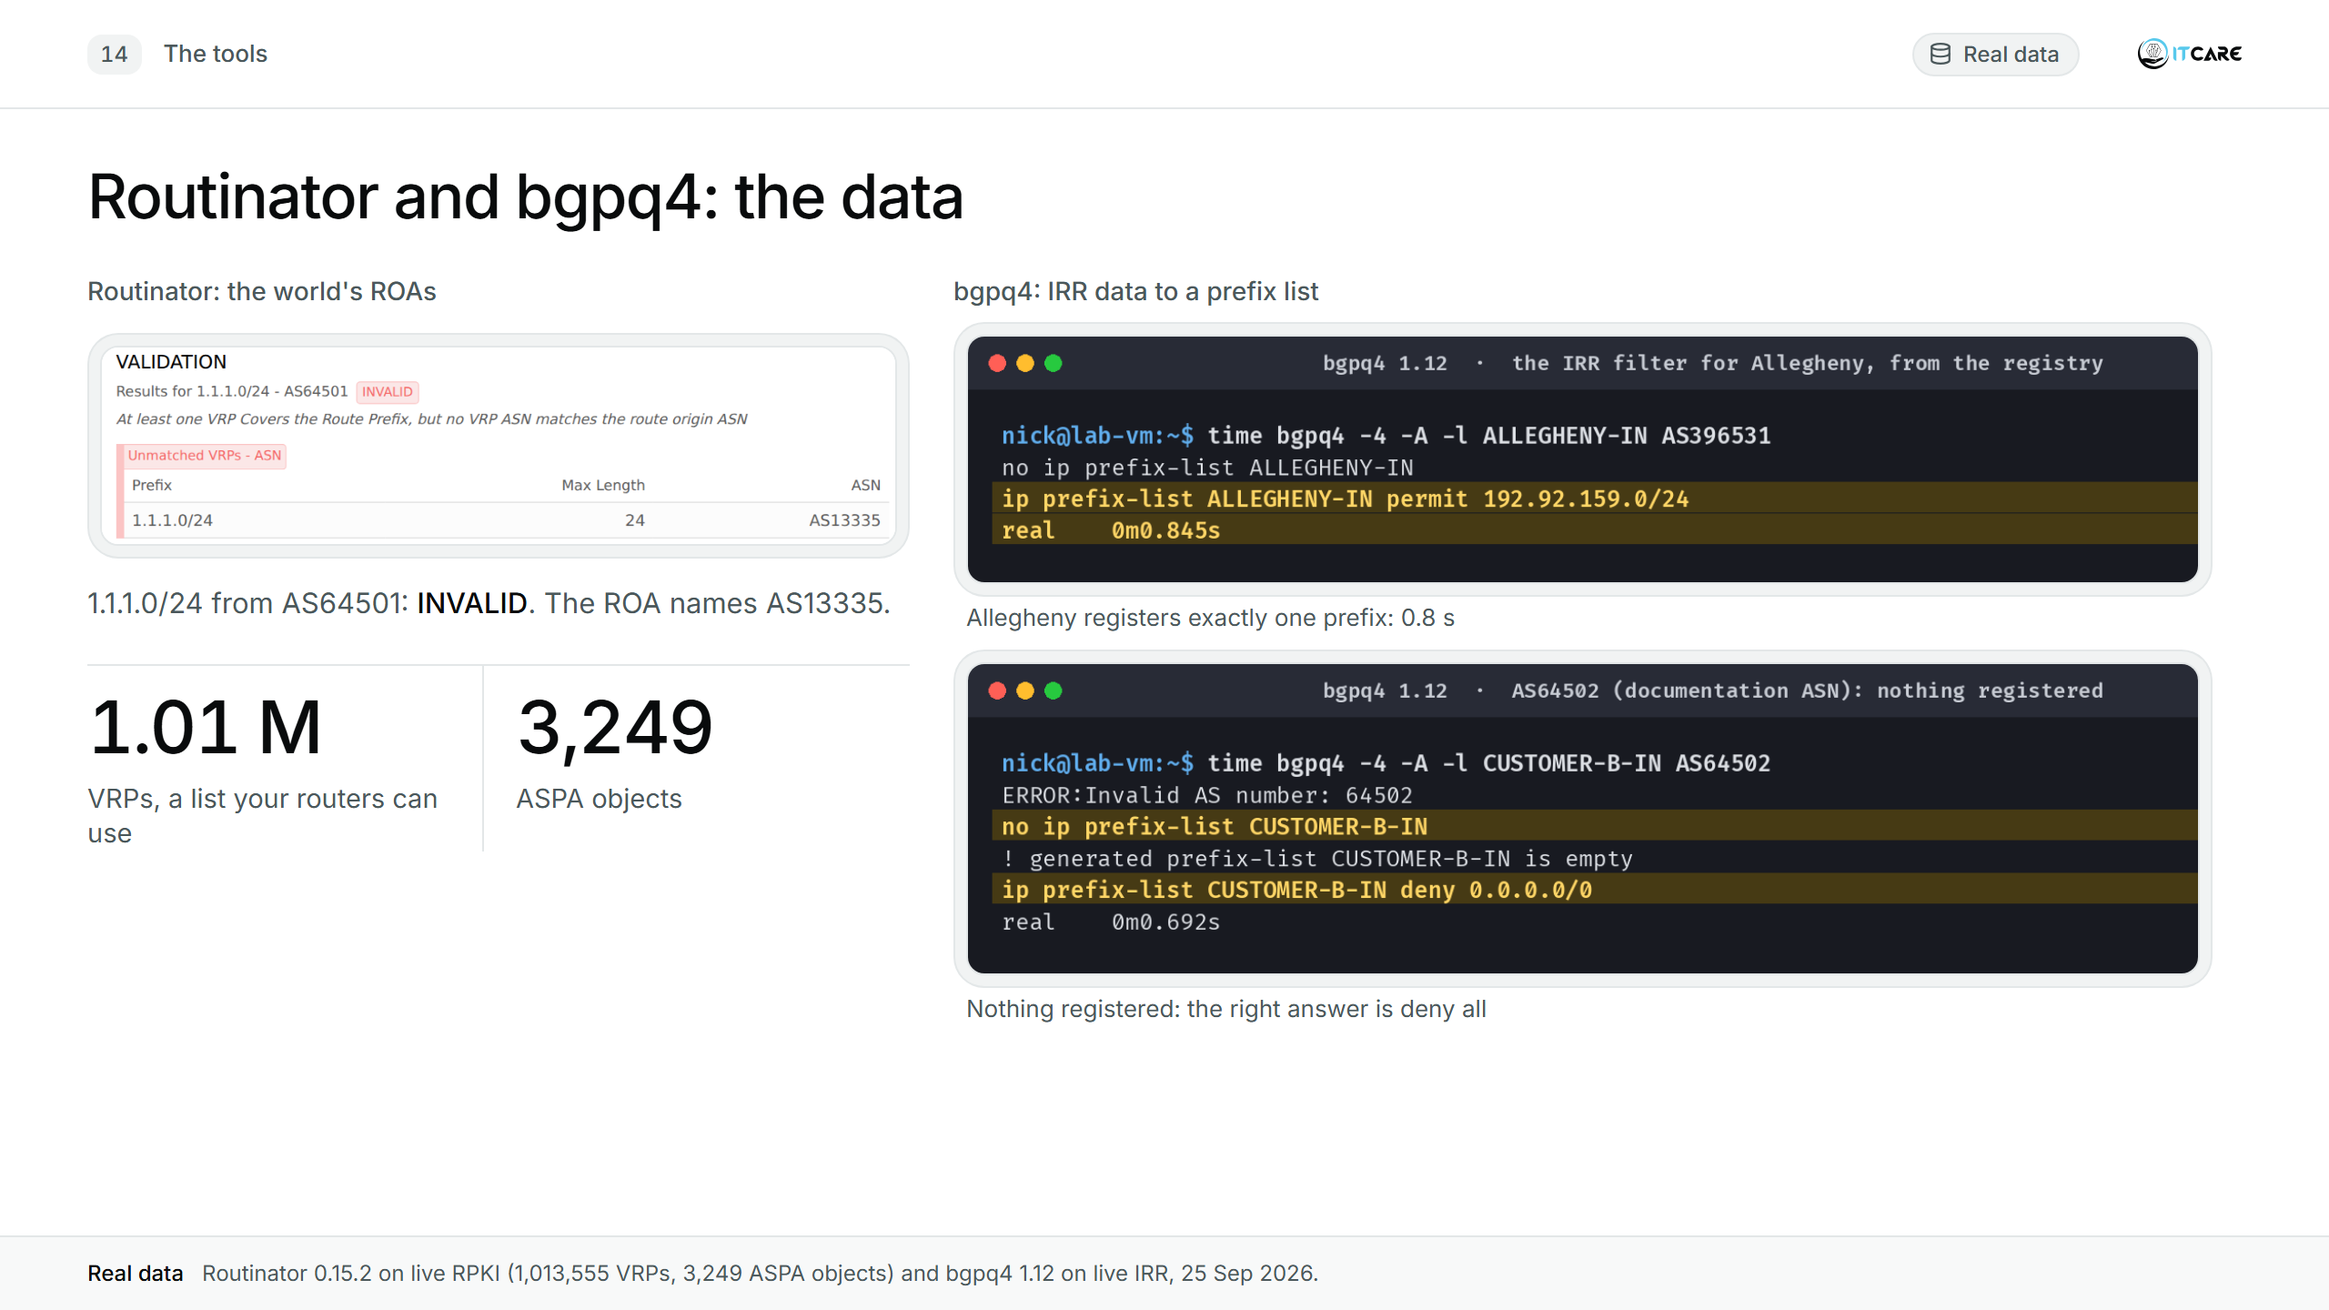
Notes:
(0:45) Routinator turns the world's ROAs into a list your routers can use. bgpq4 turns IRR data into a prefix list: Allegheny registers exactly one prefix. And if there is nothing registered, the right answer is "deny all", which is what bgpq4 gives you.

Slide 17
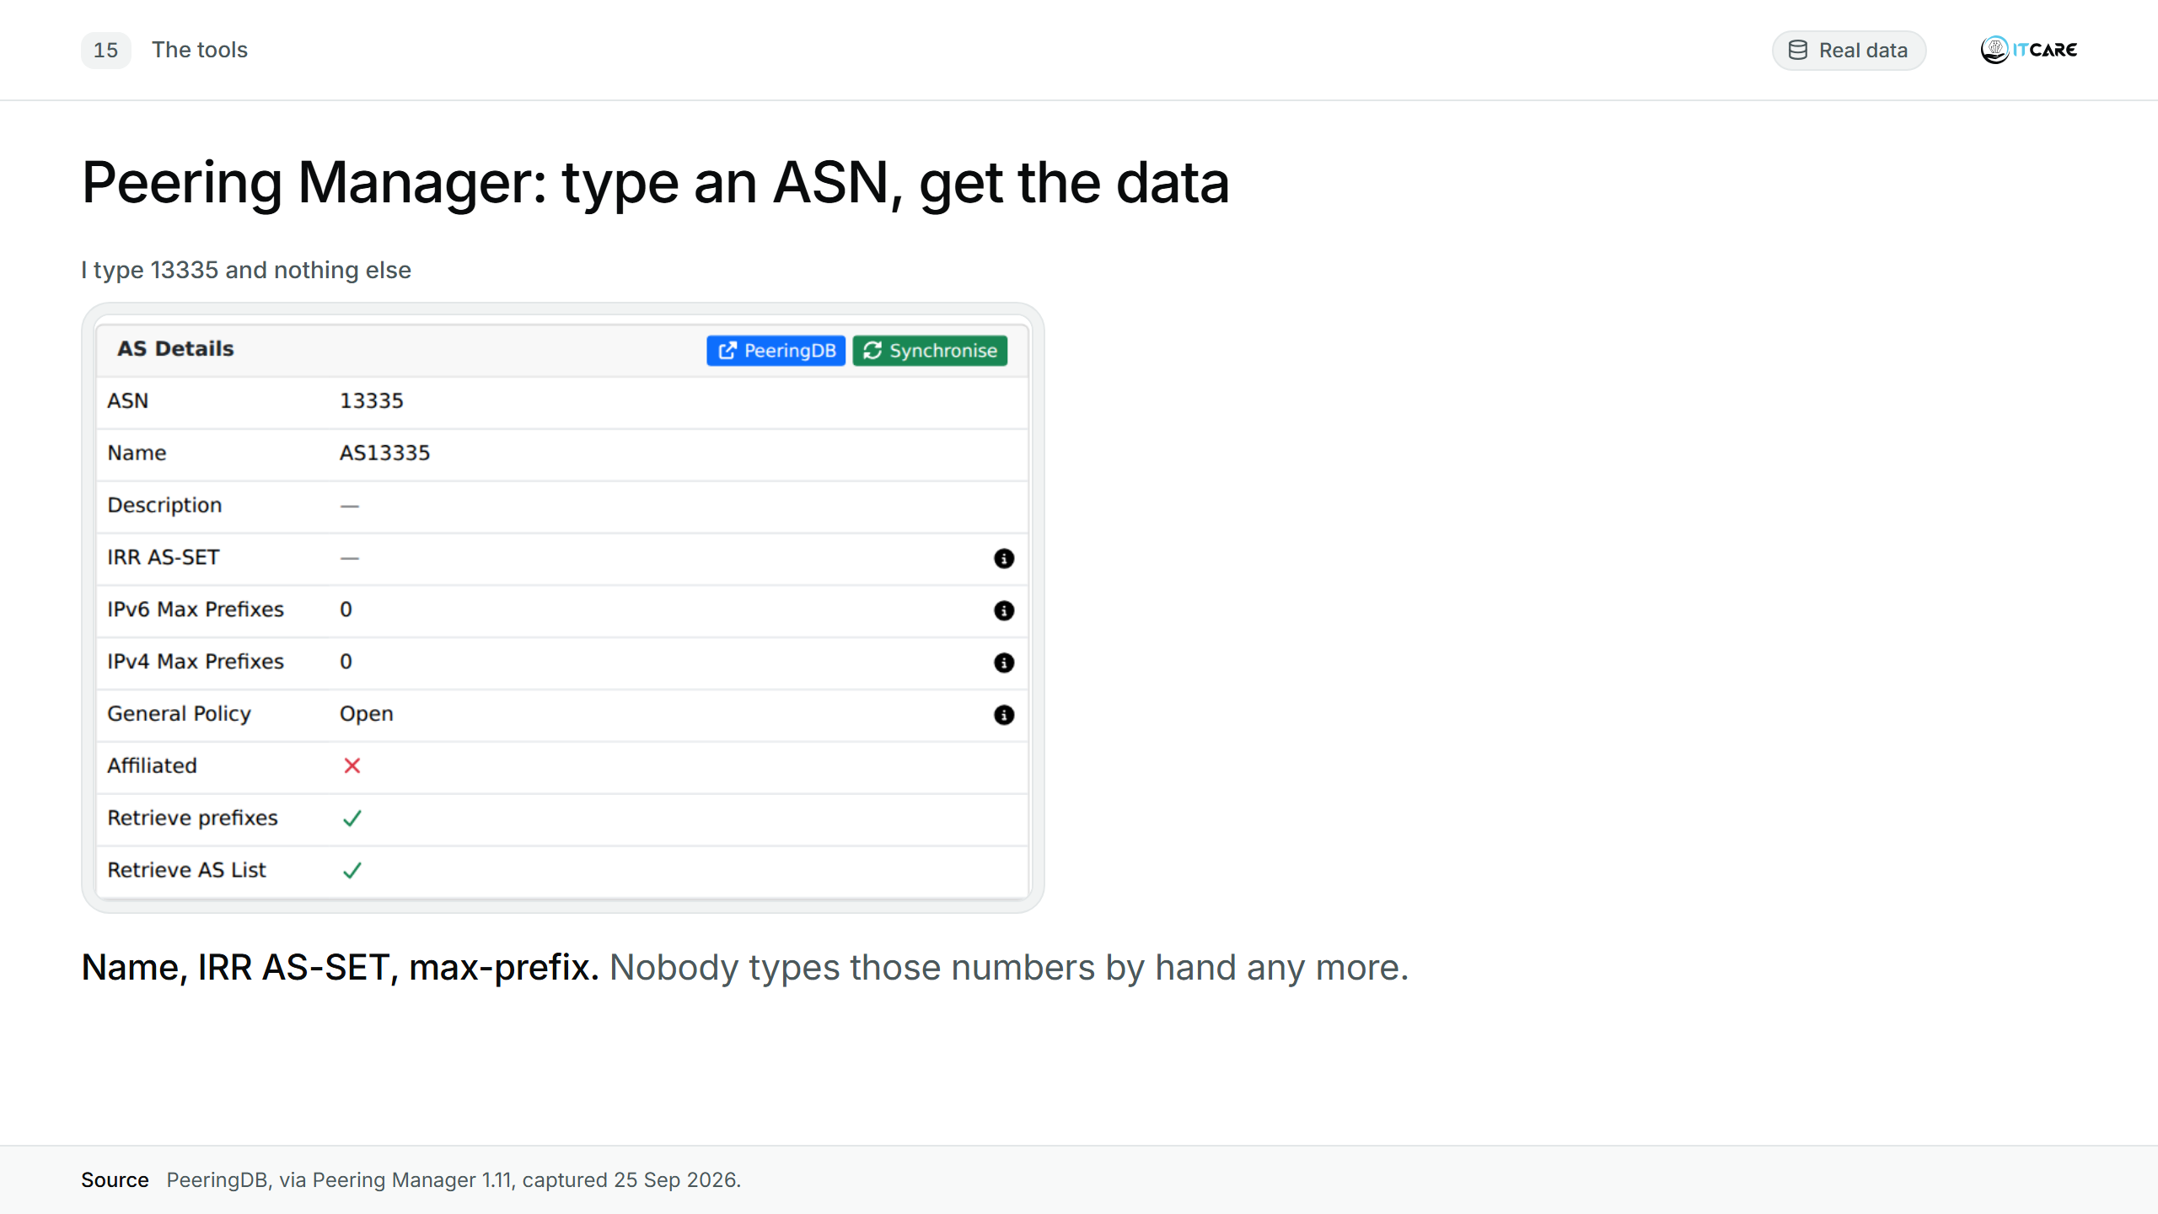
Notes:
(1:00) I type 13335 and nothing else. [click] I click "Synchronise", and PeeringDB fills in the name, the AS-SET and the max-prefix. Nobody types those numbers by hand any more.

Slide 18
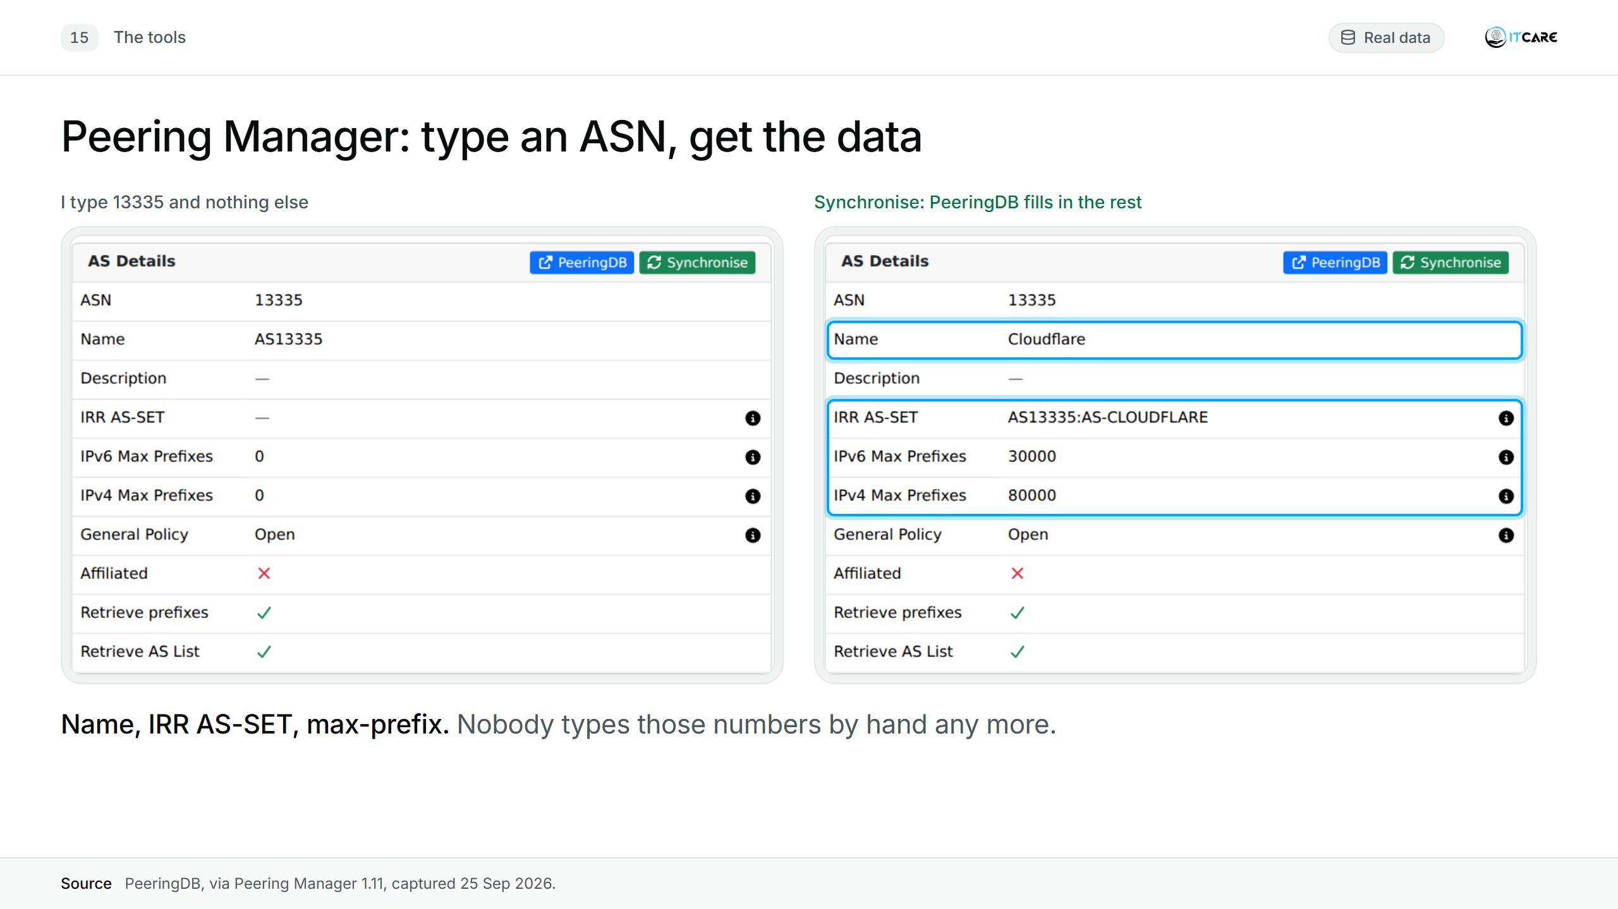
Notes:
(1:00) I type 13335 and nothing else. [click] I click "Synchronise", and PeeringDB fills in the name, the AS-SET and the max-prefix. Nobody types those numbers by hand any more.

Slide 19
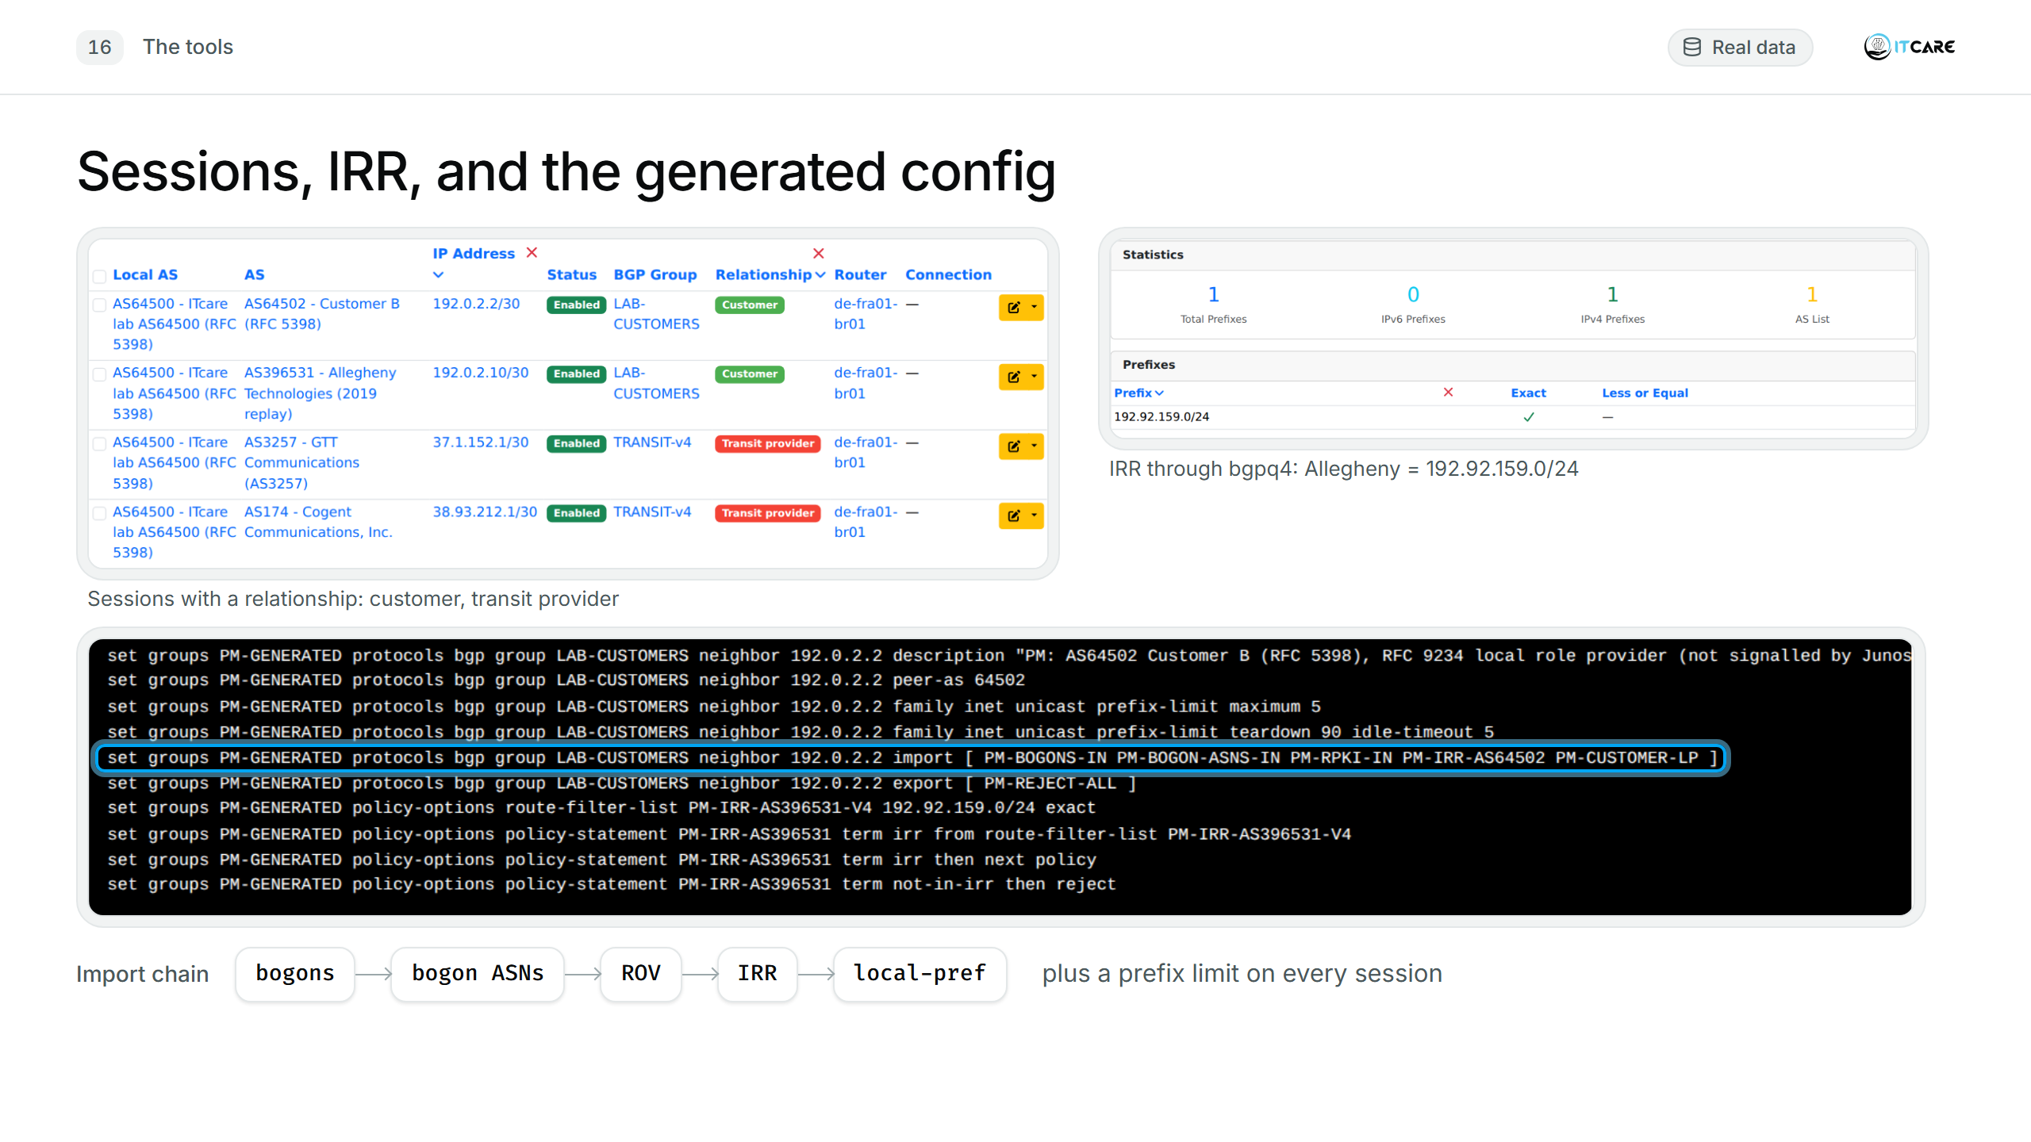
Notes:
(1:00) Sessions have a relationship and an RFC 9234 role. PM fetches the IRR prefixes with bgpq4 and the max-prefix from PeeringDB, and a template turns that into router config: bogons, private ASNs, ROV, IRR, local-pref, prefix limit. The routers can't signal RFC 9234 roles yet; PM already models them.
[Optional inset if asked: 2-15b-pm-policy-customer-lp.]

Slide 20
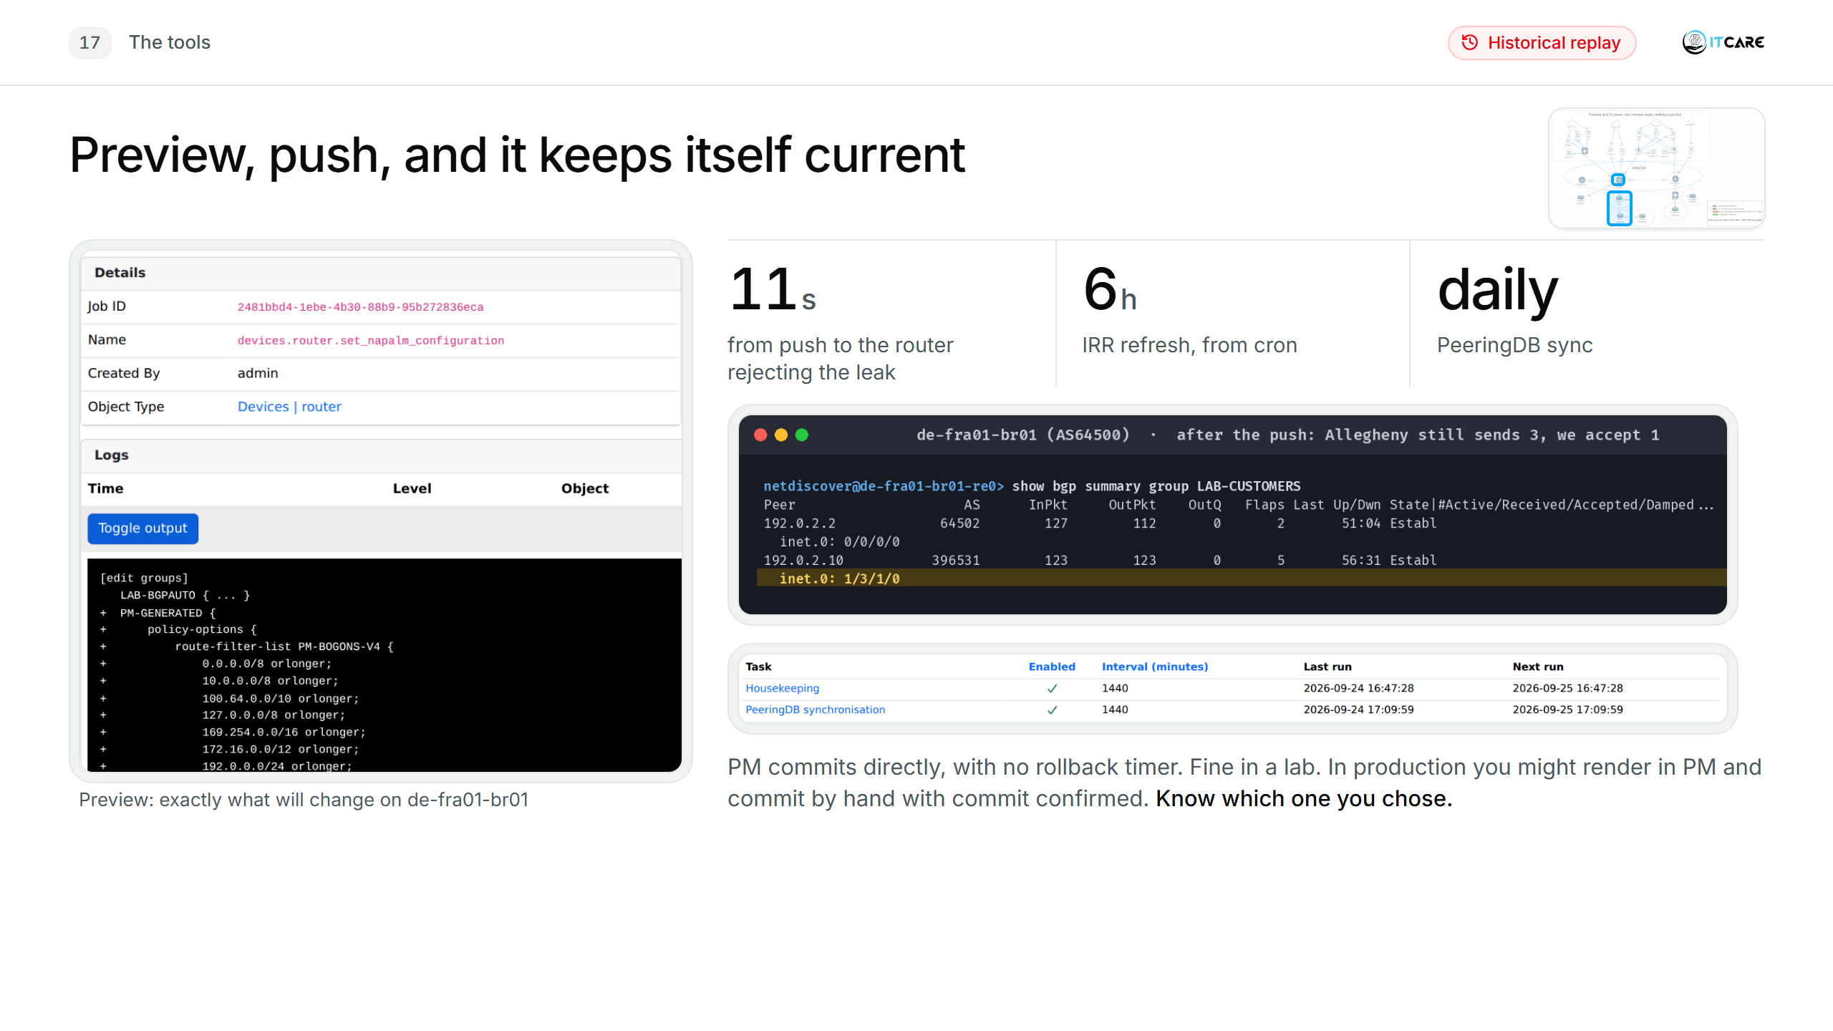
Notes:
(1:00) Preview shows exactly what will change. Push, and 11 seconds later Allegheny still sends three routes but we accept one. PeeringDB syncs daily out of the box; IRR refresh and push are PM commands you run from cron. PM commits directly, with no rollback timer. Fine in a lab; in production you might render in PM and commit by hand with commit confirmed. Know which one you chose.

Slide 21
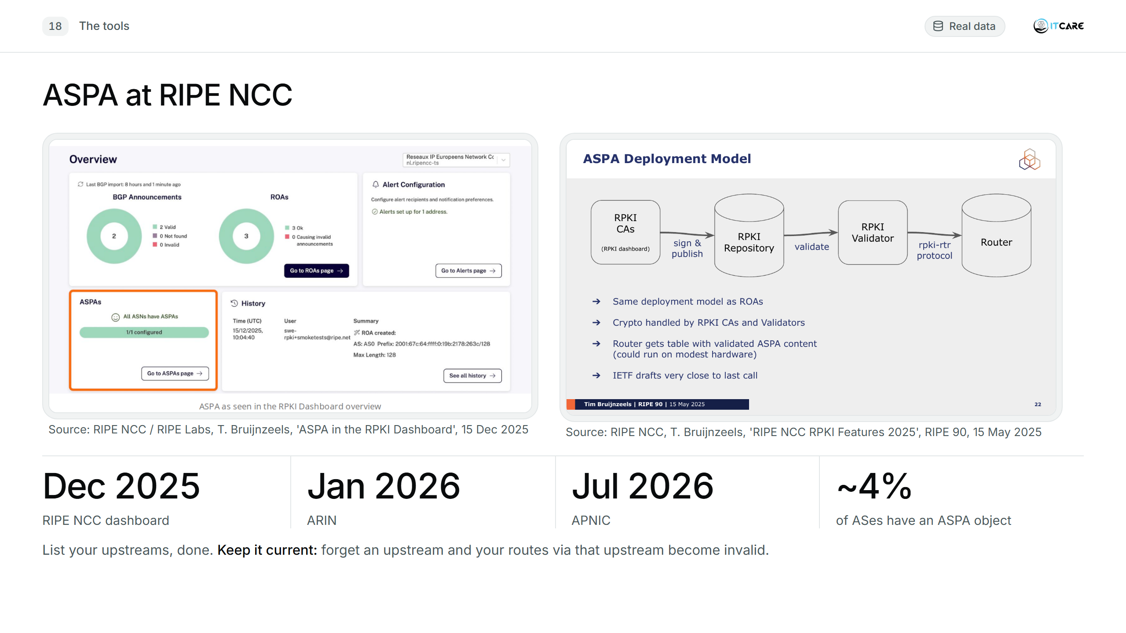
Notes:
(0:45) Since December the RIPE dashboard lets you publish an ASPA object next to your ROAs: list your upstreams, done. ARIN since January, APNIC since July. Only about 4% of ASes have one. Keep it current: forget an upstream and your routes via that upstream become invalid.
[Keep this slide: the ASPA fix on slide 24 points back to it.]
[RIPE NCC images are used whole and unmodified, credited as RIPE NCC documents, per https://www.ripe.net/about-us/legal/copyright-statement/]

Slide 22
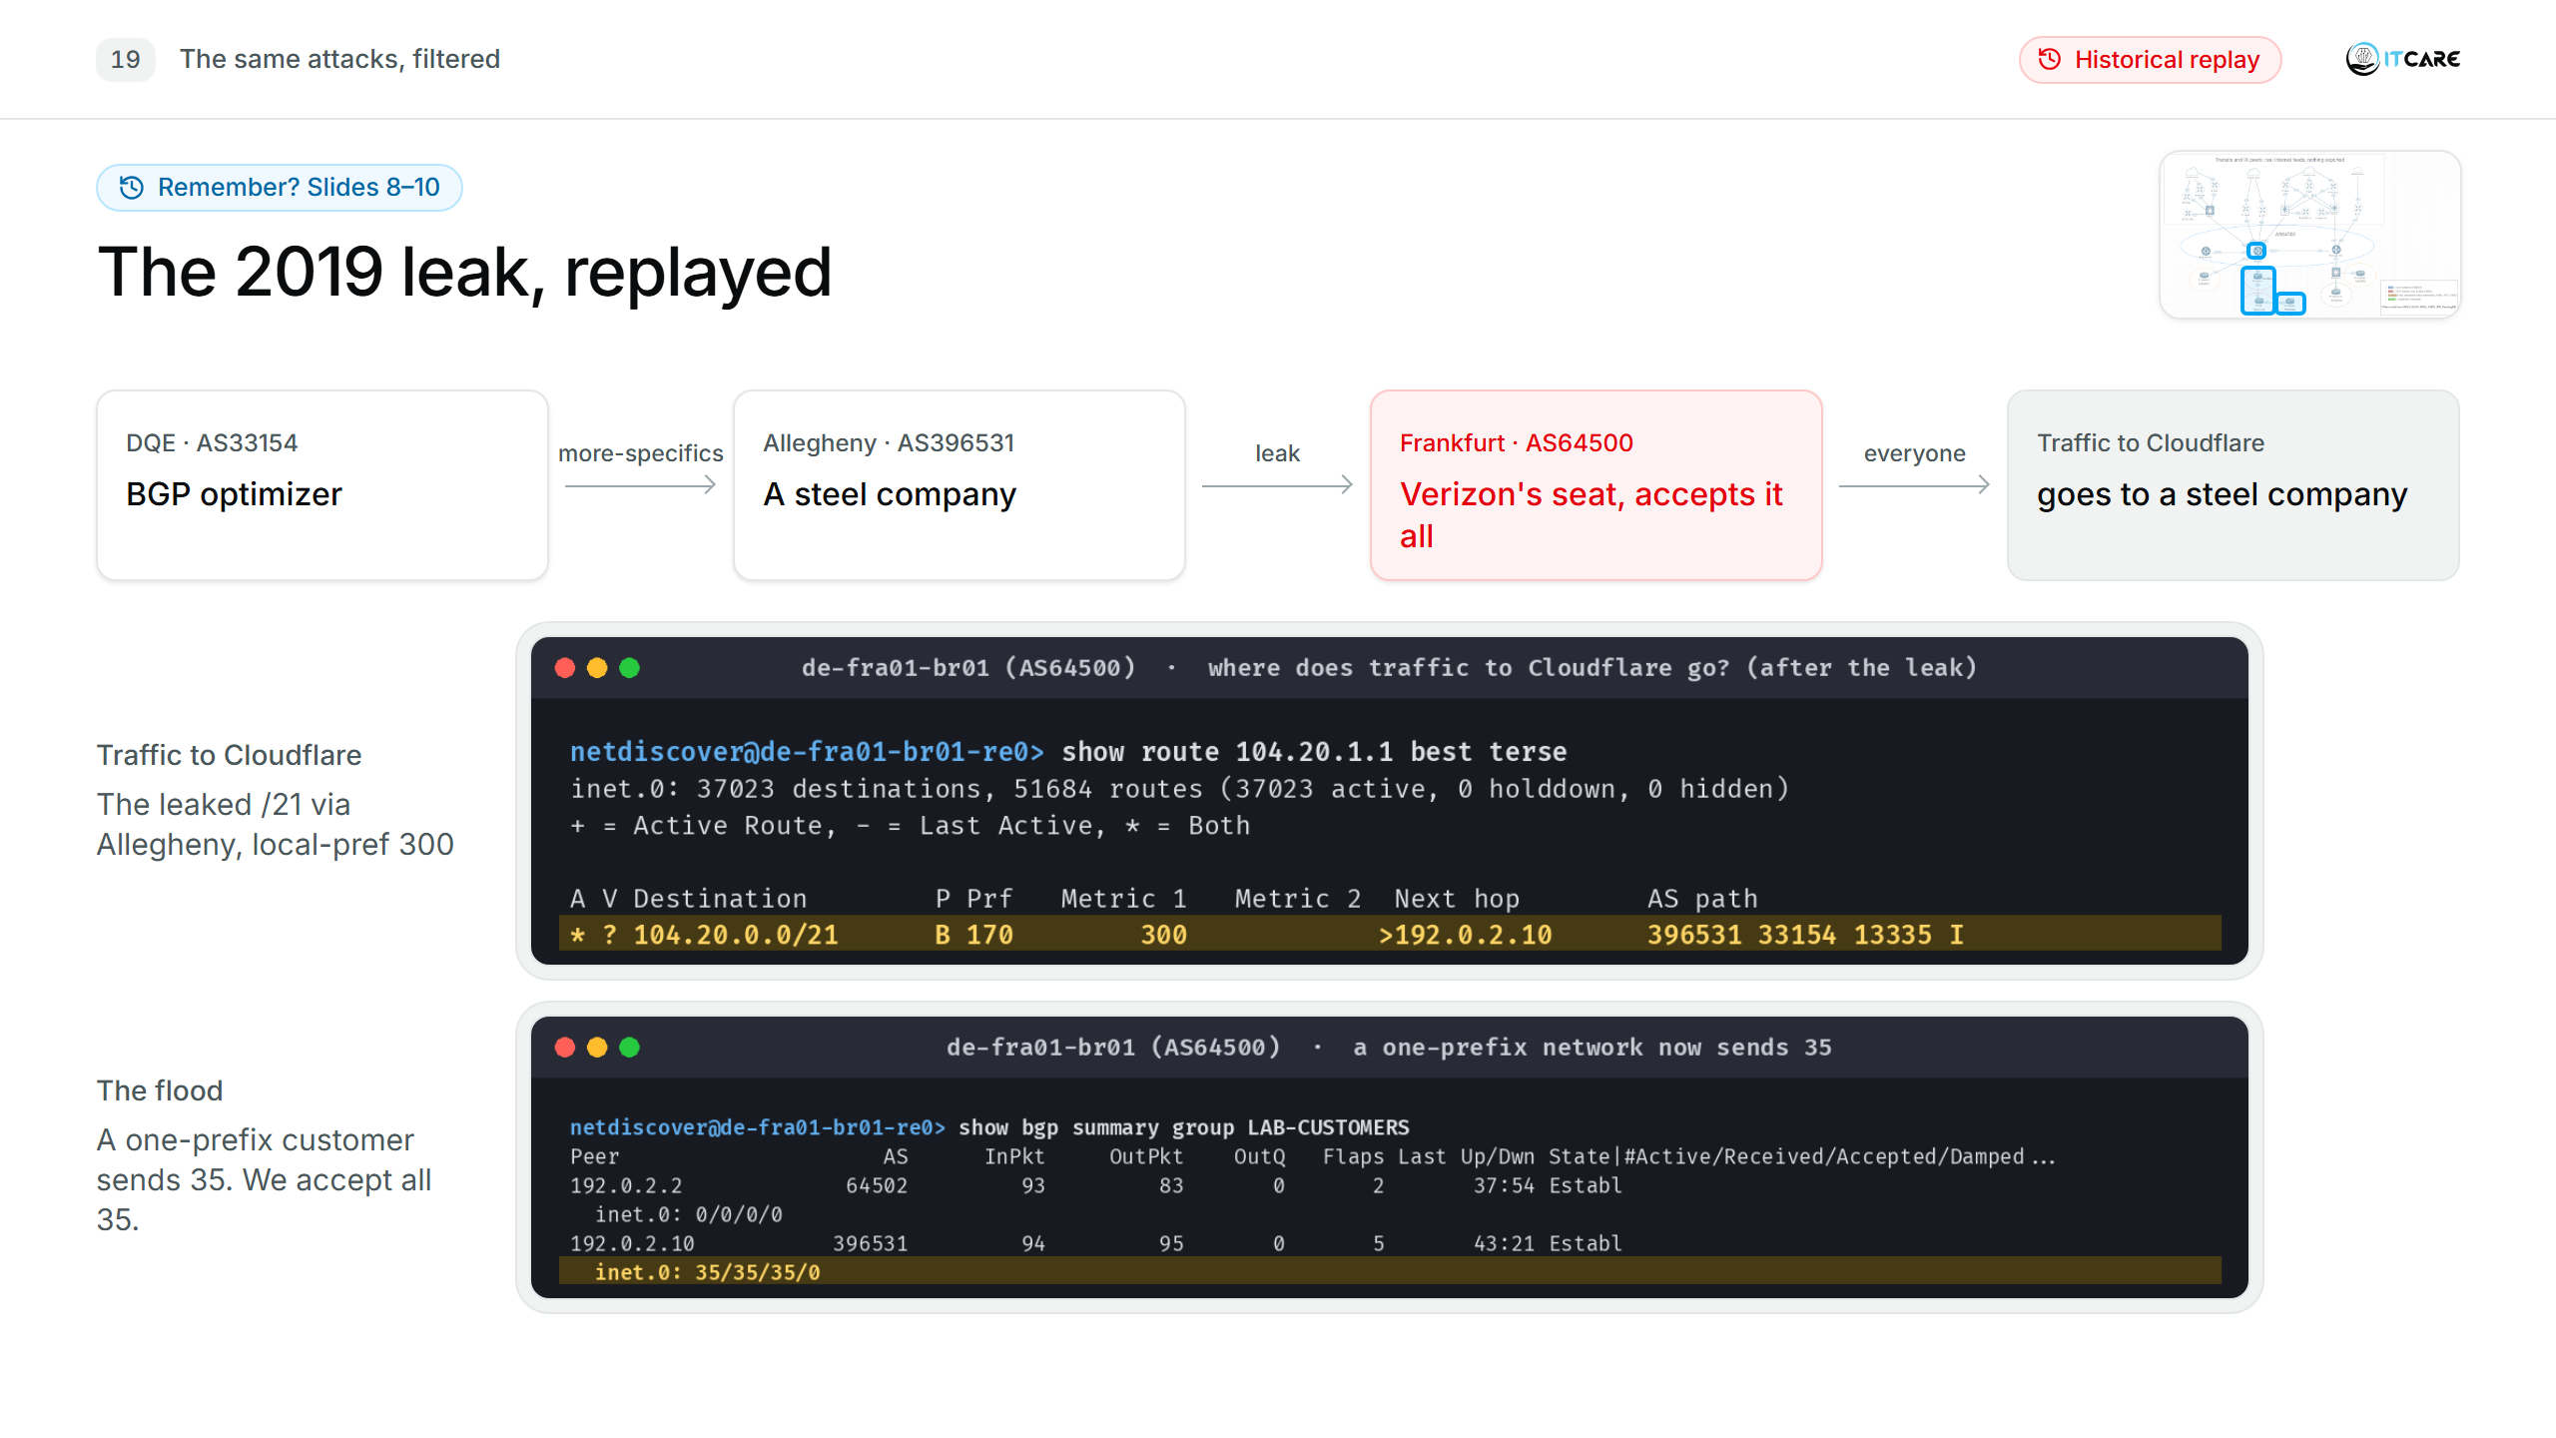
Notes:
(0:10) Remember this? DQE's more-specifics came in through Allegheny, we preferred them, and a customer with one registered prefix sent us 35. Same leak, now with the tools.

Slide 23
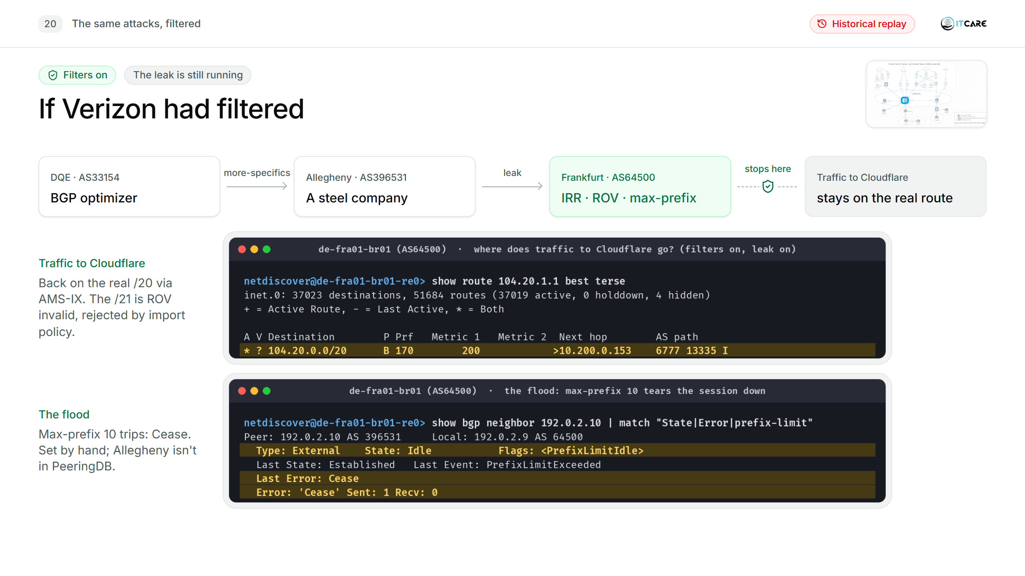
Notes:
(0:50) The leak is still running; DQE and Allegheny haven't changed anything. Frankfurt, in Verizon's seat, now has IRR, ROV and a prefix limit on the Allegheny session. Traffic to Cloudflare is back on the /20 via AMS-IX. The /21 is rejected twice over: ROV says invalid, and IRR says Allegheny owns one prefix. The flood trips max-prefix 10 and the session goes down. That limit was set by hand, because Allegheny, like most customers, isn't in PeeringDB. These are the three things Cloudflare named in 2019.
[If asked for the proof of the rejection: 4-03-why-rejected, "Validation State: invalid (Max-Length mismatch)", "Hidden reason: Rejected by import policy".]
[If asked about Allegheny's IRR in 2019: Allegheny originated exactly one prefix all of 2019, 192.92.159.0/24 (RIPEstat routing history). Its only route object today (RADB) is maintained by DQE (MAINT-AS33154) and dated 23 Oct 2019, four months after the leak; in June 2019 it may not have existed. Either way an IRR filter on the Allegheny session would have allowed at most that one /24, or nothing at all. Do not claim it had exactly one route object in 2019: the public data doesn't prove it.]

Slide 24
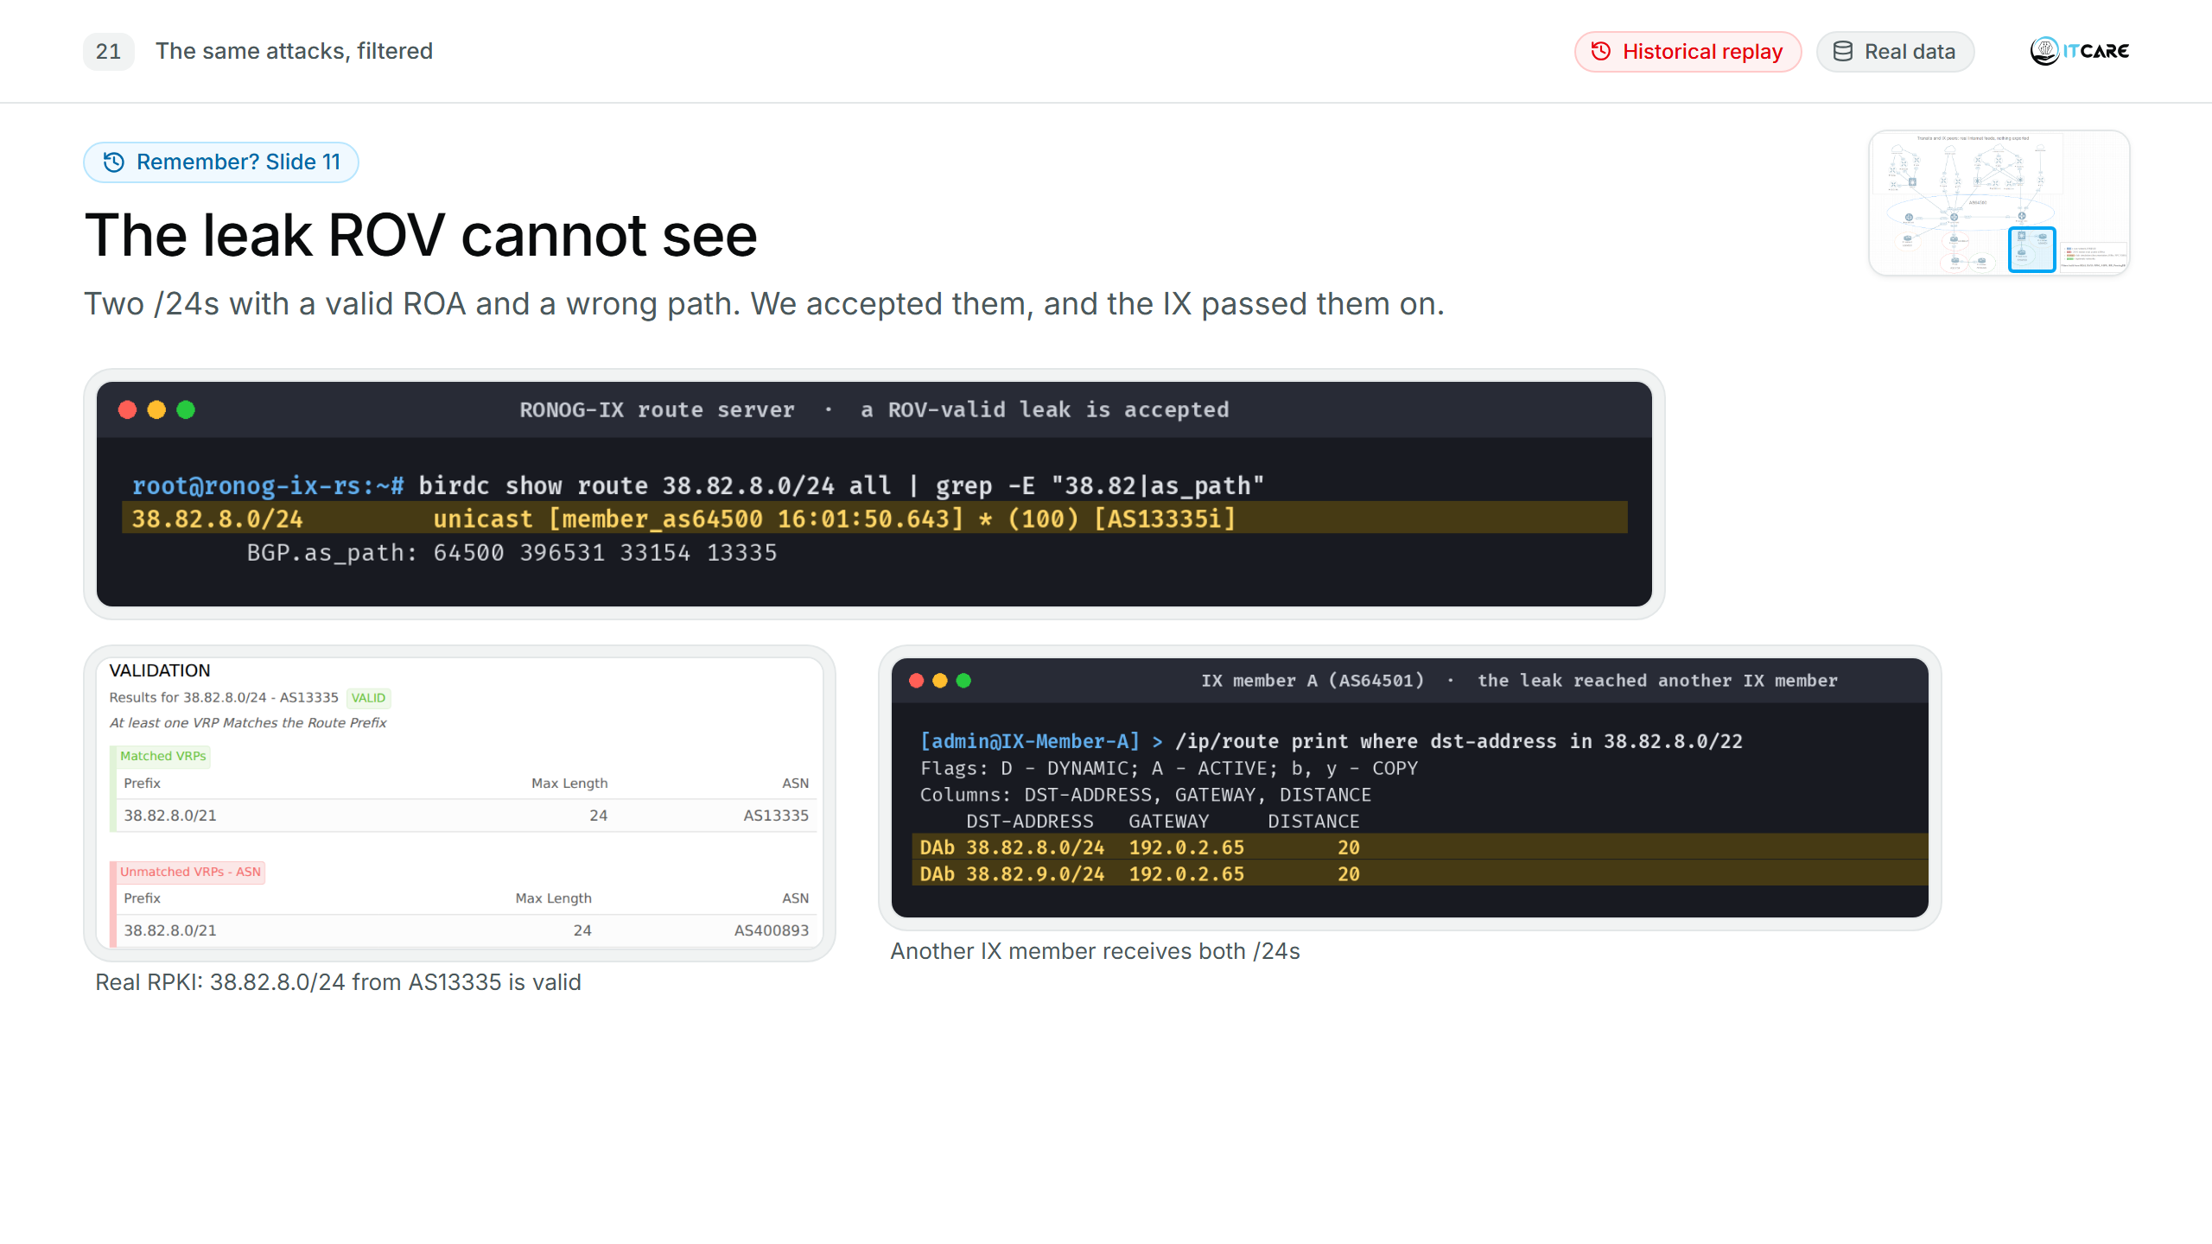
Notes:
(0:10) And the leak ROV cannot see: a valid ROA, a wrong path, passed by us and by the IX.

Slide 25
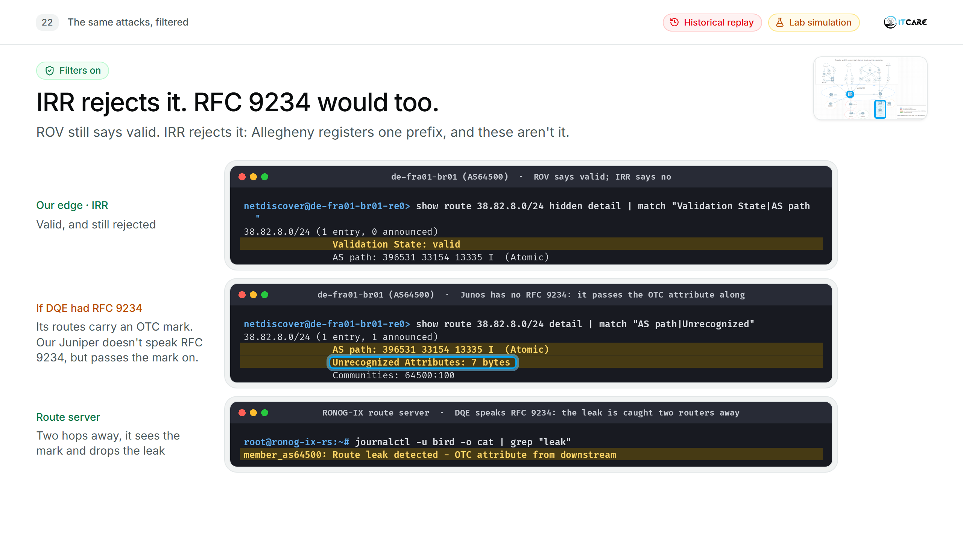
Notes:
(0:45) ROV still says valid. It doesn't matter: the IRR filter rejects it, because Allegheny registers one prefix and these aren't it. And a second layer, if the origin network helps: suppose DQE had RFC 9234 roles. It marks its routes "for customers only", the OTC attribute. Our Juniper doesn't speak RFC 9234: it shows the mark as "Unrecognized Attributes: 7 bytes", and passes it on anyway. The route server two hops away does understand it, sees a customer route coming back up, and drops the leak. RFC 9234 working even where it isn't deployed.
[Backup B5: Allegheny's own export filter fixes it at the source (4-08b).]

Slide 26
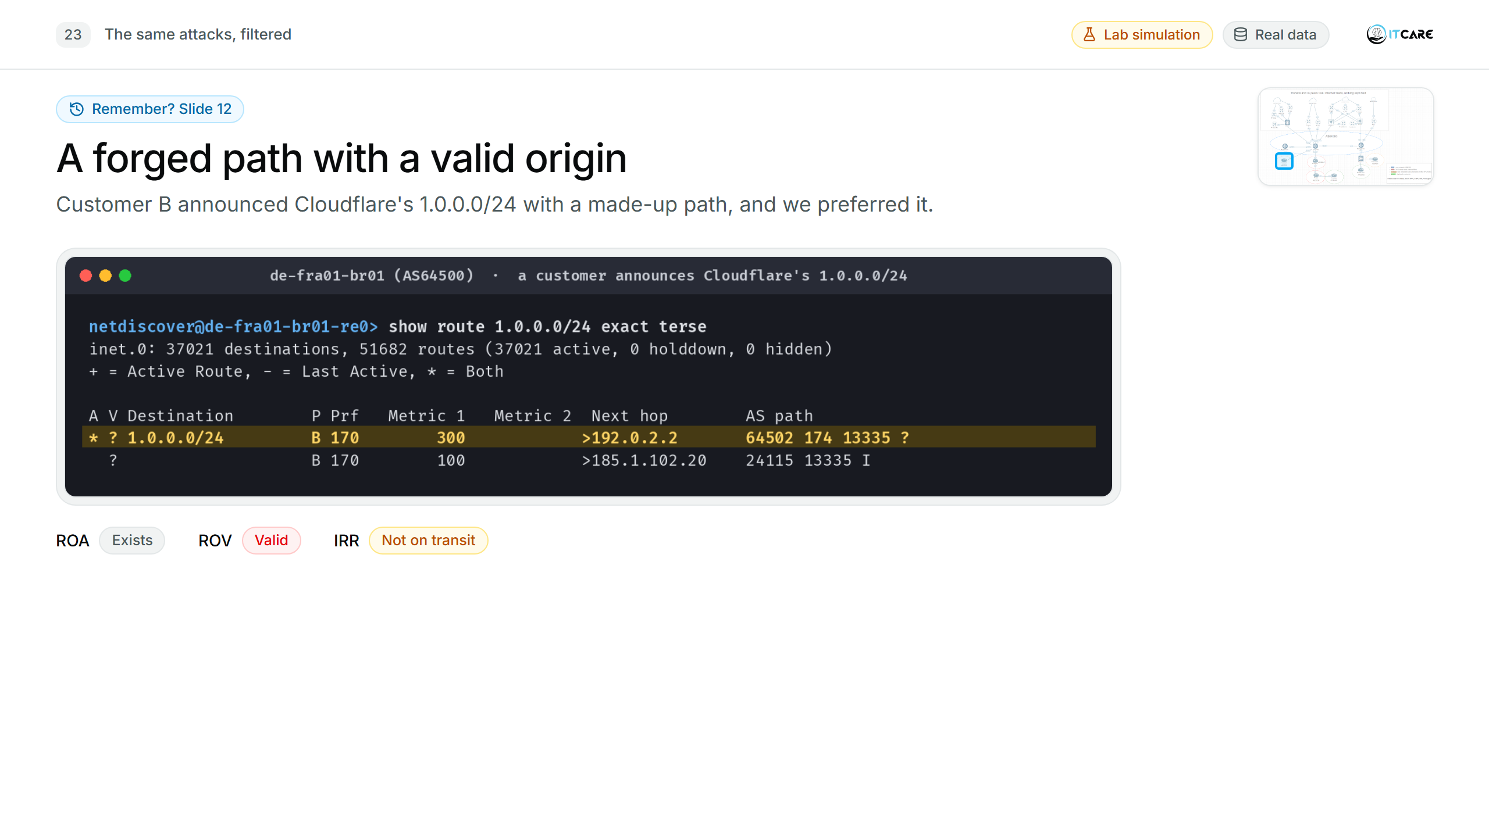
Notes:
(0:10) Remember the forged path? The ROA exists, ROV says valid, and we preferred it. I asked what checks the path.

Slide 27
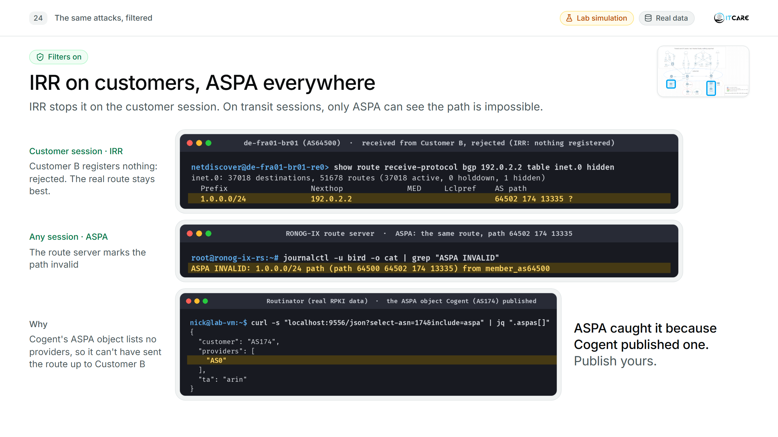
Notes:
(0:50) On a customer session, IRR does the job: Customer B registers nothing, so bgpq4 gives us deny-all, and the real route stays best. On a transit session, carrying the full table, there's no prefix list to build. That's where ASPA comes in: the route server checks the path, and Cogent's ASPA object says it has no providers, so it can't have passed the route up to Customer B. Invalid. ASPA only caught this because Cogent published an object. That's the argument for publishing yours; slide 18 showed where, in the RIPE dashboard.
[Where the check runs: here the ASPA verdict comes from the BIRD route server (ASPA INVALID in its log). The real route staying best on our edge: 4-09-customer-hijack-rejected.]

Slide 28
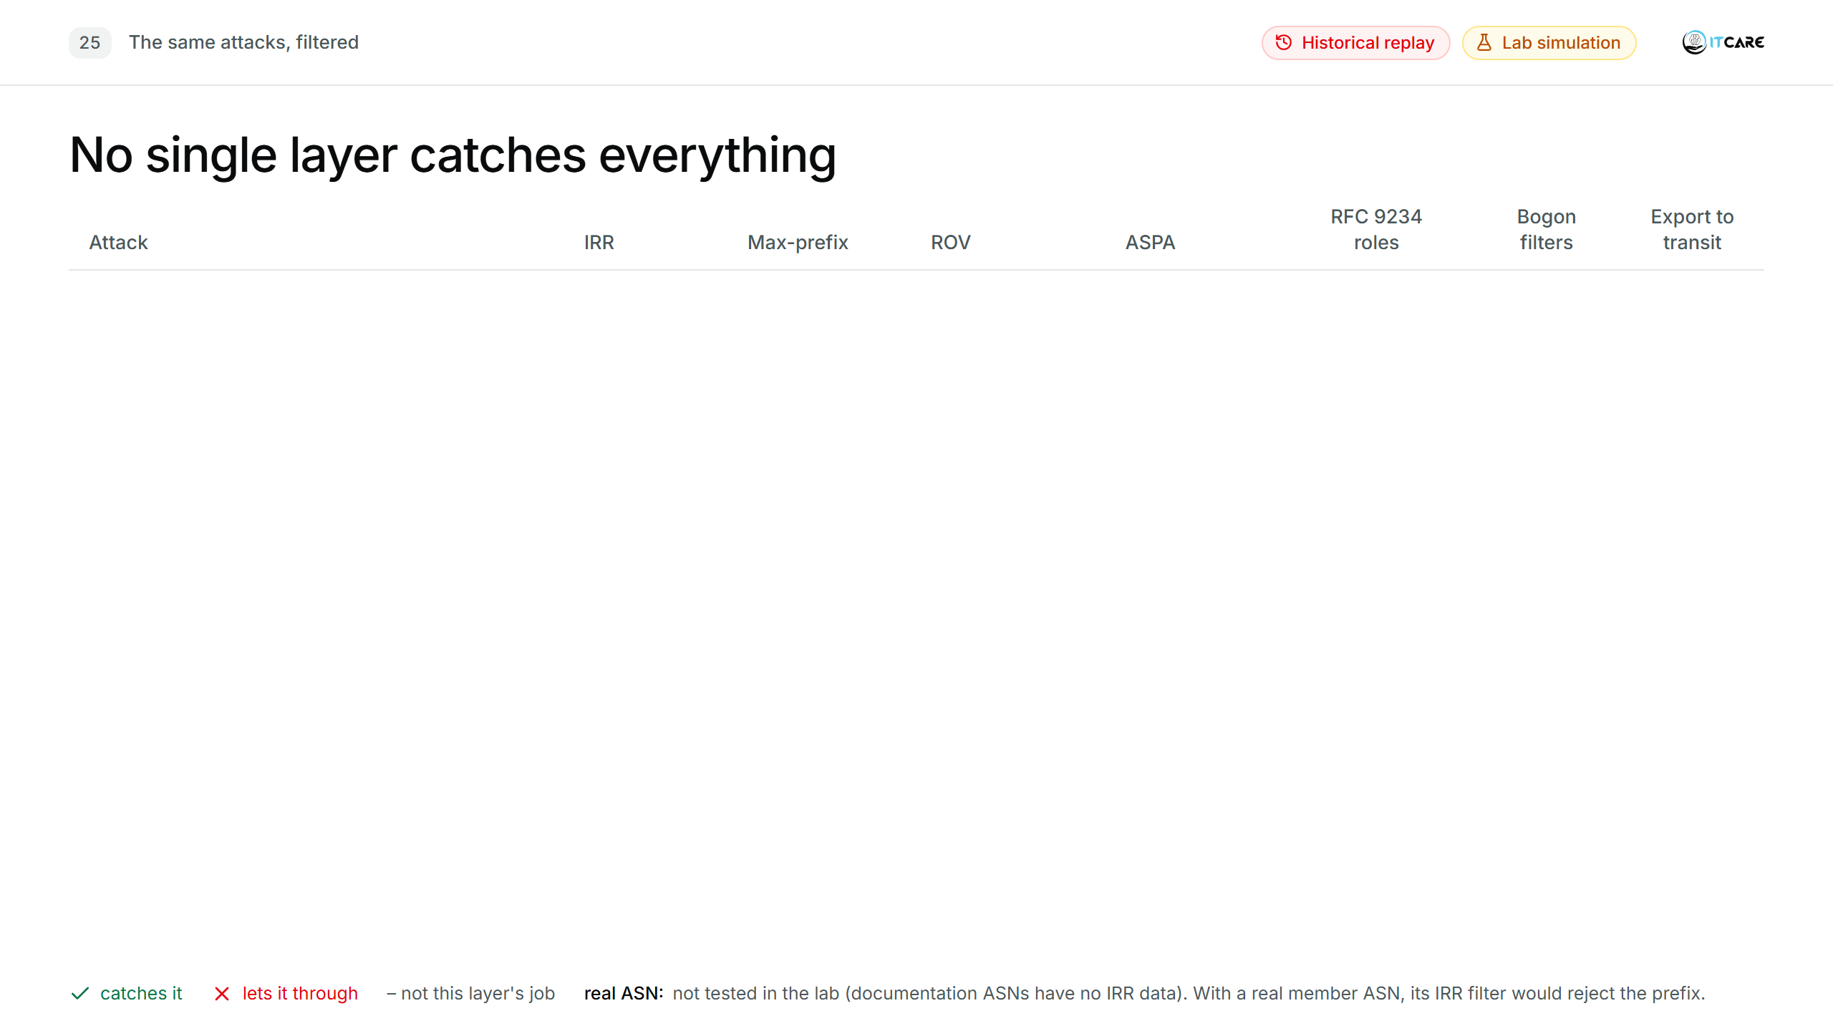
Notes:
(1:15) [One row per click, then the 2019 box.] Read the "ROV-valid leak" row: ROV says valid, because the origin and the prefix length are both right. Without IRR, ASPA or RFC 9234 roles, it goes through.
Why the 2019 /21s fail ROV even though the origin is Cloudflare: ROV checks the prefix length too. Cloudflare's ROA allows up to /20; the leaked /21s are longer, so they are invalid (lab: "Validation State: invalid, Reason: Max-Length mismatch", 4-03). Cloudflare said the same in 2019. Only the /24s inside 38.82.8.0/21, whose ROA allows /24, pass ROV.
[Click] 2019: had Verizon deployed them, IRR or a prefix limit on the Allegheny session would each have stopped the whole leak, and ROV the Cloudflare /21s. ASPA didn't exist yet (first draft June 2018), but with it one object from DQE would have been enough: DQE's providers don't include Allegheny, so a route going DQE → Allegheny → Verizon is a valley, invalid for every prefix, ROV-valid ones included.
[Cell by cell, if asked]
- 2019 rows, ASPA: needs DQE's object (lists DQE's providers). Cloudflare's object would also catch the Cloudflare prefixes (DQE is not Cloudflare's provider). DQE, Allegheny and Verizon have none today.
- Flood, ROV "32 of 35": the 32 /21s are invalid; Allegheny's own prefix is legitimate, and DQE's two own routes pass ROV (they are leaks ROV can't see).
- Forged path, IRR "unless IRR is forged": Customer B registers nothing, so deny-all. An attacker can register bogus IRR objects; Celer Bridge did.
- Private ASN (38.82.10.0/24, path 64502 64512 13335): ROV valid, the ROA 38.82.8.0/21 max /24 covers it. Caught by the bogon-ASN filter and by IRR. ASPA only if Cloudflare publishes an object (64512 is not its provider).
- IX member hijack (shown in backups B3 and B21): ROV catches it (origin 64501, ROA says 13335). ASPA does not check the origin. IRR "real ASN": with a real member ASN, the route server's per-member IRR filter, or your prefix list on a bilateral session, would drop 1.1.1.0/24; the lab member uses a documentation ASN with no IRR data.
- Bogons (10.0.0.0/8, 192.168.100.0/24): no ROA, so ROV says not-found. Caught by the bogon filter; IRR with a real ASN.
- Export to transit: an export policy that only sends our own and our customers' registered prefixes. It protects everyone else, not us. In the lab nothing was exported at all (B1).

Slide 29
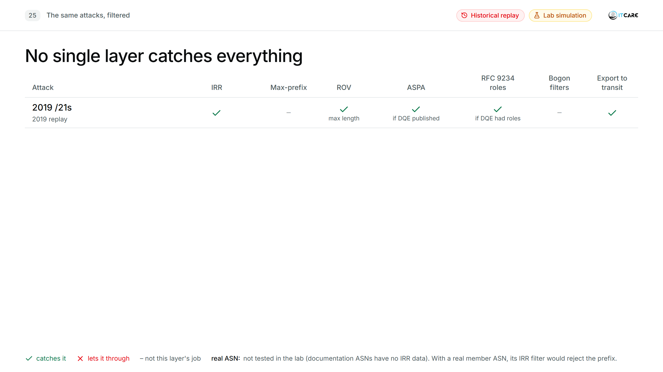
Notes:
(1:15) [One row per click, then the 2019 box.] Read the "ROV-valid leak" row: ROV says valid, because the origin and the prefix length are both right. Without IRR, ASPA or RFC 9234 roles, it goes through.
Why the 2019 /21s fail ROV even though the origin is Cloudflare: ROV checks the prefix length too. Cloudflare's ROA allows up to /20; the leaked /21s are longer, so they are invalid (lab: "Validation State: invalid, Reason: Max-Length mismatch", 4-03). Cloudflare said the same in 2019. Only the /24s inside 38.82.8.0/21, whose ROA allows /24, pass ROV.
[Click] 2019: had Verizon deployed them, IRR or a prefix limit on the Allegheny session would each have stopped the whole leak, and ROV the Cloudflare /21s. ASPA didn't exist yet (first draft June 2018), but with it one object from DQE would have been enough: DQE's providers don't include Allegheny, so a route going DQE → Allegheny → Verizon is a valley, invalid for every prefix, ROV-valid ones included.
[Cell by cell, if asked]
- 2019 rows, ASPA: needs DQE's object (lists DQE's providers). Cloudflare's object would also catch the Cloudflare prefixes (DQE is not Cloudflare's provider). DQE, Allegheny and Verizon have none today.
- Flood, ROV "32 of 35": the 32 /21s are invalid; Allegheny's own prefix is legitimate, and DQE's two own routes pass ROV (they are leaks ROV can't see).
- Forged path, IRR "unless IRR is forged": Customer B registers nothing, so deny-all. An attacker can register bogus IRR objects; Celer Bridge did.
- Private ASN (38.82.10.0/24, path 64502 64512 13335): ROV valid, the ROA 38.82.8.0/21 max /24 covers it. Caught by the bogon-ASN filter and by IRR. ASPA only if Cloudflare publishes an object (64512 is not its provider).
- IX member hijack (shown in backups B3 and B21): ROV catches it (origin 64501, ROA says 13335). ASPA does not check the origin. IRR "real ASN": with a real member ASN, the route server's per-member IRR filter, or your prefix list on a bilateral session, would drop 1.1.1.0/24; the lab member uses a documentation ASN with no IRR data.
- Bogons (10.0.0.0/8, 192.168.100.0/24): no ROA, so ROV says not-found. Caught by the bogon filter; IRR with a real ASN.
- Export to transit: an export policy that only sends our own and our customers' registered prefixes. It protects everyone else, not us. In the lab nothing was exported at all (B1).

Slide 30
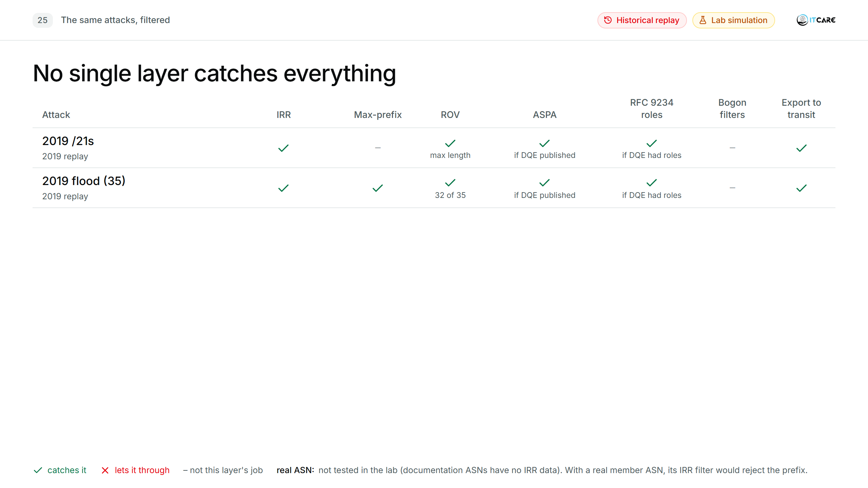
Notes:
(1:15) [One row per click, then the 2019 box.] Read the "ROV-valid leak" row: ROV says valid, because the origin and the prefix length are both right. Without IRR, ASPA or RFC 9234 roles, it goes through.
Why the 2019 /21s fail ROV even though the origin is Cloudflare: ROV checks the prefix length too. Cloudflare's ROA allows up to /20; the leaked /21s are longer, so they are invalid (lab: "Validation State: invalid, Reason: Max-Length mismatch", 4-03). Cloudflare said the same in 2019. Only the /24s inside 38.82.8.0/21, whose ROA allows /24, pass ROV.
[Click] 2019: had Verizon deployed them, IRR or a prefix limit on the Allegheny session would each have stopped the whole leak, and ROV the Cloudflare /21s. ASPA didn't exist yet (first draft June 2018), but with it one object from DQE would have been enough: DQE's providers don't include Allegheny, so a route going DQE → Allegheny → Verizon is a valley, invalid for every prefix, ROV-valid ones included.
[Cell by cell, if asked]
- 2019 rows, ASPA: needs DQE's object (lists DQE's providers). Cloudflare's object would also catch the Cloudflare prefixes (DQE is not Cloudflare's provider). DQE, Allegheny and Verizon have none today.
- Flood, ROV "32 of 35": the 32 /21s are invalid; Allegheny's own prefix is legitimate, and DQE's two own routes pass ROV (they are leaks ROV can't see).
- Forged path, IRR "unless IRR is forged": Customer B registers nothing, so deny-all. An attacker can register bogus IRR objects; Celer Bridge did.
- Private ASN (38.82.10.0/24, path 64502 64512 13335): ROV valid, the ROA 38.82.8.0/21 max /24 covers it. Caught by the bogon-ASN filter and by IRR. ASPA only if Cloudflare publishes an object (64512 is not its provider).
- IX member hijack (shown in backups B3 and B21): ROV catches it (origin 64501, ROA says 13335). ASPA does not check the origin. IRR "real ASN": with a real member ASN, the route server's per-member IRR filter, or your prefix list on a bilateral session, would drop 1.1.1.0/24; the lab member uses a documentation ASN with no IRR data.
- Bogons (10.0.0.0/8, 192.168.100.0/24): no ROA, so ROV says not-found. Caught by the bogon filter; IRR with a real ASN.
- Export to transit: an export policy that only sends our own and our customers' registered prefixes. It protects everyone else, not us. In the lab nothing was exported at all (B1).

Slide 31
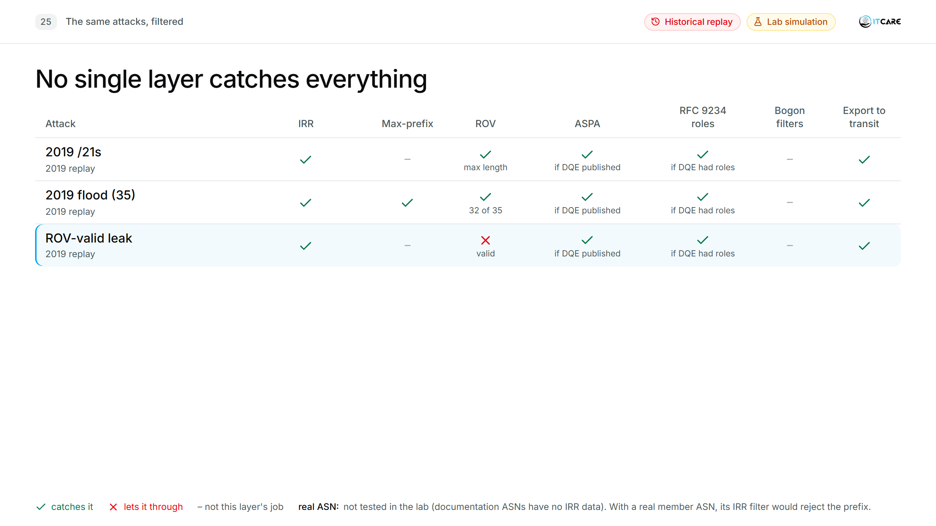
Notes:
(1:15) [One row per click, then the 2019 box.] Read the "ROV-valid leak" row: ROV says valid, because the origin and the prefix length are both right. Without IRR, ASPA or RFC 9234 roles, it goes through.
Why the 2019 /21s fail ROV even though the origin is Cloudflare: ROV checks the prefix length too. Cloudflare's ROA allows up to /20; the leaked /21s are longer, so they are invalid (lab: "Validation State: invalid, Reason: Max-Length mismatch", 4-03). Cloudflare said the same in 2019. Only the /24s inside 38.82.8.0/21, whose ROA allows /24, pass ROV.
[Click] 2019: had Verizon deployed them, IRR or a prefix limit on the Allegheny session would each have stopped the whole leak, and ROV the Cloudflare /21s. ASPA didn't exist yet (first draft June 2018), but with it one object from DQE would have been enough: DQE's providers don't include Allegheny, so a route going DQE → Allegheny → Verizon is a valley, invalid for every prefix, ROV-valid ones included.
[Cell by cell, if asked]
- 2019 rows, ASPA: needs DQE's object (lists DQE's providers). Cloudflare's object would also catch the Cloudflare prefixes (DQE is not Cloudflare's provider). DQE, Allegheny and Verizon have none today.
- Flood, ROV "32 of 35": the 32 /21s are invalid; Allegheny's own prefix is legitimate, and DQE's two own routes pass ROV (they are leaks ROV can't see).
- Forged path, IRR "unless IRR is forged": Customer B registers nothing, so deny-all. An attacker can register bogus IRR objects; Celer Bridge did.
- Private ASN (38.82.10.0/24, path 64502 64512 13335): ROV valid, the ROA 38.82.8.0/21 max /24 covers it. Caught by the bogon-ASN filter and by IRR. ASPA only if Cloudflare publishes an object (64512 is not its provider).
- IX member hijack (shown in backups B3 and B21): ROV catches it (origin 64501, ROA says 13335). ASPA does not check the origin. IRR "real ASN": with a real member ASN, the route server's per-member IRR filter, or your prefix list on a bilateral session, would drop 1.1.1.0/24; the lab member uses a documentation ASN with no IRR data.
- Bogons (10.0.0.0/8, 192.168.100.0/24): no ROA, so ROV says not-found. Caught by the bogon filter; IRR with a real ASN.
- Export to transit: an export policy that only sends our own and our customers' registered prefixes. It protects everyone else, not us. In the lab nothing was exported at all (B1).

Slide 32
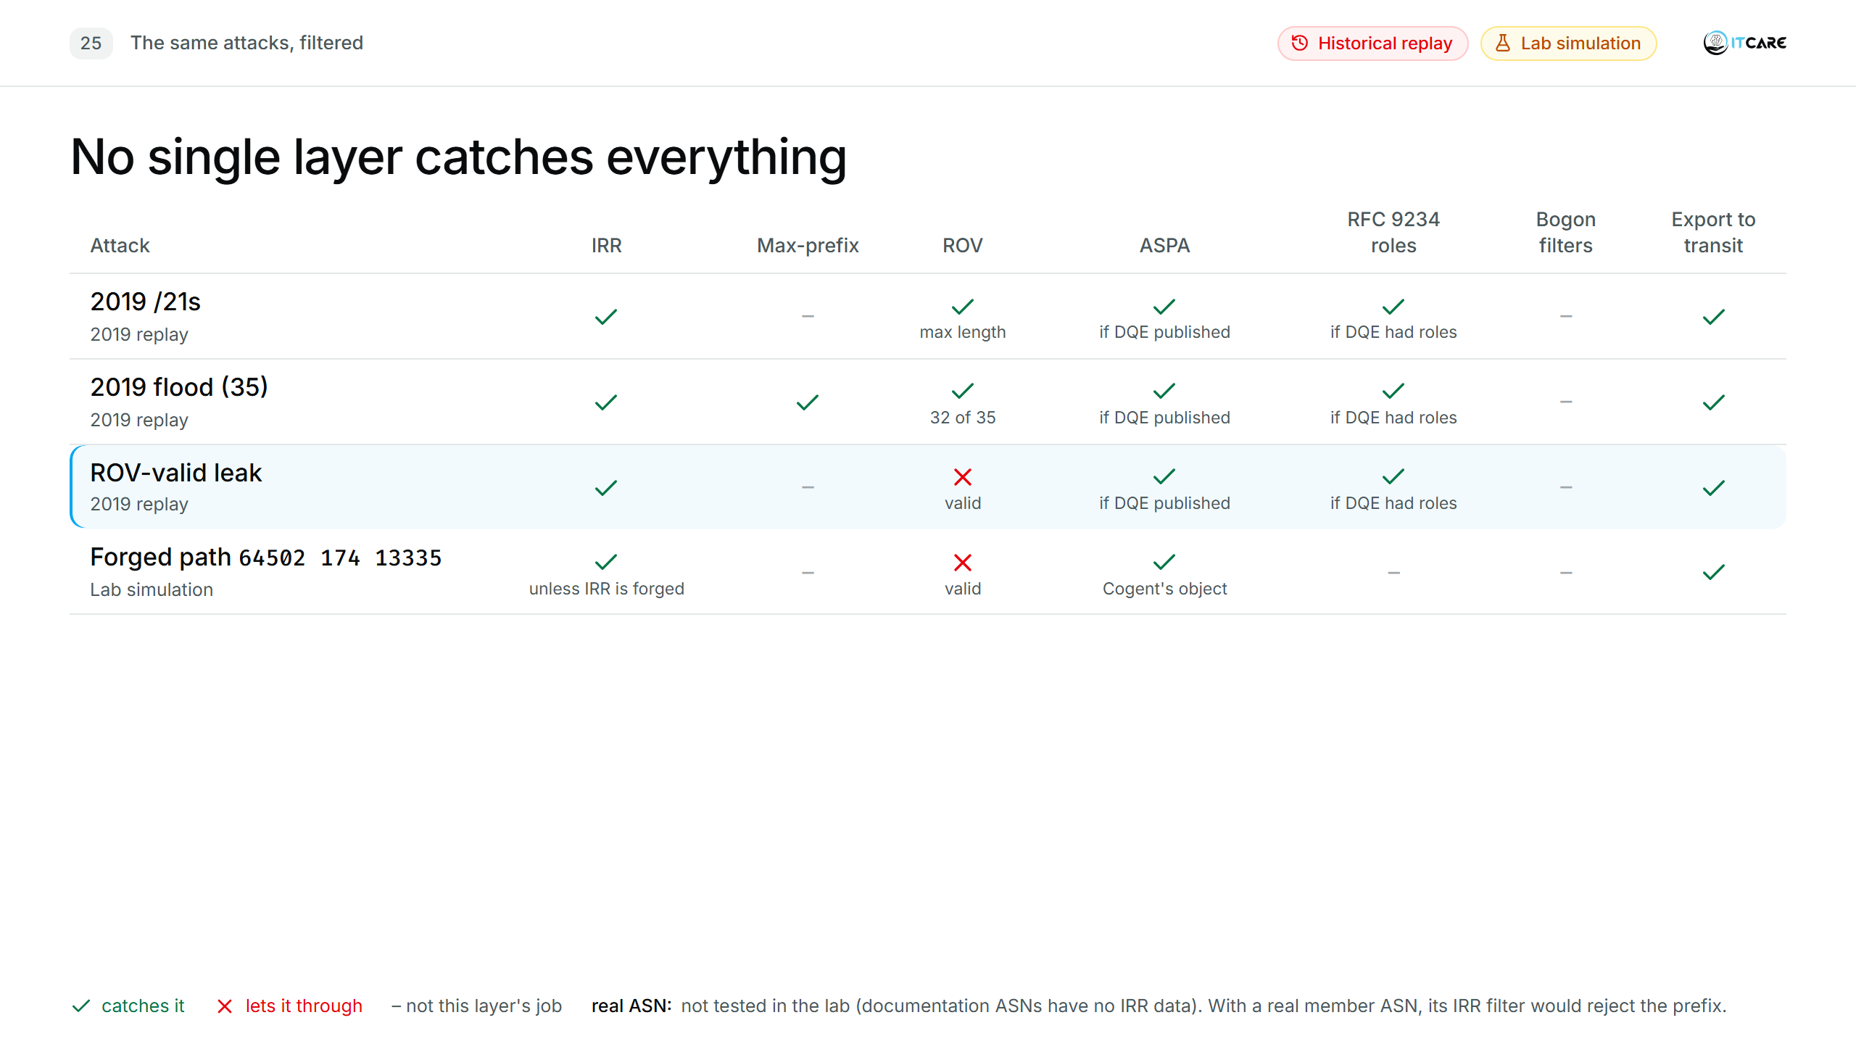
Notes:
(1:15) [One row per click, then the 2019 box.] Read the "ROV-valid leak" row: ROV says valid, because the origin and the prefix length are both right. Without IRR, ASPA or RFC 9234 roles, it goes through.
Why the 2019 /21s fail ROV even though the origin is Cloudflare: ROV checks the prefix length too. Cloudflare's ROA allows up to /20; the leaked /21s are longer, so they are invalid (lab: "Validation State: invalid, Reason: Max-Length mismatch", 4-03). Cloudflare said the same in 2019. Only the /24s inside 38.82.8.0/21, whose ROA allows /24, pass ROV.
[Click] 2019: had Verizon deployed them, IRR or a prefix limit on the Allegheny session would each have stopped the whole leak, and ROV the Cloudflare /21s. ASPA didn't exist yet (first draft June 2018), but with it one object from DQE would have been enough: DQE's providers don't include Allegheny, so a route going DQE → Allegheny → Verizon is a valley, invalid for every prefix, ROV-valid ones included.
[Cell by cell, if asked]
- 2019 rows, ASPA: needs DQE's object (lists DQE's providers). Cloudflare's object would also catch the Cloudflare prefixes (DQE is not Cloudflare's provider). DQE, Allegheny and Verizon have none today.
- Flood, ROV "32 of 35": the 32 /21s are invalid; Allegheny's own prefix is legitimate, and DQE's two own routes pass ROV (they are leaks ROV can't see).
- Forged path, IRR "unless IRR is forged": Customer B registers nothing, so deny-all. An attacker can register bogus IRR objects; Celer Bridge did.
- Private ASN (38.82.10.0/24, path 64502 64512 13335): ROV valid, the ROA 38.82.8.0/21 max /24 covers it. Caught by the bogon-ASN filter and by IRR. ASPA only if Cloudflare publishes an object (64512 is not its provider).
- IX member hijack (shown in backups B3 and B21): ROV catches it (origin 64501, ROA says 13335). ASPA does not check the origin. IRR "real ASN": with a real member ASN, the route server's per-member IRR filter, or your prefix list on a bilateral session, would drop 1.1.1.0/24; the lab member uses a documentation ASN with no IRR data.
- Bogons (10.0.0.0/8, 192.168.100.0/24): no ROA, so ROV says not-found. Caught by the bogon filter; IRR with a real ASN.
- Export to transit: an export policy that only sends our own and our customers' registered prefixes. It protects everyone else, not us. In the lab nothing was exported at all (B1).

Slide 33
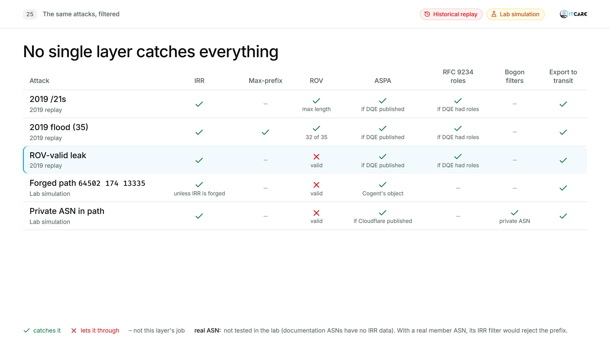
Notes:
(1:15) [One row per click, then the 2019 box.] Read the "ROV-valid leak" row: ROV says valid, because the origin and the prefix length are both right. Without IRR, ASPA or RFC 9234 roles, it goes through.
Why the 2019 /21s fail ROV even though the origin is Cloudflare: ROV checks the prefix length too. Cloudflare's ROA allows up to /20; the leaked /21s are longer, so they are invalid (lab: "Validation State: invalid, Reason: Max-Length mismatch", 4-03). Cloudflare said the same in 2019. Only the /24s inside 38.82.8.0/21, whose ROA allows /24, pass ROV.
[Click] 2019: had Verizon deployed them, IRR or a prefix limit on the Allegheny session would each have stopped the whole leak, and ROV the Cloudflare /21s. ASPA didn't exist yet (first draft June 2018), but with it one object from DQE would have been enough: DQE's providers don't include Allegheny, so a route going DQE → Allegheny → Verizon is a valley, invalid for every prefix, ROV-valid ones included.
[Cell by cell, if asked]
- 2019 rows, ASPA: needs DQE's object (lists DQE's providers). Cloudflare's object would also catch the Cloudflare prefixes (DQE is not Cloudflare's provider). DQE, Allegheny and Verizon have none today.
- Flood, ROV "32 of 35": the 32 /21s are invalid; Allegheny's own prefix is legitimate, and DQE's two own routes pass ROV (they are leaks ROV can't see).
- Forged path, IRR "unless IRR is forged": Customer B registers nothing, so deny-all. An attacker can register bogus IRR objects; Celer Bridge did.
- Private ASN (38.82.10.0/24, path 64502 64512 13335): ROV valid, the ROA 38.82.8.0/21 max /24 covers it. Caught by the bogon-ASN filter and by IRR. ASPA only if Cloudflare publishes an object (64512 is not its provider).
- IX member hijack (shown in backups B3 and B21): ROV catches it (origin 64501, ROA says 13335). ASPA does not check the origin. IRR "real ASN": with a real member ASN, the route server's per-member IRR filter, or your prefix list on a bilateral session, would drop 1.1.1.0/24; the lab member uses a documentation ASN with no IRR data.
- Bogons (10.0.0.0/8, 192.168.100.0/24): no ROA, so ROV says not-found. Caught by the bogon filter; IRR with a real ASN.
- Export to transit: an export policy that only sends our own and our customers' registered prefixes. It protects everyone else, not us. In the lab nothing was exported at all (B1).

Slide 34
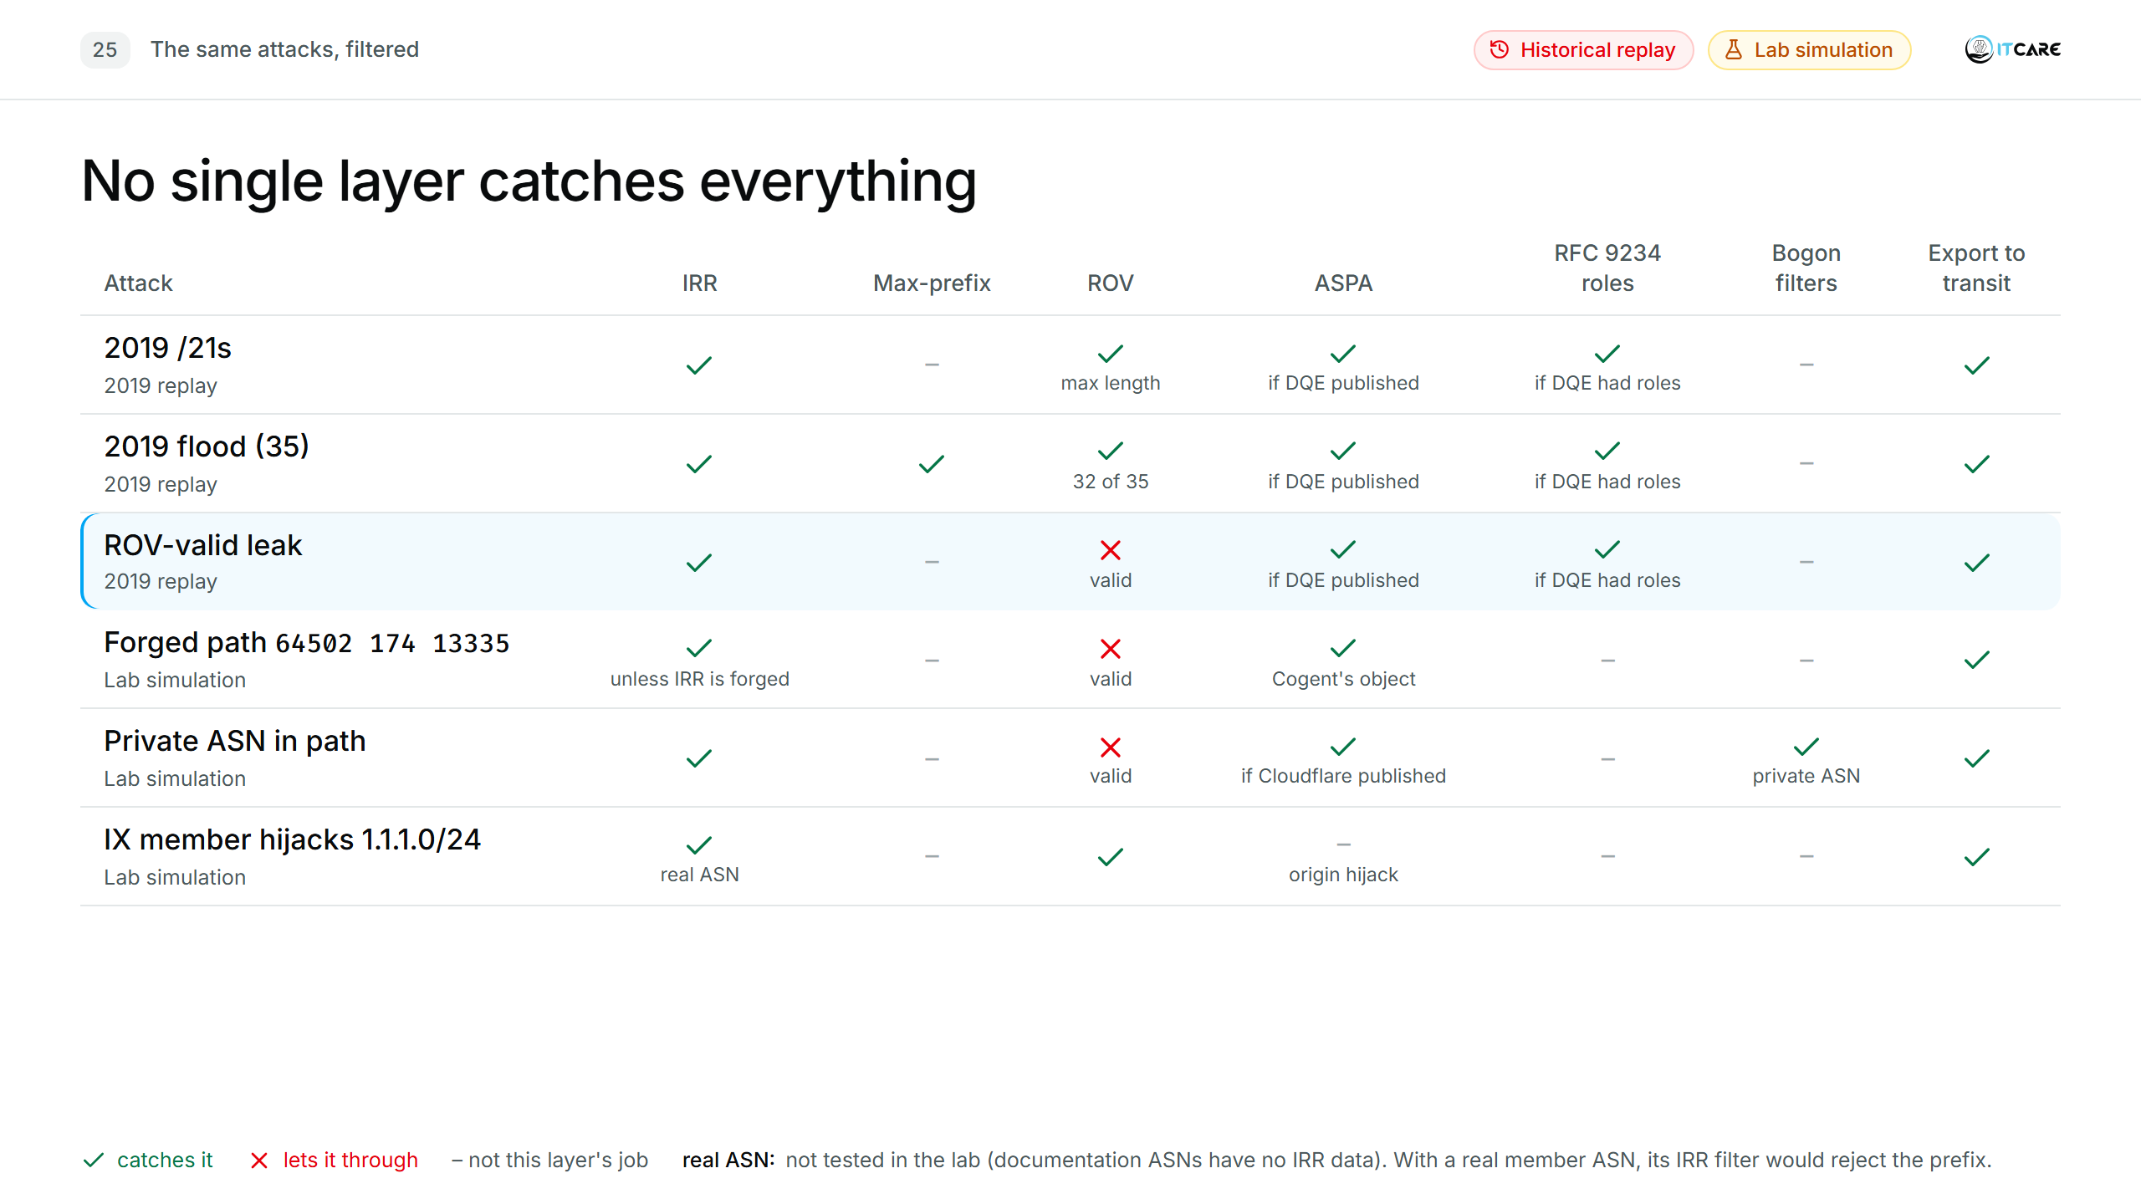
Notes:
(1:15) [One row per click, then the 2019 box.] Read the "ROV-valid leak" row: ROV says valid, because the origin and the prefix length are both right. Without IRR, ASPA or RFC 9234 roles, it goes through.
Why the 2019 /21s fail ROV even though the origin is Cloudflare: ROV checks the prefix length too. Cloudflare's ROA allows up to /20; the leaked /21s are longer, so they are invalid (lab: "Validation State: invalid, Reason: Max-Length mismatch", 4-03). Cloudflare said the same in 2019. Only the /24s inside 38.82.8.0/21, whose ROA allows /24, pass ROV.
[Click] 2019: had Verizon deployed them, IRR or a prefix limit on the Allegheny session would each have stopped the whole leak, and ROV the Cloudflare /21s. ASPA didn't exist yet (first draft June 2018), but with it one object from DQE would have been enough: DQE's providers don't include Allegheny, so a route going DQE → Allegheny → Verizon is a valley, invalid for every prefix, ROV-valid ones included.
[Cell by cell, if asked]
- 2019 rows, ASPA: needs DQE's object (lists DQE's providers). Cloudflare's object would also catch the Cloudflare prefixes (DQE is not Cloudflare's provider). DQE, Allegheny and Verizon have none today.
- Flood, ROV "32 of 35": the 32 /21s are invalid; Allegheny's own prefix is legitimate, and DQE's two own routes pass ROV (they are leaks ROV can't see).
- Forged path, IRR "unless IRR is forged": Customer B registers nothing, so deny-all. An attacker can register bogus IRR objects; Celer Bridge did.
- Private ASN (38.82.10.0/24, path 64502 64512 13335): ROV valid, the ROA 38.82.8.0/21 max /24 covers it. Caught by the bogon-ASN filter and by IRR. ASPA only if Cloudflare publishes an object (64512 is not its provider).
- IX member hijack (shown in backups B3 and B21): ROV catches it (origin 64501, ROA says 13335). ASPA does not check the origin. IRR "real ASN": with a real member ASN, the route server's per-member IRR filter, or your prefix list on a bilateral session, would drop 1.1.1.0/24; the lab member uses a documentation ASN with no IRR data.
- Bogons (10.0.0.0/8, 192.168.100.0/24): no ROA, so ROV says not-found. Caught by the bogon filter; IRR with a real ASN.
- Export to transit: an export policy that only sends our own and our customers' registered prefixes. It protects everyone else, not us. In the lab nothing was exported at all (B1).

Slide 35
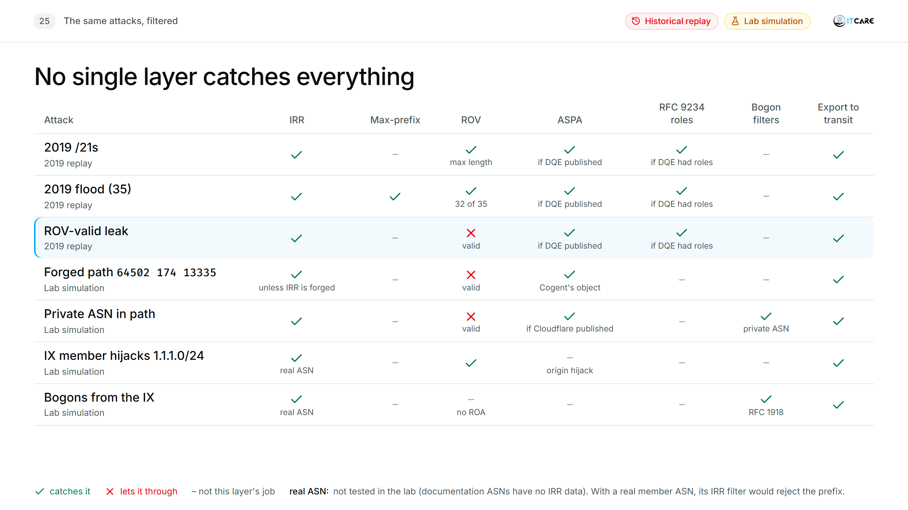
Notes:
(1:15) [One row per click, then the 2019 box.] Read the "ROV-valid leak" row: ROV says valid, because the origin and the prefix length are both right. Without IRR, ASPA or RFC 9234 roles, it goes through.
Why the 2019 /21s fail ROV even though the origin is Cloudflare: ROV checks the prefix length too. Cloudflare's ROA allows up to /20; the leaked /21s are longer, so they are invalid (lab: "Validation State: invalid, Reason: Max-Length mismatch", 4-03). Cloudflare said the same in 2019. Only the /24s inside 38.82.8.0/21, whose ROA allows /24, pass ROV.
[Click] 2019: had Verizon deployed them, IRR or a prefix limit on the Allegheny session would each have stopped the whole leak, and ROV the Cloudflare /21s. ASPA didn't exist yet (first draft June 2018), but with it one object from DQE would have been enough: DQE's providers don't include Allegheny, so a route going DQE → Allegheny → Verizon is a valley, invalid for every prefix, ROV-valid ones included.
[Cell by cell, if asked]
- 2019 rows, ASPA: needs DQE's object (lists DQE's providers). Cloudflare's object would also catch the Cloudflare prefixes (DQE is not Cloudflare's provider). DQE, Allegheny and Verizon have none today.
- Flood, ROV "32 of 35": the 32 /21s are invalid; Allegheny's own prefix is legitimate, and DQE's two own routes pass ROV (they are leaks ROV can't see).
- Forged path, IRR "unless IRR is forged": Customer B registers nothing, so deny-all. An attacker can register bogus IRR objects; Celer Bridge did.
- Private ASN (38.82.10.0/24, path 64502 64512 13335): ROV valid, the ROA 38.82.8.0/21 max /24 covers it. Caught by the bogon-ASN filter and by IRR. ASPA only if Cloudflare publishes an object (64512 is not its provider).
- IX member hijack (shown in backups B3 and B21): ROV catches it (origin 64501, ROA says 13335). ASPA does not check the origin. IRR "real ASN": with a real member ASN, the route server's per-member IRR filter, or your prefix list on a bilateral session, would drop 1.1.1.0/24; the lab member uses a documentation ASN with no IRR data.
- Bogons (10.0.0.0/8, 192.168.100.0/24): no ROA, so ROV says not-found. Caught by the bogon filter; IRR with a real ASN.
- Export to transit: an export policy that only sends our own and our customers' registered prefixes. It protects everyone else, not us. In the lab nothing was exported at all (B1).

Slide 36
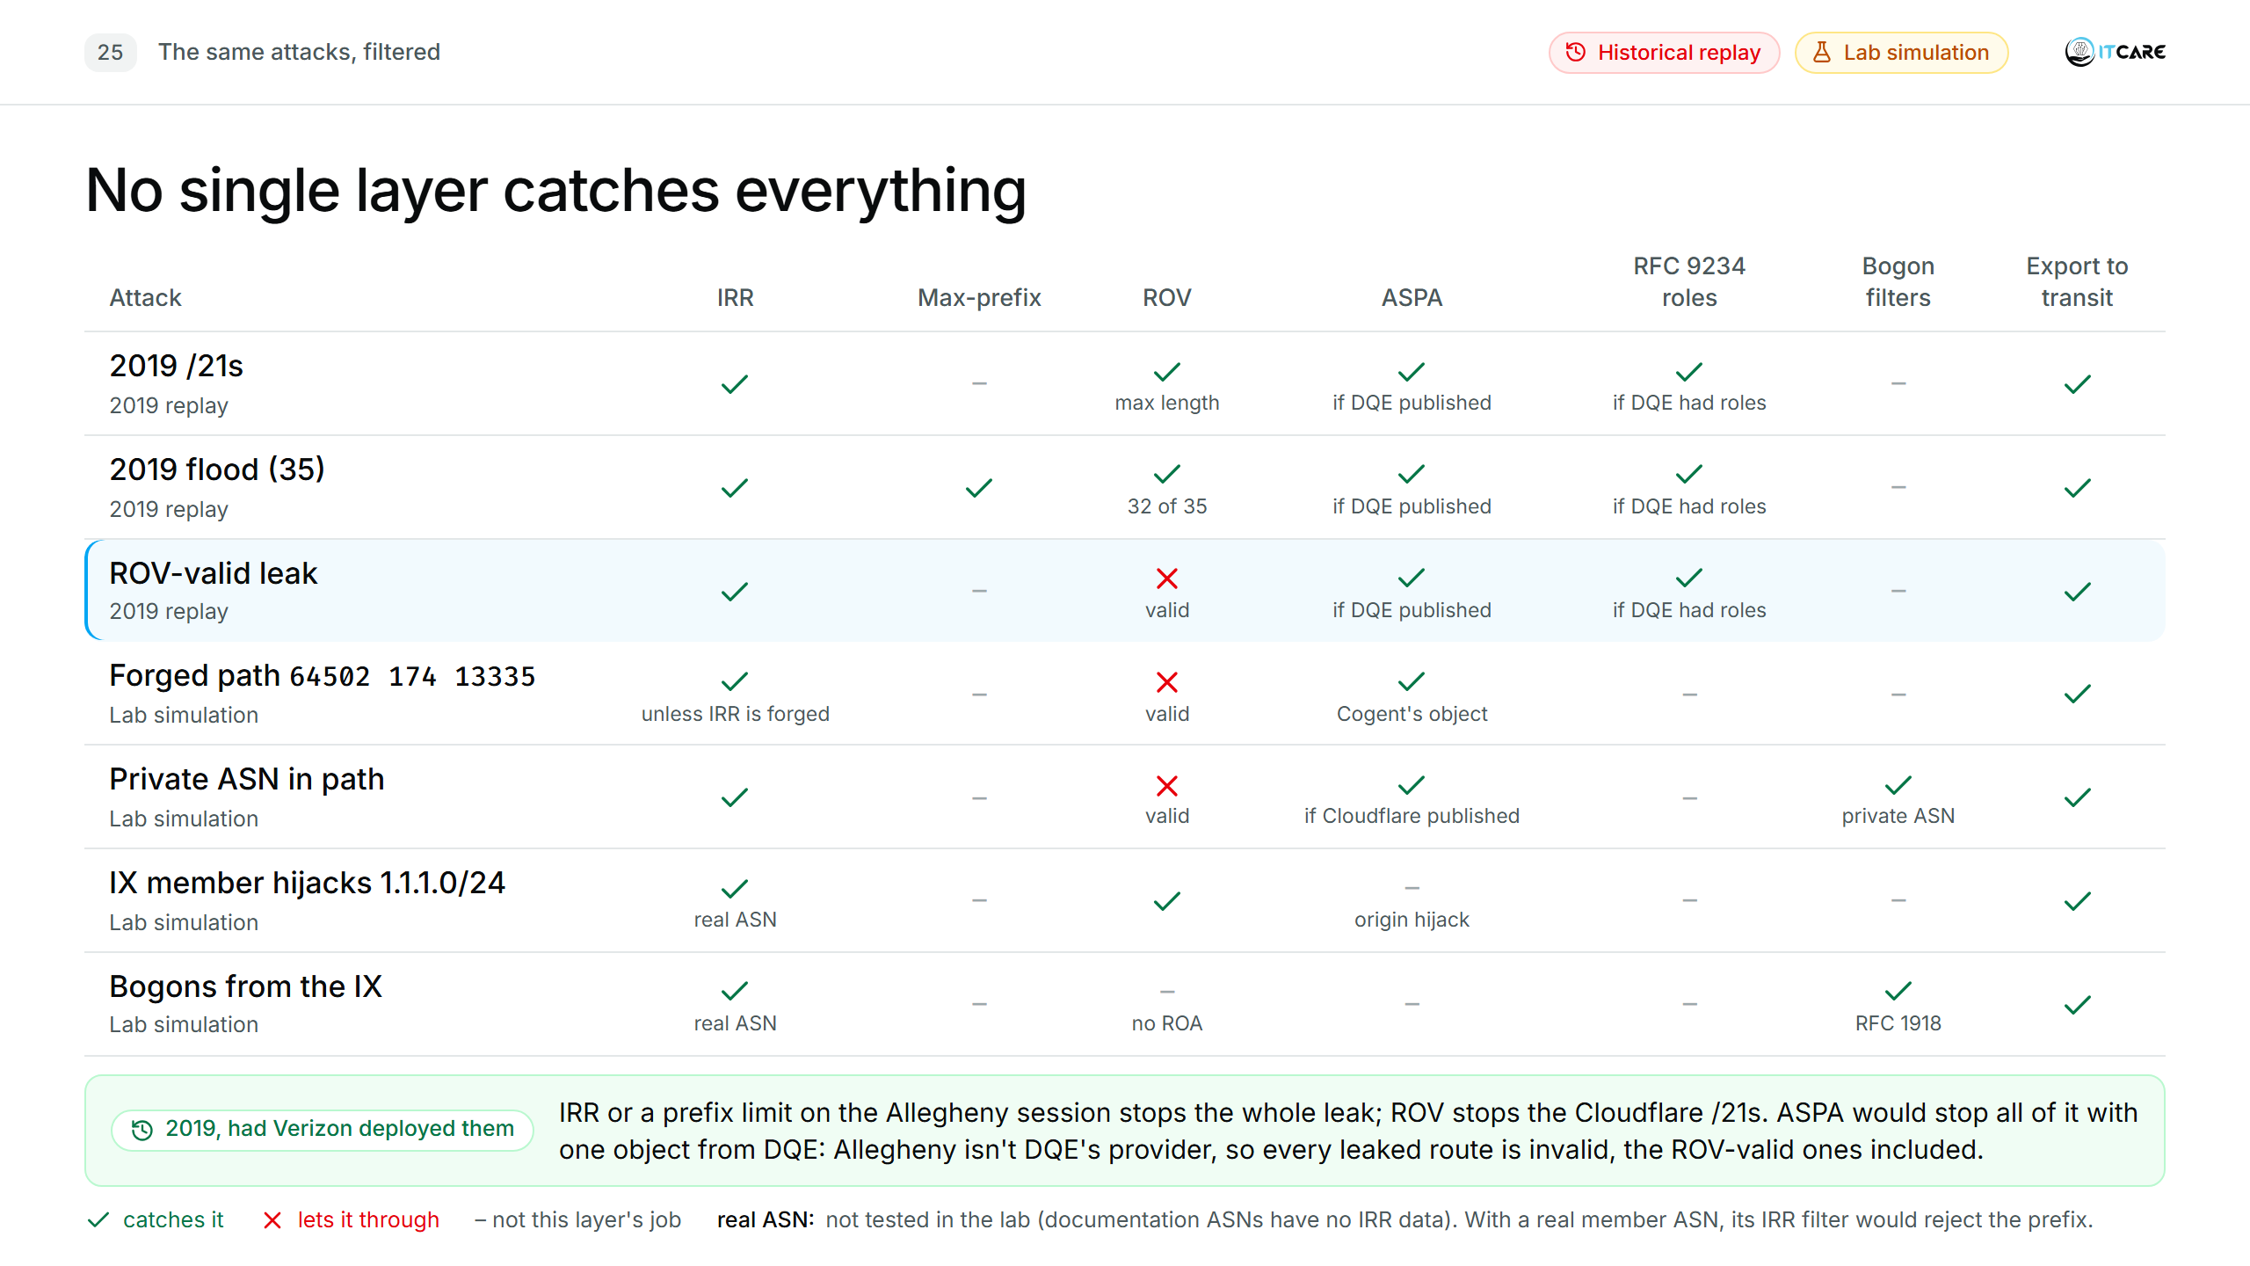
Notes:
(1:15) [One row per click, then the 2019 box.] Read the "ROV-valid leak" row: ROV says valid, because the origin and the prefix length are both right. Without IRR, ASPA or RFC 9234 roles, it goes through.
Why the 2019 /21s fail ROV even though the origin is Cloudflare: ROV checks the prefix length too. Cloudflare's ROA allows up to /20; the leaked /21s are longer, so they are invalid (lab: "Validation State: invalid, Reason: Max-Length mismatch", 4-03). Cloudflare said the same in 2019. Only the /24s inside 38.82.8.0/21, whose ROA allows /24, pass ROV.
[Click] 2019: had Verizon deployed them, IRR or a prefix limit on the Allegheny session would each have stopped the whole leak, and ROV the Cloudflare /21s. ASPA didn't exist yet (first draft June 2018), but with it one object from DQE would have been enough: DQE's providers don't include Allegheny, so a route going DQE → Allegheny → Verizon is a valley, invalid for every prefix, ROV-valid ones included.
[Cell by cell, if asked]
- 2019 rows, ASPA: needs DQE's object (lists DQE's providers). Cloudflare's object would also catch the Cloudflare prefixes (DQE is not Cloudflare's provider). DQE, Allegheny and Verizon have none today.
- Flood, ROV "32 of 35": the 32 /21s are invalid; Allegheny's own prefix is legitimate, and DQE's two own routes pass ROV (they are leaks ROV can't see).
- Forged path, IRR "unless IRR is forged": Customer B registers nothing, so deny-all. An attacker can register bogus IRR objects; Celer Bridge did.
- Private ASN (38.82.10.0/24, path 64502 64512 13335): ROV valid, the ROA 38.82.8.0/21 max /24 covers it. Caught by the bogon-ASN filter and by IRR. ASPA only if Cloudflare publishes an object (64512 is not its provider).
- IX member hijack (shown in backups B3 and B21): ROV catches it (origin 64501, ROA says 13335). ASPA does not check the origin. IRR "real ASN": with a real member ASN, the route server's per-member IRR filter, or your prefix list on a bilateral session, would drop 1.1.1.0/24; the lab member uses a documentation ASN with no IRR data.
- Bogons (10.0.0.0/8, 192.168.100.0/24): no ROA, so ROV says not-found. Caught by the bogon filter; IRR with a real ASN.
- Export to transit: an export policy that only sends our own and our customers' registered prefixes. It protects everyone else, not us. In the lab nothing was exported at all (B1).

Slide 37
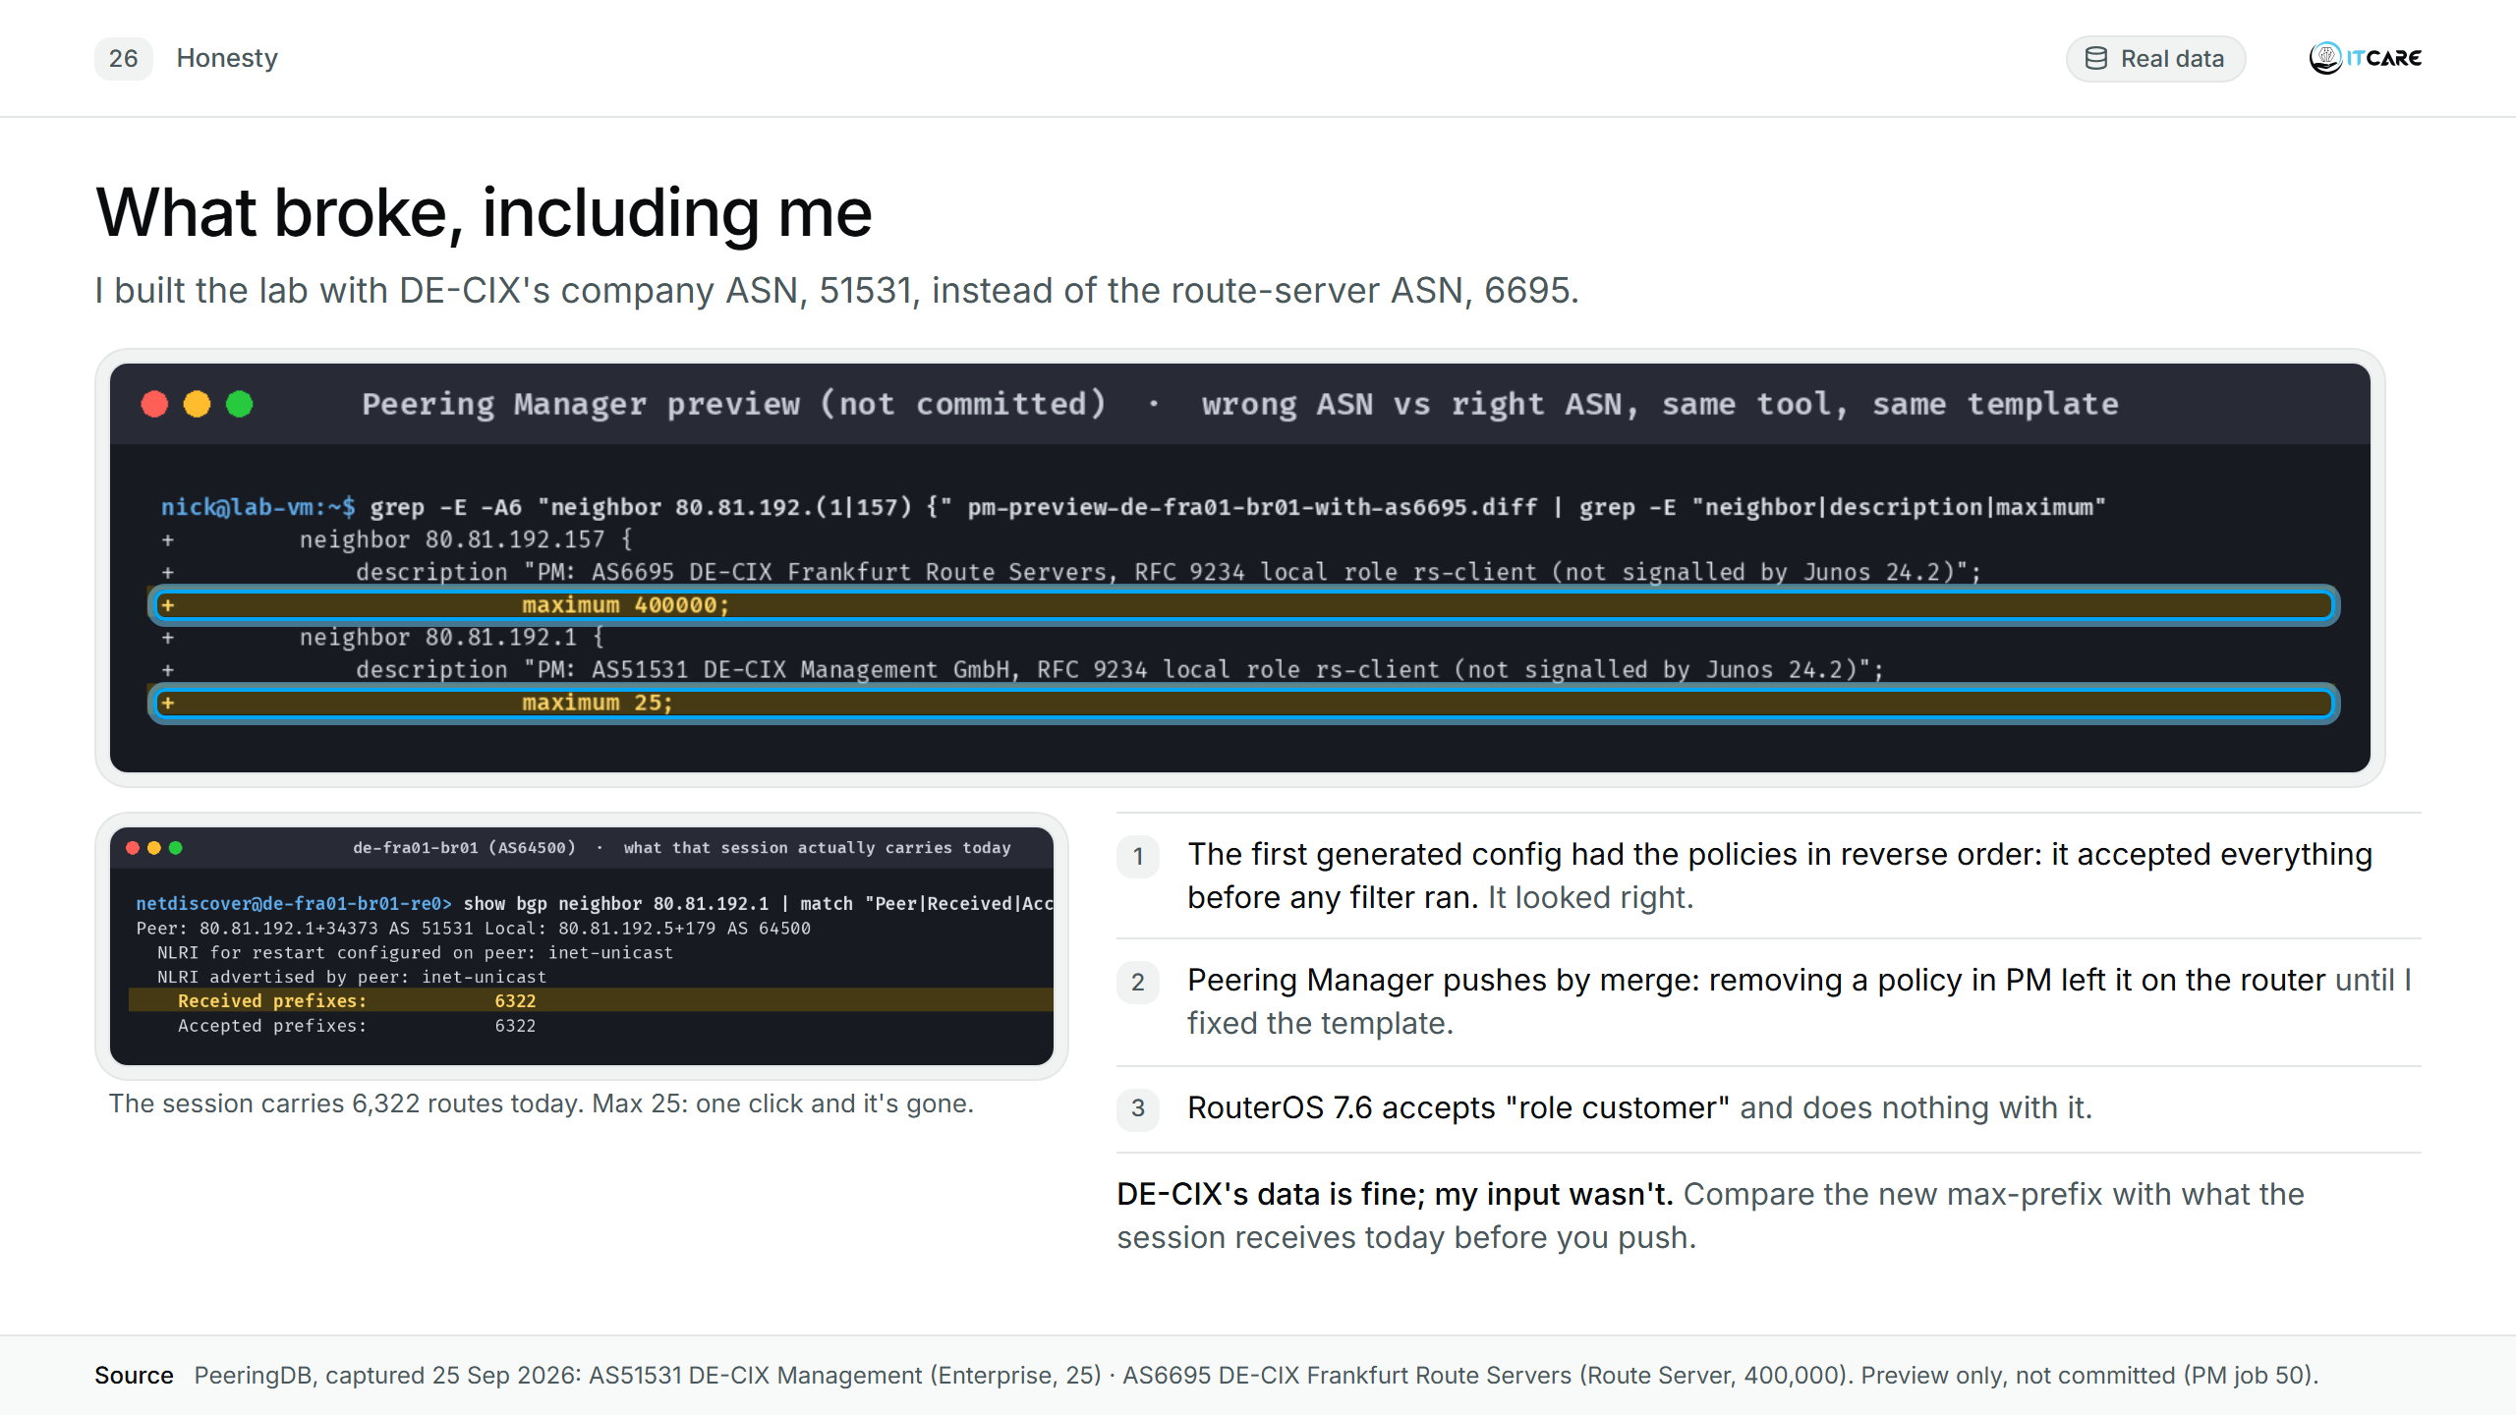
Notes:
(1:15) Confession: I built the lab with DE-CIX's company ASN, 51531, instead of the route-server ASN, 6695. Peering Manager took the max-prefix from PeeringDB, 25, correct for DE-CIX's own network, and was about to put it on a session carrying 6,322 routes. One click and our Frankfurt IX session is gone. With the right ASN, the same tool and template produce 400,000. DE-CIX's data is fine; my input wasn't. Automation trusts its input completely, so compare the new max-prefix with what the session receives today before you push.
[Evidence: 1 = captures/pm-render-fra-reversed-order-bug.txt. 3 = 4-13-routeros-role-no-effect.png (backup B19). Backup: B6–B10 (PeeringDB pages: Enterprise 25 vs Route Server 400000; 4-12f every other session fits).]

Slide 38
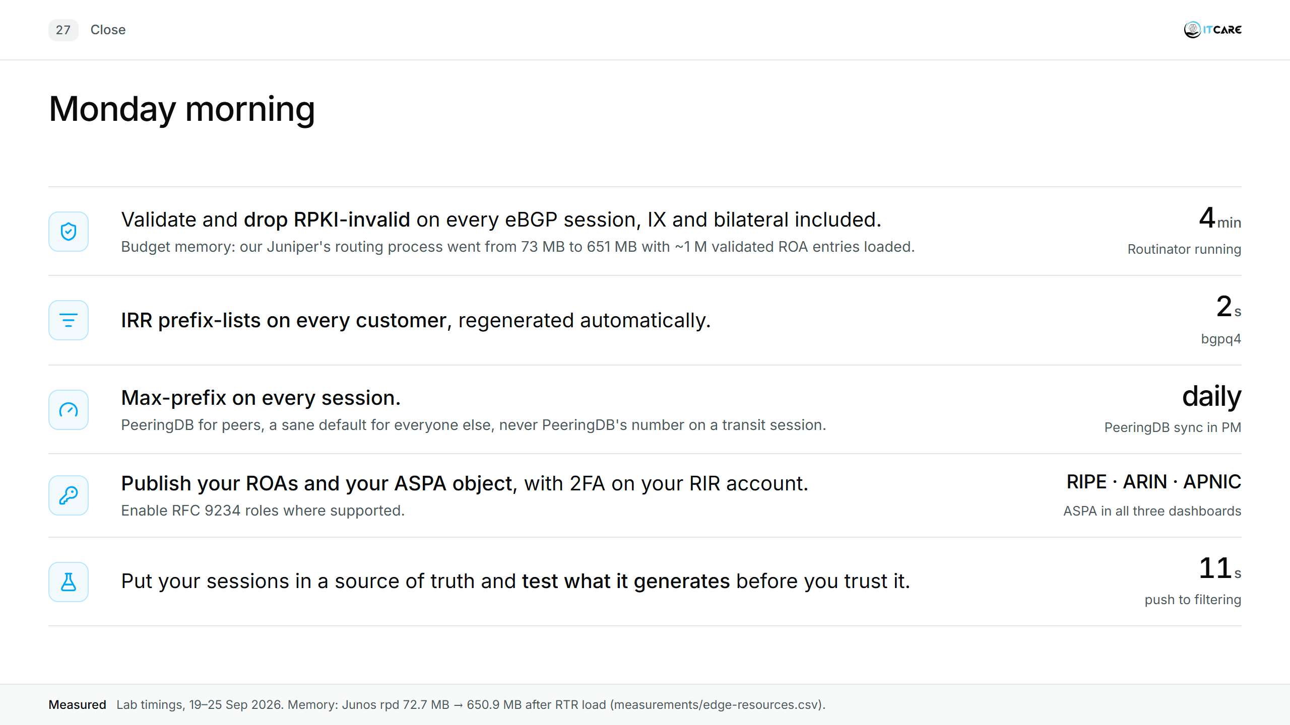
Notes:
(1:00) One line per item.
1. Validate and drop RPKI-invalid on every eBGP session, IX and bilateral included: don't leave it to the route server. Routinator was running in 4 minutes. Budget memory: our Juniper's routing process went from 73 MB to 651 MB with about a million validated ROA entries loaded.
2. IRR prefix-lists on every customer, regenerated automatically. bgpq4: 2 seconds.
3. Max-prefix on every session: PeeringDB for peers, a sane default for everyone else, never PeeringDB's number on a transit session.
4. Publish your ROAs and your ASPA object, with 2FA on your RIR account; enable RFC 9234 roles where supported.
5. Put your sessions in a source of truth and test what it generates before you trust it.
[If Phase 5 is done by then: "I published ASPA for AS31252 this week; here is the object."]

Slide 39
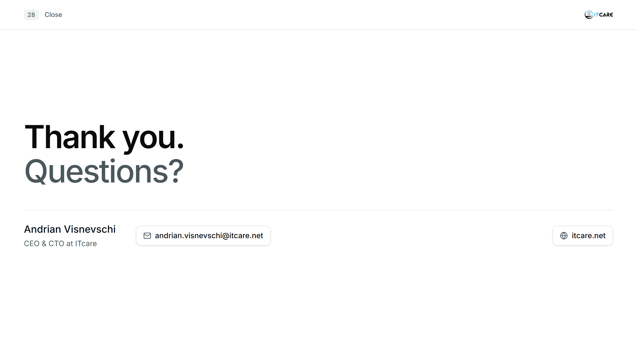
Notes:
(0:15) Thank you. Questions?
[Optional: QR code to a public page with the sources.]

