Slide 1

The New AI Crossroads of Central & Eastern Europe:
Connectivity, Clouds and the Sofia Metro
Zdravko Nikolov,
Managing Director, Equinix Bulgaria
zdravko.nikolov@eu.equinix.com
Notes:
AI is creating a new digital infrastructure map. Success will no longer depend only on who has the largest GPUs, but also on who can connect data, networks, clouds and users with low latency and within regulatory boundaries.

Slide 2
RONOG 11
What is an expert?
"a person who has made all the mistakes that can be made in a very narrow field."
Neils Bohr
Sources include TeleGeography subscriber data and RIPE Atlas observations
01
Notes:
Prepared for RONOG 11 in Bucharest on 29 September 2026. The presentation examines Romania's role in a CEE and Black Sea connectivity corridor. Source base: supplied TeleGeography datasets and reports, plus RIPE Atlas latency observations collected 20 September 2026. RONOG event and speaker details: https://www.ronog.ro/

Slide 3
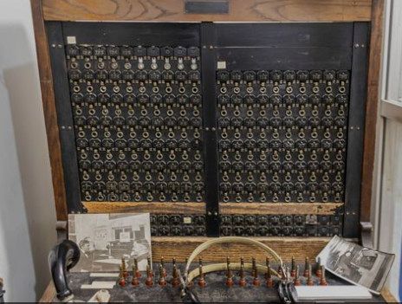
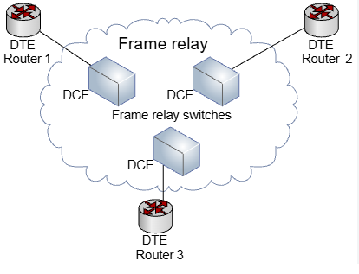

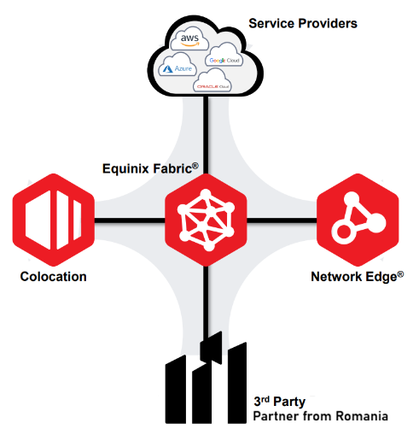
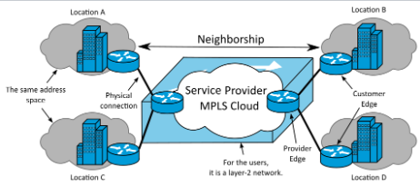
RONOG 11
What do we do in telecom for enterprise? Who orders the music?
What is an expert?
1876 - 1990
1980-2000
2000-2020
now
Sources include TeleGeography subscriber data and RIPE Atlas observations
01
Notes:
Prepared for RONOG 11 in Bucharest on 29 September 2026. The presentation examines Romania's role in a CEE and Black Sea connectivity corridor. Source base: supplied TeleGeography datasets and reports, plus RIPE Atlas latency observations collected 20 September 2026. RONOG event and speaker details: https://www.ronog.ro/

Slide 4
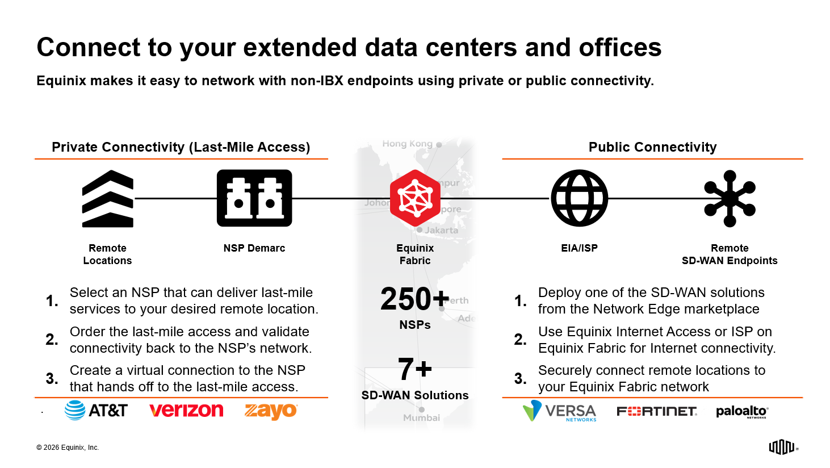

Slide 5




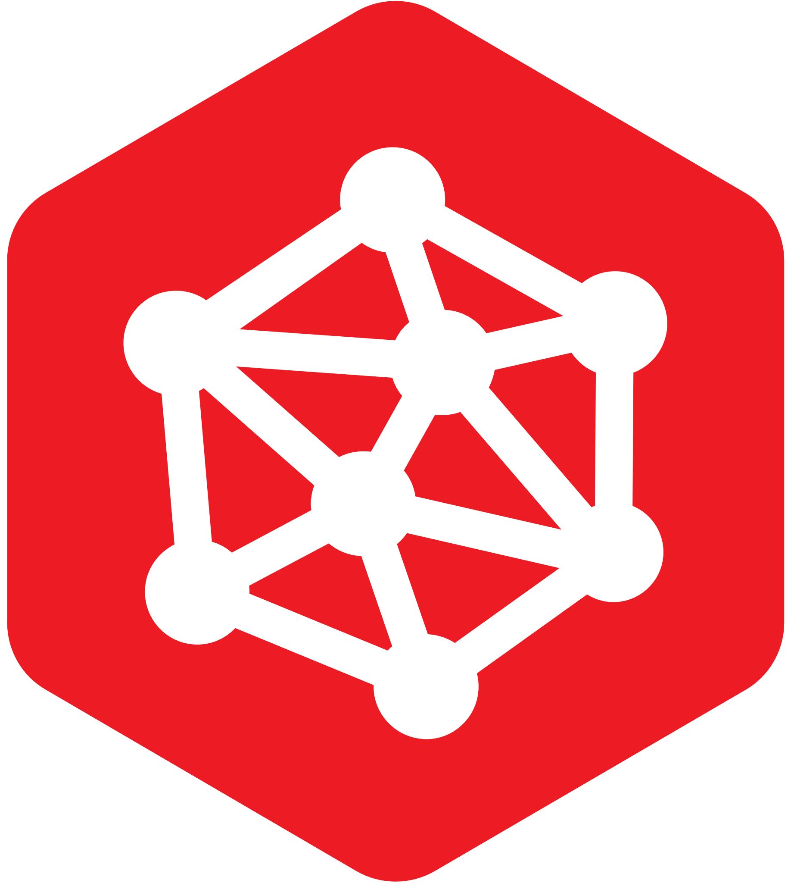

Service Elements
Combine ports, virtual connections, and cloud routers to reach thousands of destinations.
Element |  | Billing | Bandwidth | Options
 | Port | MRC; 1-Year Term | 1 / 10 / 100 / 400 Gbps | Standard Unlimited Local Unlimited Plus
 | Virtual Connection | MRC; On-Demand & 12 / 24 / 36 Months | 10 Mbps – 100 Gbps | P2P (E-LINE) MP2MP (E-LAN)
 | Fabric Cloud Router | MRC; On-Demand & 12 / 24 / 36 Months | 10 Mbps – 1000 Gbps | Lab + Basic, Standard, and Advanced
Basic Connection:
Port
Port
A-Side
Z-Side
P2P VC
© 2025 Equinix, Inc.

Slide 6
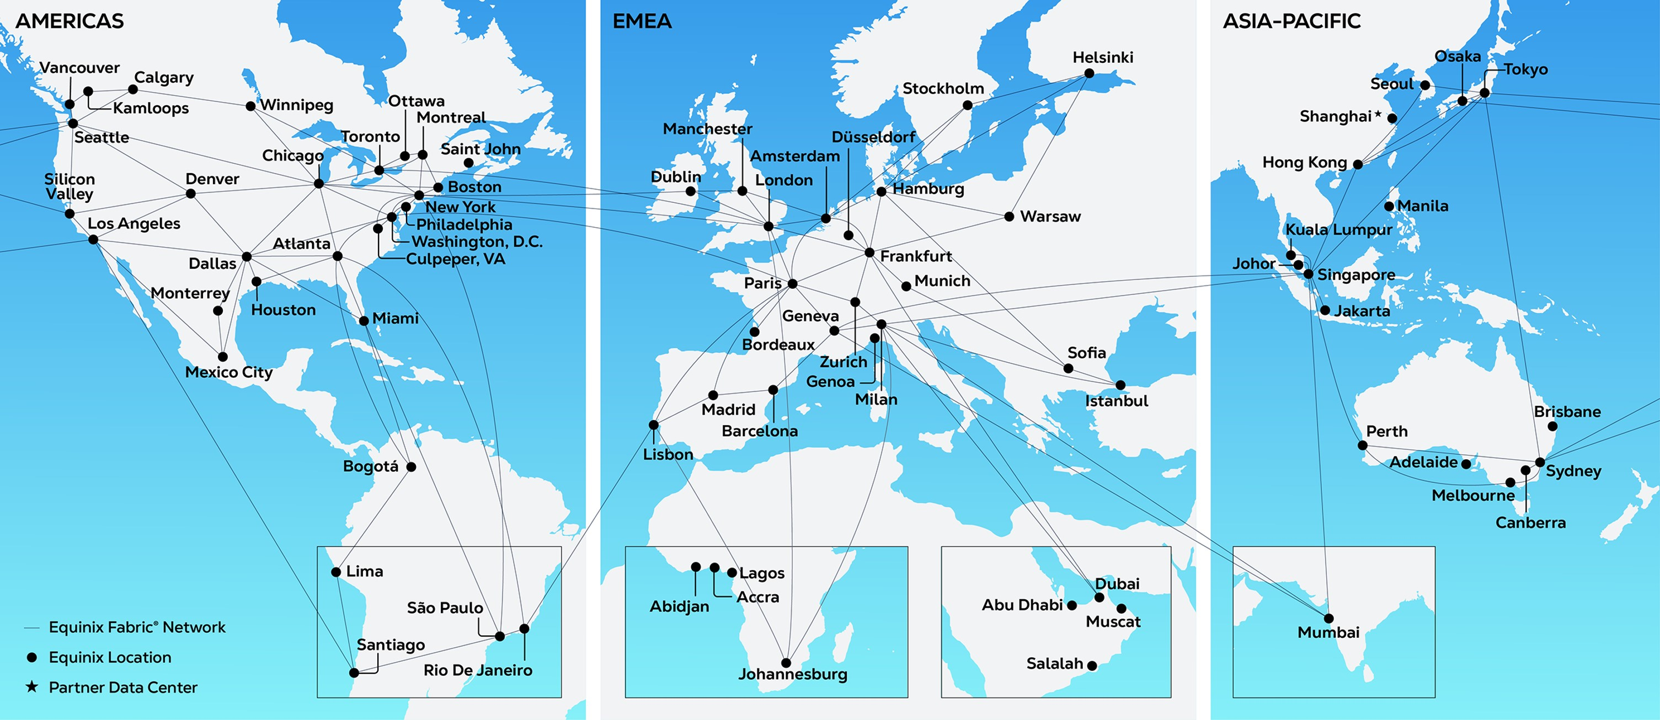
280+ | 77 | 36 | 99.9999%+
Data centers | Metros | Countries | Uptime record*
Notes:
When we talk about complementing your network with our virtual services, this map shows what we mean by global scale.
Equinix provides a global footprint of more than 280+ data centers, giving you instant access to key markets across six continents.
2000+ networks
~3,000 cloud, IT and AI services
5500+ enterprises
This is not just about physical space. It is a highly interconnected platform, woven together by Equinix Fabric. This allows you to privately and securely connect to the clouds partners and ecosystems that matter most to your customers.
And it is all backed by our proven operational reliability, delivering 99.999% uptime globally. This is the reach and resilience you can build on.
Purpose-built infrastructure
Equinix Fabric and Network Edge run on our high-performance, AI-ready data center foundation.
Unmatched scale
The world’s most interconnected data center environment with 507,000+ interconnections.
Proven reliability
Leveraging 27+ years of data center excellence.
Secure and scalable
On-demand access across a robust,
global physical footprint.

Slide 7
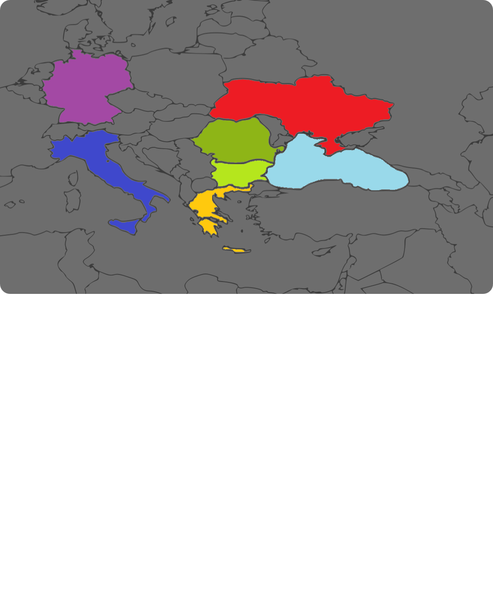
Romania anchors the addressable corridor
Bucharest is a growing market, not an Equinix location. Sofia is the proposed regional service point and a protection route.
CORRIDOR LEGS
ROMANIA MARKET
ADDRESSABLE MARKET, NO LOCAL EQUINIX FACILITY
6.0
14.0
18.7%
Frankfurt
2026 Tbps
2031 Tbps
CAGR
Odessa
Bucharest
MEASURED RTT
Sofia
BUH → SOF
15 ms
Schille
Poti
SOF → IST
13 ms
Istanbul
SOF → FRA
24 ms
Direct BUH → FRA
28 ms
Commercial message
Regional aggregation and resilience, rather than a faster Frankfurt detour.
RTT: RIPE Atlas, 20 Sep 2026. Demand: TeleGeography. Basemap: Wikimedia Commons, public domain.
03
Notes:
Audience framing: Bucharest represents an addressable Romanian market; Equinix has no local facility in Bucharest or Romania. The commercial hypothesis is partner-delivered transport into the Sofia interconnection ecosystem, not a claimed local footprint. Latency method: median RTT for each available anchor pair over the trailing 24 hours, then median of path medians. Bucharest–Sofia 21.1 ms, Sofia–Istanbul 13.5 ms, Istanbul–Frankfurt 38.6 ms, Bucharest–Frankfurt 28.2 ms. The three-leg sum combines separate measurements and is not a coherent routed end-to-end test. Country IPT demand figures are not corridor flow. Basemap: Europe blank map.svg by Radoslaw Botev, based on a public-domain map from Demis, via Wikimedia Commons; cropped and recolored for this slide.

Slide 8






















2,000+
Network operators and service providers trust Equinix as their digital infrastructure partner.
10,500+ customers globally | 60%+ of the Fortune 500 | 44%+ of the Forbes Global 2000
Notes:
We have talked about empowering your teams to say ‘Yes' with confidence. This is not just a theoretical concept. It is a proven strategy that your peers are already using to accelerate their growth.
More than 2,000 network operators and service providers are saying ‘Yes' by working with Equinix as their trusted digital infrastructure partner. They rely on our capabilities to augment their own networks, capture new revenue and meet complex enterprise demands.
And this trust extends across the entire digital economy. We provide the digital infrastructure foundation for more than 10,500 customers globally, including over 60 % of the Fortune 500. This ecosystem is your opportunity. It is the marketplace where your next high-value contracts are waiting.

Slide 9












Zayo’s Network
AI Ecosystem at Equinix
CONNECTIVITY FOR AI
400G Waves
Equinix Data Centers
Enterprises
Ethernet
Zayo Deployments
Major Clouds
Zayo needed an AI-ready data center partner to expand its 400G wavelength services and enable service deliveries in less than 24 hours.
IP Transit
Neoclouds
Other Services
AI Providers
Data Platforms
Zayo Network
Interconnection at Equinix
1
Solution
2
Outcomes
3
Benefit
Expansion of 400G capabilities
Infrastructure and support teams at Equinix data centers worked to meet the demand for high-bandwidth connectivity on Zayo’s 400G-enabled network.
On-demand wavelengths
Instantly delivered letters of authorization/Circuit Facility Assignments (LOAs/CFAs).
Fast service delivery
Enabled access to high-capacity bandwidth without lengthy setup times—less than 24 hours.
Bandwidth for AI
400G waves deliver the high-performance
connectivity needed for AI, real-time
analytics and cloud workloads.
Notes:
Notes:
To see this in action, let’s look at how Zayo, a leading NSP, captured value by partnering with Equinix for their AI deployment
Zayo needed to deliver ultra-fast, high-capacity connectivity for AI workloads—across a distributed, global ecosystem.
By leveraging Equinix’s AI-optimized data centers and 400G network capabilities, Zayo was able to offer instant, reliable, and scalable bandwidth.
This partnership enabled Zayo’s customers to launch enterprise AI and data-intensive services faster, with seamless access to key markets and partners.
The Zayo–Equinix story is a blueprint for how NSPs can unlock new value and accelerate innovation in the distributed AI landscape.

Slide 10









Other Customer
Environments
Private Cage: Continental
NVIDIA GPU Cluster
Cloud and IT Services Ecosystem
ENTERPRISE AI
Data Centers
WAN
IBM Storage Cluster
AWS®
Continental needed a distributed AI solution to centrally process vehicle data generated at the edge.
Local Sites
Microsoft Azure®
Internal Users
NSP
Fabric
Google Cloud™
Wireless Networks
Oracle Cloud®
Connected Cars
Other Clouds
External Users
Network Services
Equinix Fabric®
1
Solution
2
Outcomes
3
Benefit
Connected AI Center of Excellence
A distributed AI solution with reliable edge-to-core connectivity through NSP services, interconnected
via Equinix Fabric®.
Rapid deployment
Two-week deployment of AI and storage infrastructure
as well as edge-to-cloud connectivity.
Room to scale
20% growth headroom—hundreds of GPUs and
150+ TB storage.
Fast AI learning for safer vehicles
70% reduction in AI model training time, allowing for 14x
more deep learning trainings per month.
AWS, Azure, Google Cloud and Oracle Cloud are registered trademarks or trademarks of their respective owners.
Equinix Fabric is a registered trademark of Equinix, Inc.
Notes:
Notes
Looking at the Enterprise side, Equinix is driving many of the world’s most advanced AI deployments for Enterprises. Here is one of of our best of class examples At Equinix – Continental. Their AI environment, as with all Enterprise environments we have come across, requires access to connect data sources, clouds and compute environments—all through a unified, high-performance infrastructure.
In all Enterprise AI use cases we have seen, Network Service Providers (NSPs) play a critical role: they bring data from the outside world into the enterprise’s AI environment,
What our customers are increasingly recognizing is our Differentiator at Equinix for their AI ambitions, is that beyond us offering an AI-ready DC environment, the simplicity of them accessing our ecosystem of telcos, clouds and AI partners provides them significant flexibility and scalability for the future
As an NSP you can leverage that advantage, by building your AI infrastructure at Equinix you will be close to the AI ecosystem – as well as NSP’s such as yourself

Slide 11




AI SERVICE PROVIDER
Other Customer
Environments
Private Cage: Groq
Cloud and IT Services Ecosystem
GroqCloud™ Platform
AWS®
AI Clouds
Data Centers
WAN
Microsoft Azure®
Zabbix
Groq needed to expand its high-performance infrastructure globally and bring AI inference capacity closer to users across Europe.
NSP
Fabric
Local Sites
Google Cloud™
SAP
Users
Private Cage: Customer
Oracle Cloud®
Salesforce
Customer Deployment
Other Clouds
ServiceNow
Groq Managed Private Cloud
Network Services
Equinix Fabric®
1
Solution
2
Outcomes
3
Benefits
Interconnected AI inferencing
AI-ready data center infrastructure for an AI inference platform with simplified, low-latency access to cloud
and network ecosystems.
Fast deployment
Rapid deployment unlocks AI ambitions immediately,
not months from now.
Ecosystem access
Ability to connect with partners and service providers privately and in real time.
Better access with lower latency
Faster response times for user networks in Europe.
AI sovereignty
Data governance aligned with regional privacy and sovereignty expectations.
AWS, Azure, Google Cloud and Oracle Cloud are registered trademarks or trademarks of their respective owners.
Equinix Fabric is a registered trademark of Equinix, Inc.
Notes:
Notes
AI Service provider Groq also recognized the unique qualification of Equinix to support their AI infrastructure and value of leveraging the AI ecosystem at Equinix to gain the most out of their AI services for their customers and gain visibility and simple access for new customers
Groq, an AI service provider, hosts their AI infrastructure at Equinix.
Their customers connect into their services via NSPs
Through Equinix’s AI ecosystem, customers and Groq can connect to hyperscalars, data platforms and AI partners easily

Slide 12




Unlock new opportunities and connect the AI ecosystem at Equinix
Discover geographic network expansion opportunities
Strengthen your growth and expansion plans.
Explore joint growth strategies
Partner on strategic growth and communication initiatives.
AI capitalization workshop
Attend a joint AI workshop to uncover opportunities to capitalize on AI.
Contact us >>
Notes:
Notes
Let's take next steps together
Whether you're expanding into new markets, modernizing your offerings, or scaling AI capabilities, we’re here to accelerate what’s next.
Equinix is powering many of the world’s most advanced AI deployments, and we’re ready to help you do the same.
Lets organize a follow-up workshop. What would be important topics to cover?
Discover geographic network expansion opportunities - Let’s identify where your infrastructure needs to go next to support growth.
Explore joint growth strategies - We can partner on strategic initiatives to help you scale faster and smarter.
AI capitalization workshop - Let’s co-host a session to uncover how you can capitalize on AI—across infrastructure, partnerships, and business models.

