Slide 1


Automated, Continuous Monitoring and On-Demand Testing of Optical Fiber Networks
Dimitrios Loukas, Solutions Consultant Fiber Monitoring & Sensing
Sept 2026

Slide 2
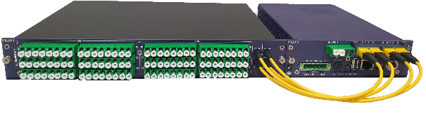
All What you can get from an OTDR Signature
And ask the System to analyze it for you…
Reflector Signature Demarcation/Peak Monitoring
Splice, Connector, Splitters Signature Loss/ Reflectance
Degradation Checking
Fiber Length
Detect Breaks and Degradation
ONT Signature:

Slide 3
From Fibre Monitoring to Critical Asset Protection
Integrated Ecosystem
Fibre Monitoring
Asset protection detects fibre degradations and breaks faster.
Fiber Strain (DTSS)
Identify installation, icing, winds, etc. loads before they impact your fiber network
Fibre Construction
Network build compliance and assurance with standard & central processes.
ONMSi
ONMSi
Fiber Temperature
Locate fires, Icing, and environmental events with Distributed Temperature Sensing (DTS)
Fibre Assets & Analytics
Look at fibre trends and monetise your fibre network infrastructure
Fibre Acoustics
Detect intrusions & interference on critical infrastructure with Distributed Acoustic Sensing (DAS)

Slide 4
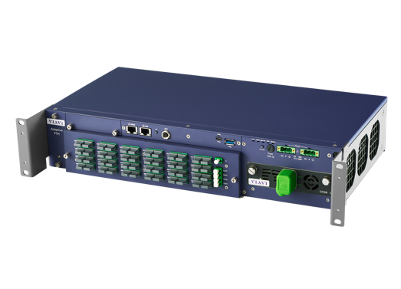
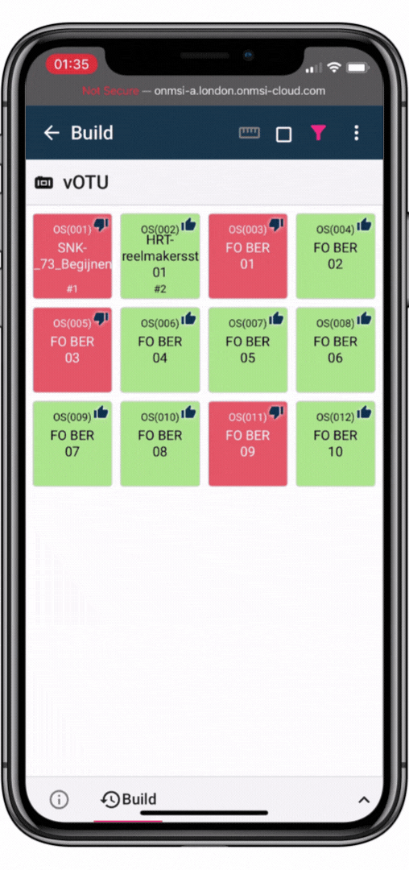
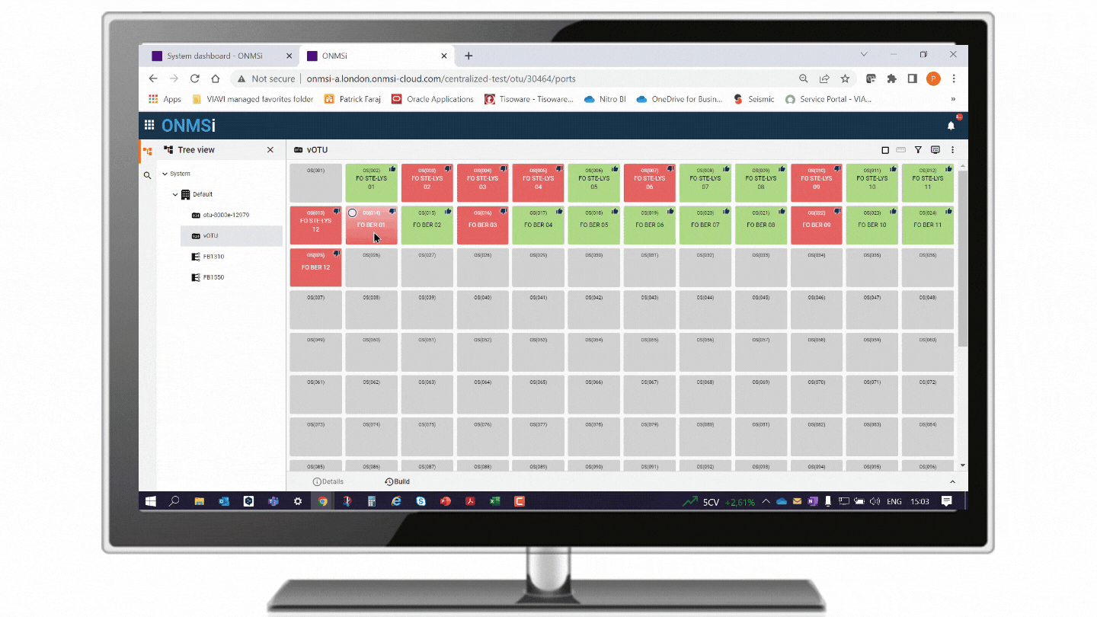
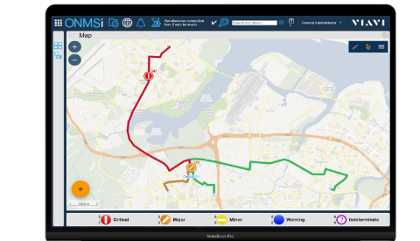
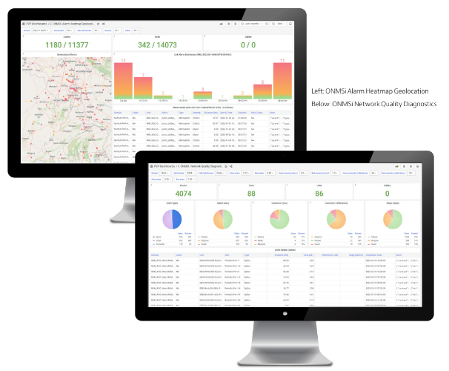
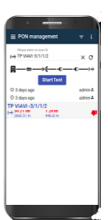
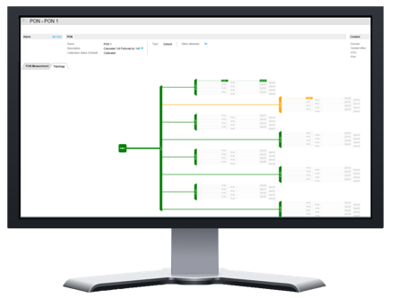
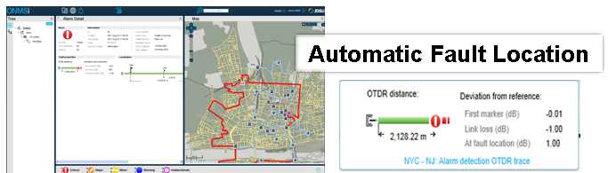
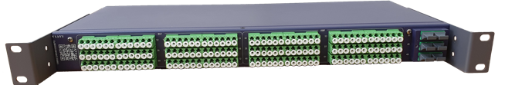
Remote Fiber Test Solution (ONMSi)
Fiber Network Visibility from Build to Monitoring that Scales with Your Business
ONMSi Hardware
ONMSi Software Applications
Build Module
Monitoring Module
Fiber Analytics Module
Centralized OTDR (Fiber Test Head)
LFM
HRD
Centralized OTDR
with High-Resolution for Accurate Fiber Characterization and Network Qualification
Easy Remote Field Testing
using smartphone mobile app with automated process and real-time results sync
GIS Inventory
of landmarks and optical routes including monitoring and failures identification and localization
Drive Operational Excellence Build progress, inventory management, KPIs tracking and reporting, trend analysis, for predictive maintenance

Slide 5

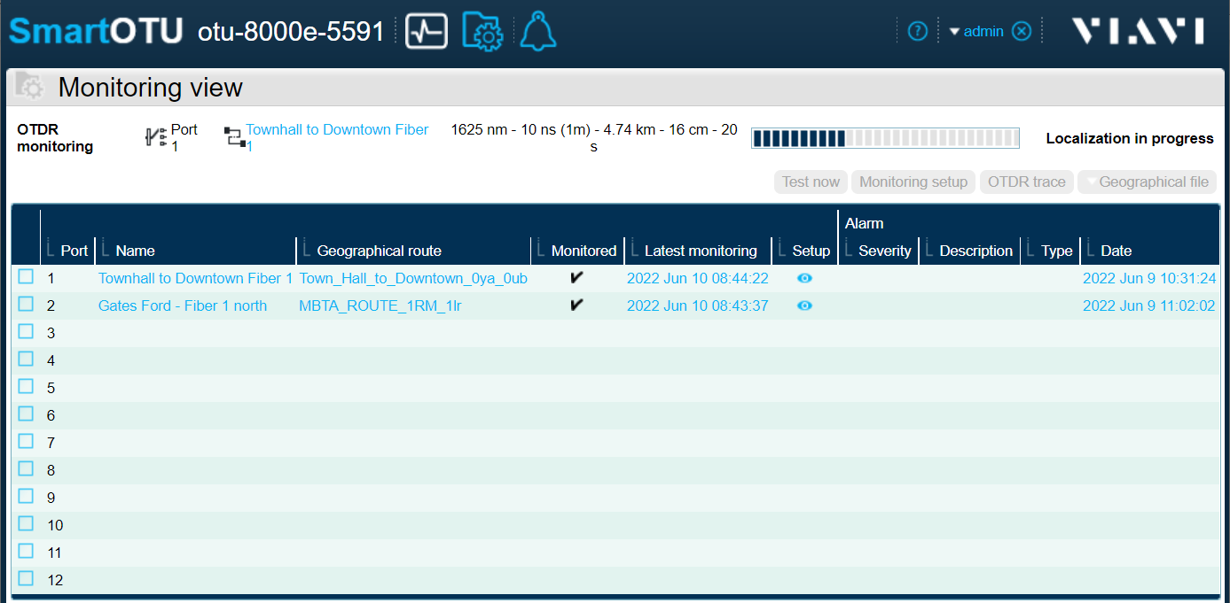
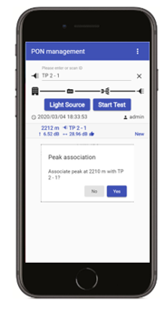
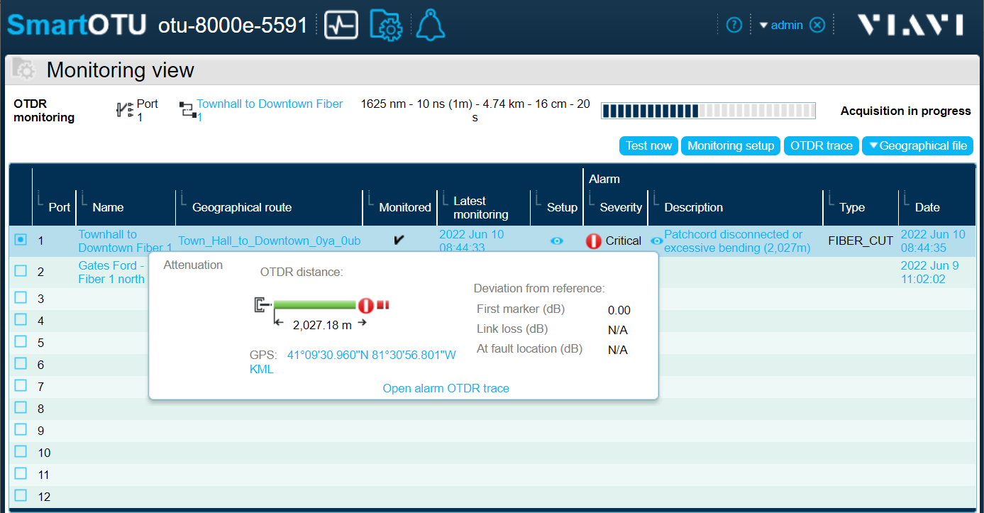
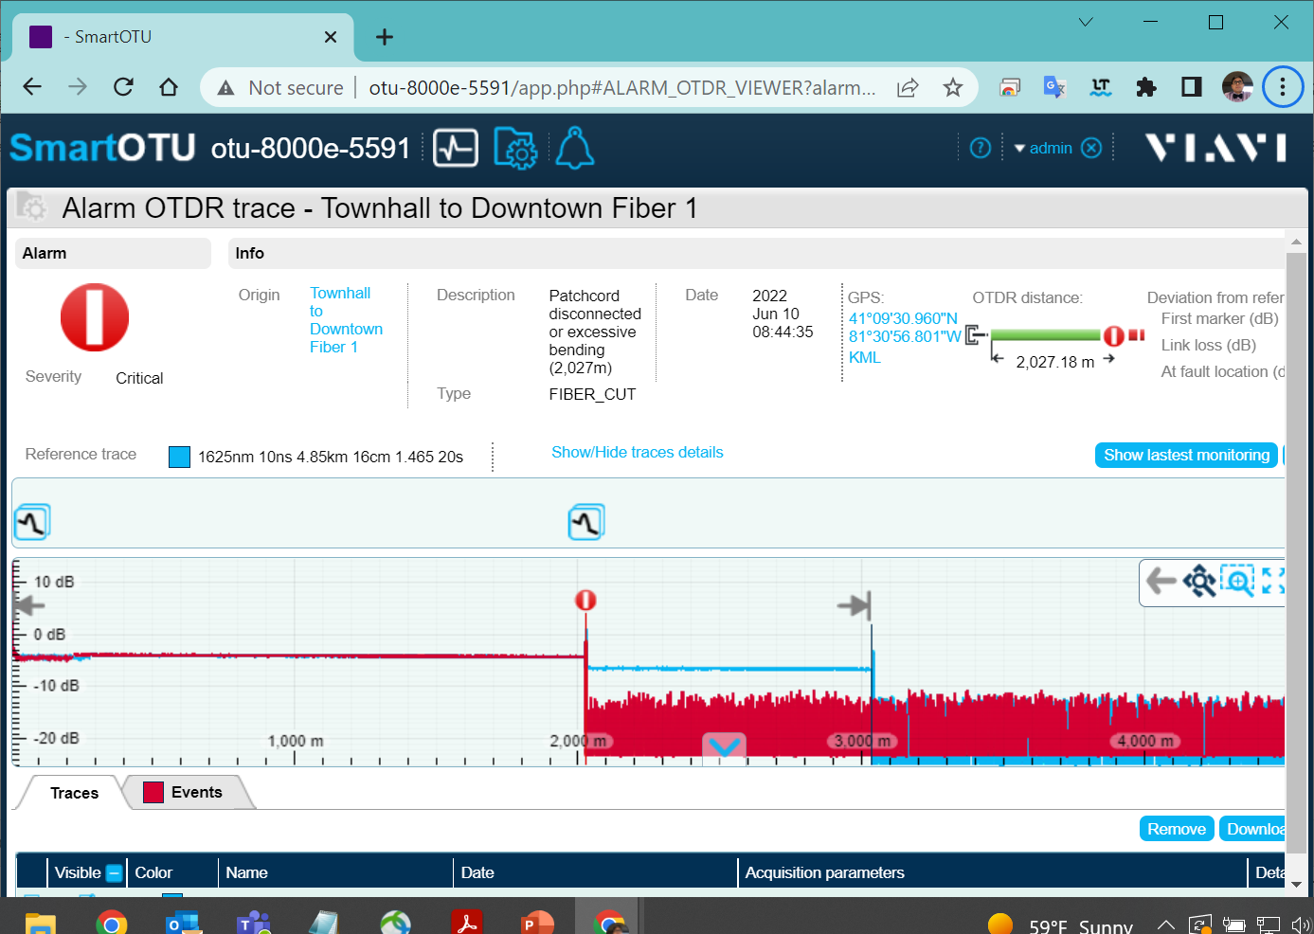
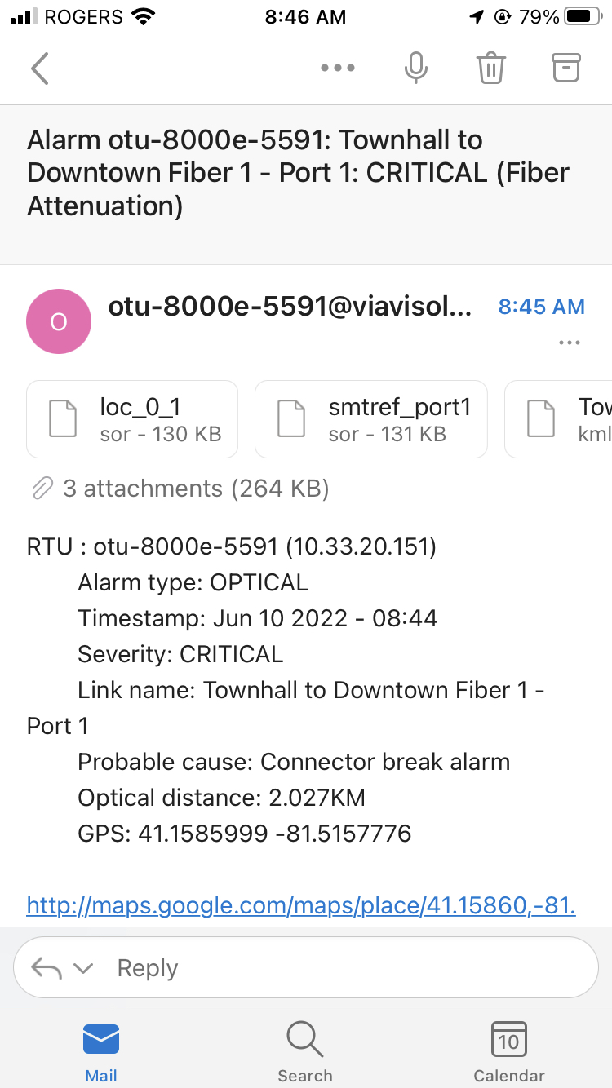
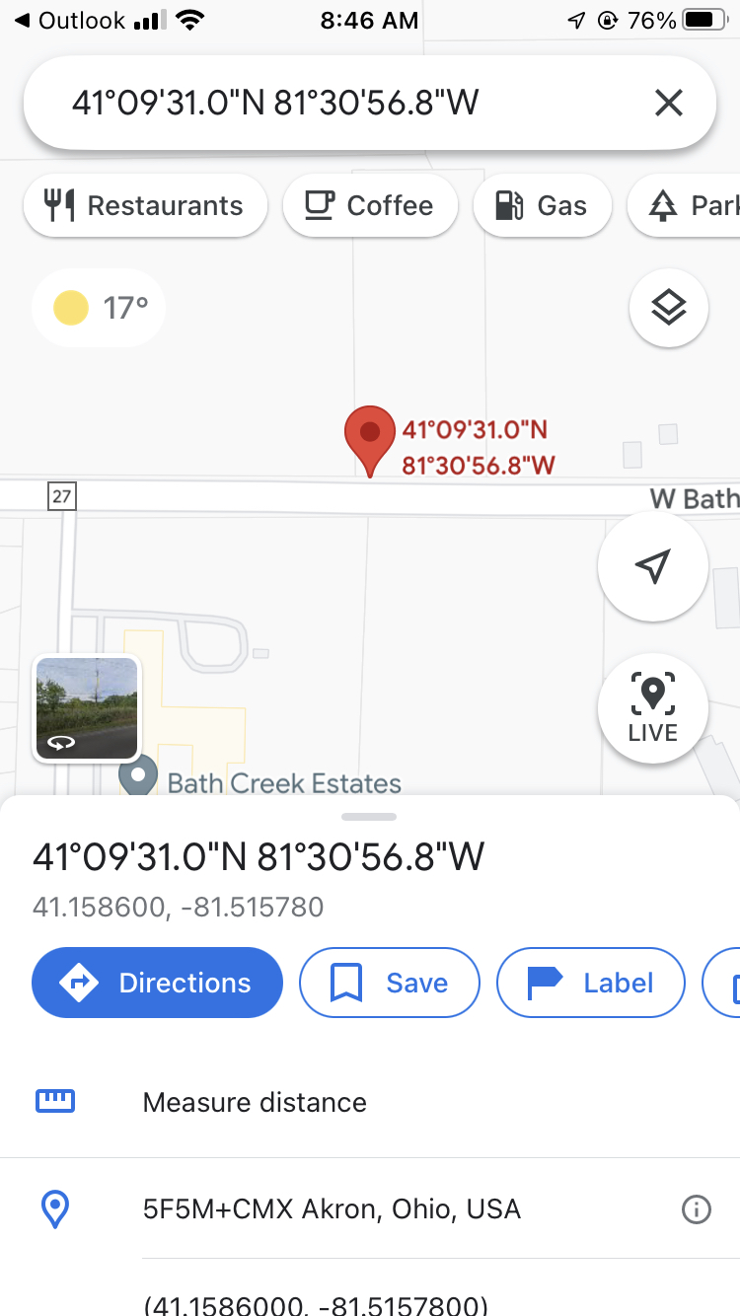
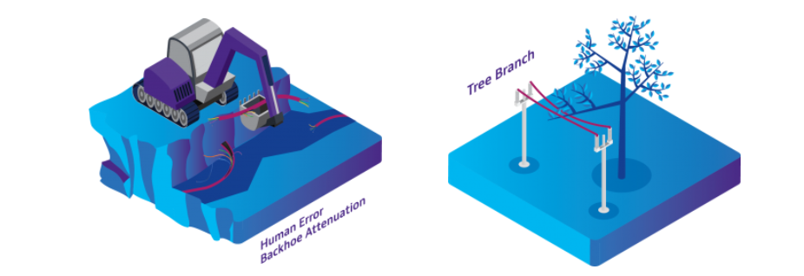
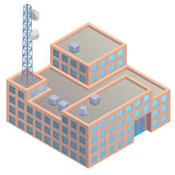

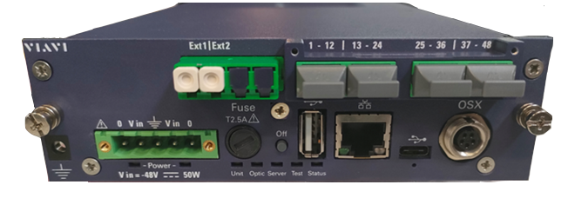

Reduction of MTTR with Less Dispatch
VIAVI Helps Minimize The Impact of Fiber Breaks
Automatic Fault Location with GPS coordinates
Techs can drive through fault location directly
NOC receives SNMP notification
Optical Fault Location sent to the technician by Email
Maintenance
Reference and current OTDR traces can be displayed
X
FTH-5000
with 48 MPO ports
Monitored Fiber

Slide 6
Remote Fiber Test System - Main Components
P2P FTH Solution
Fiber Network type
Northbound Interface - Integrations
P2P Dark Fiber
CONTROLER / SCHEDULER
1xN SWITCH
FTH-5000
To OTDR
P2P Lit Fiber
OTDR
SPF
To Equipment
Transceiver
To Equipment
Transceiver
Filter
WDM
Fiber Test Head

Slide 7
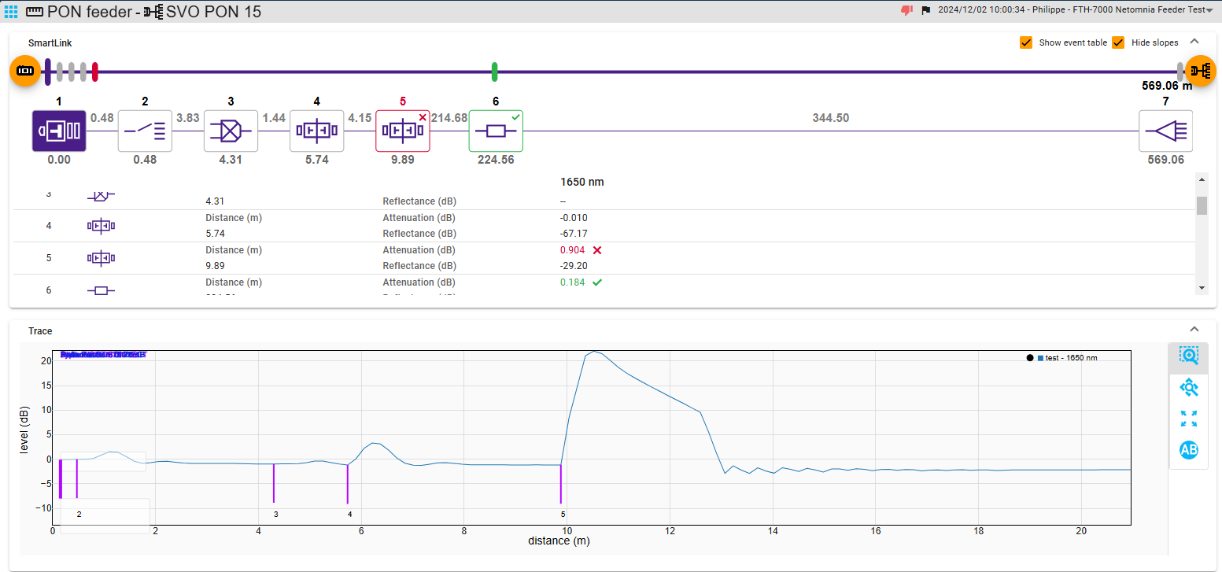
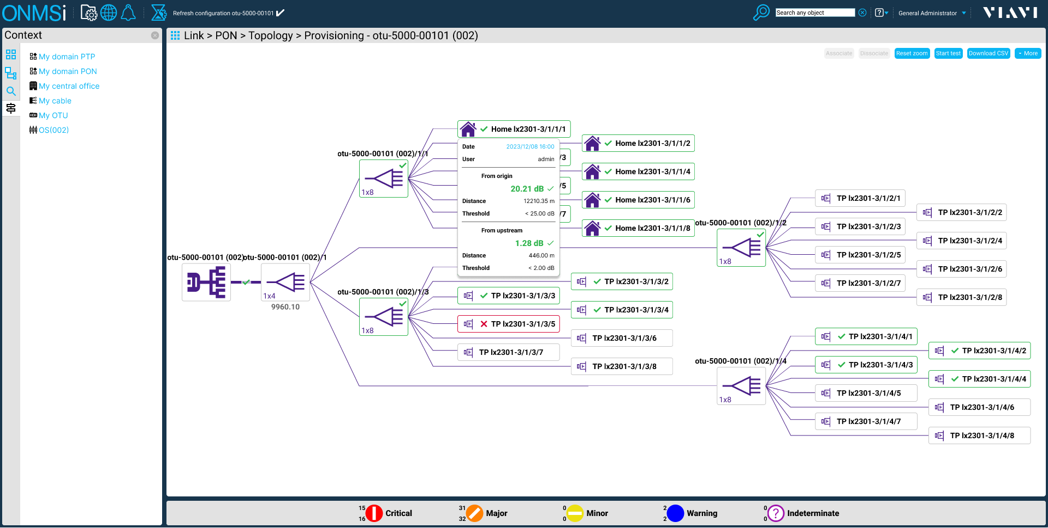
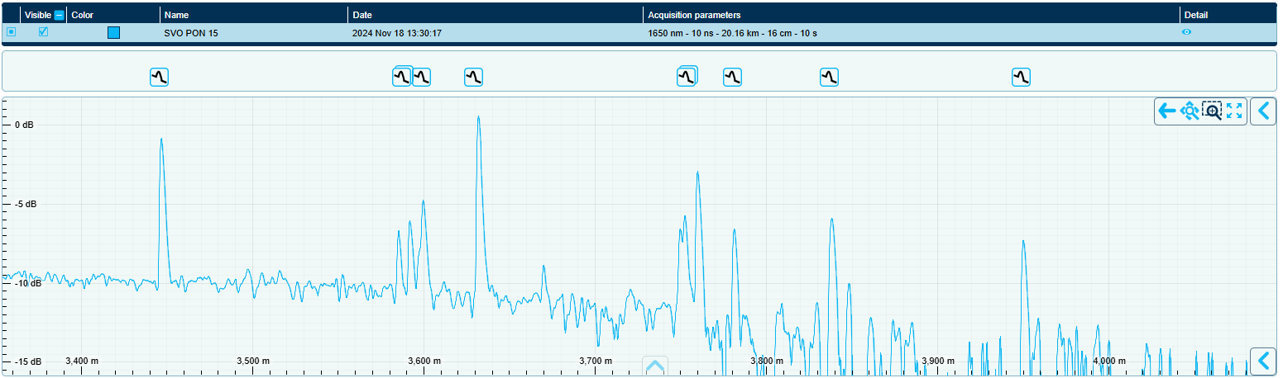
PON Provisioning & Monitoring: Feeder to ONT
ONT 8&12
ONT5
ONT9
ONT11
ONT7&6
ONT2
ONT10
ONT4
ONT3

Slide 8
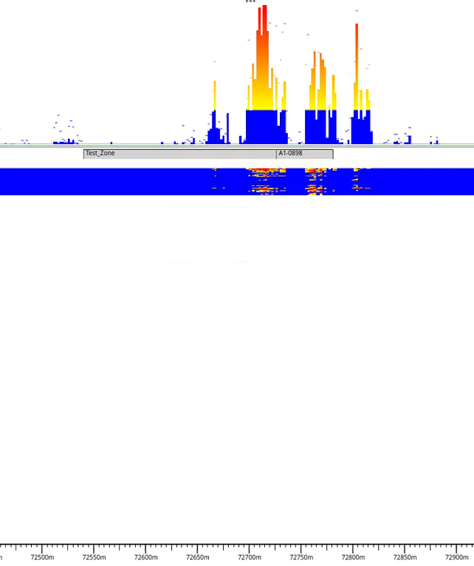

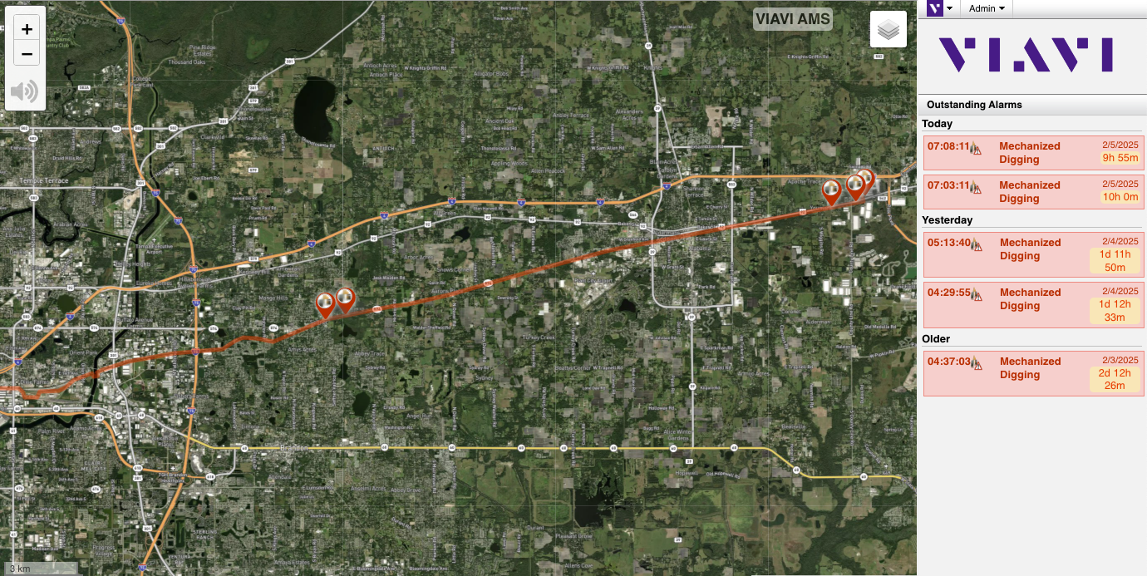
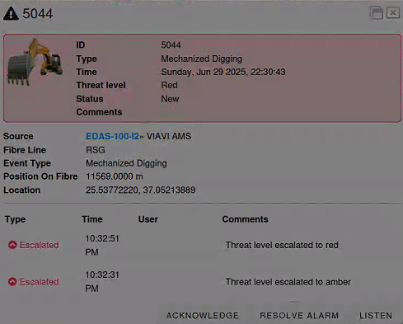
Preventing Cable Damage with DAS

Slide 9
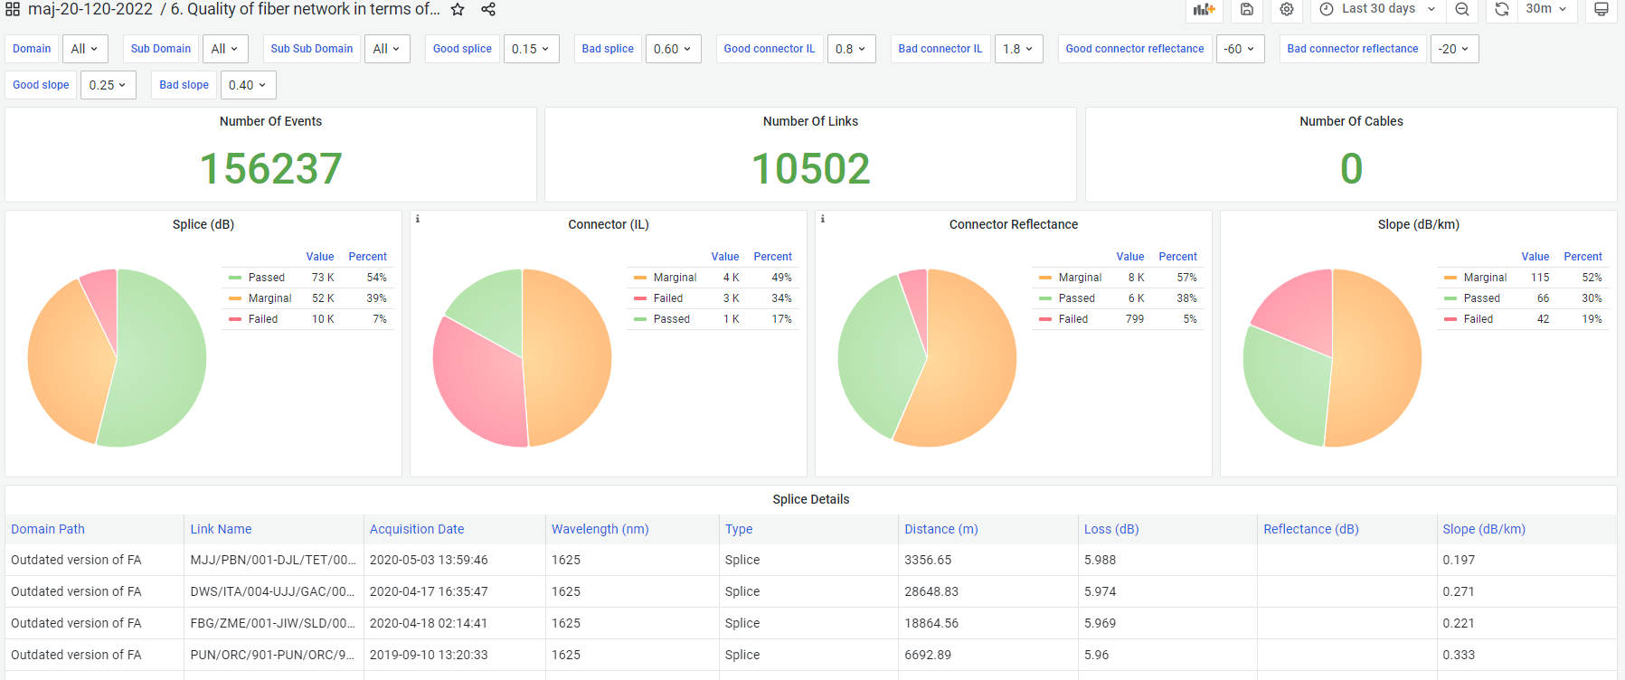
Fiber Health Dashboard
Fiber Aging Tracking – Fiber Performance Overview – Maintenance Planning
Select one or more regions or sections
Enter quality thresholds

Slide 10
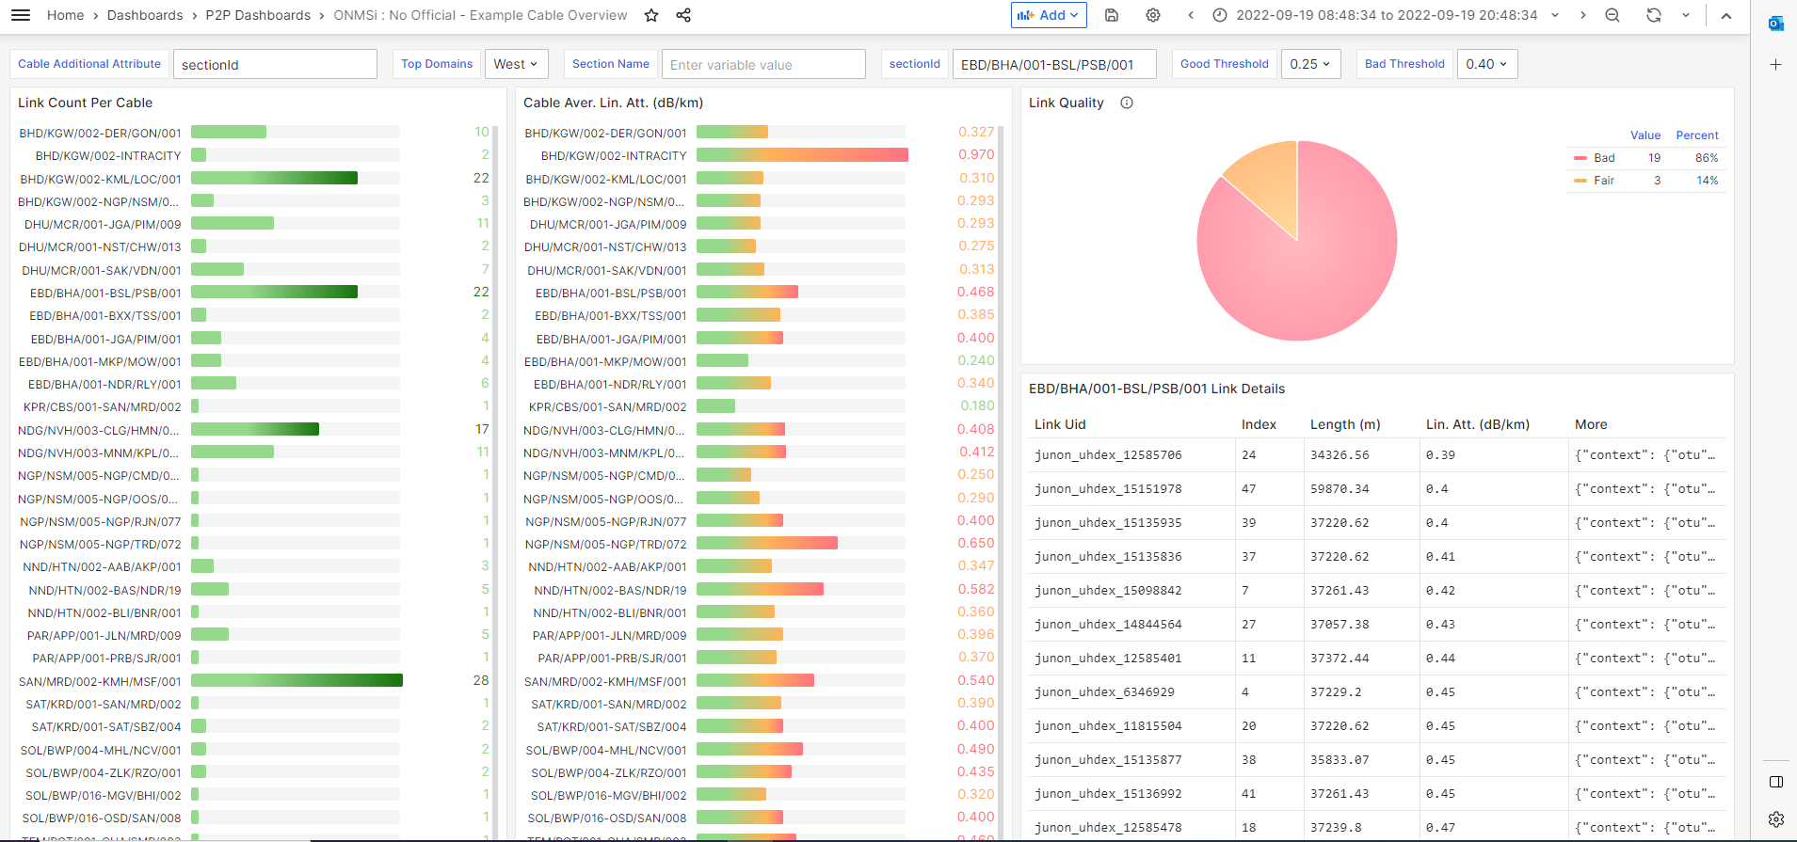
Analytics as Plannig Tool
Linear Attenuation Analysis

Slide 11
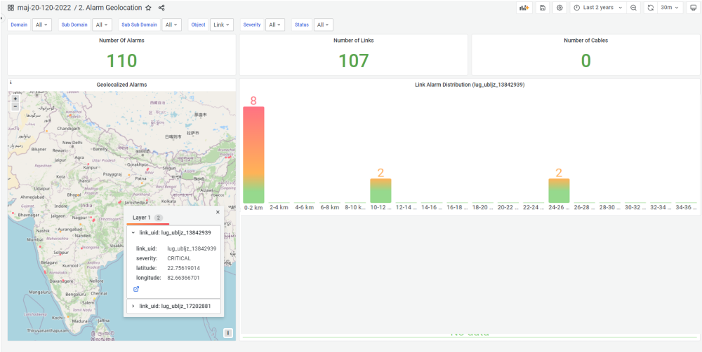
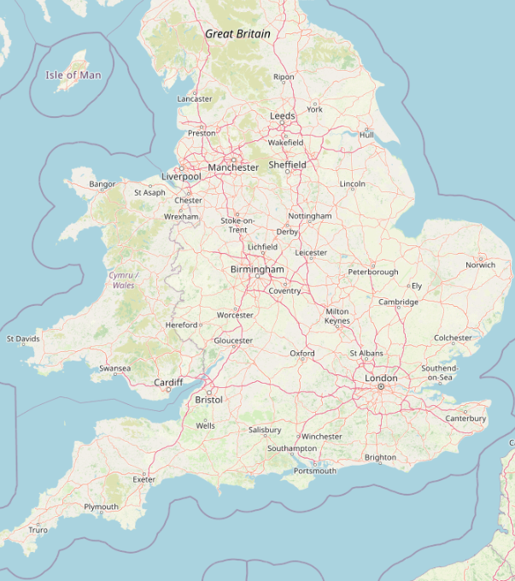
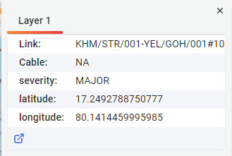
Heat Map: Showing Fiber Vulnerabilities
Optimize Cable investment Planning
Select targeted period
Location of fiber issues
Distribution of alarm occurrences along cable route

Slide 12


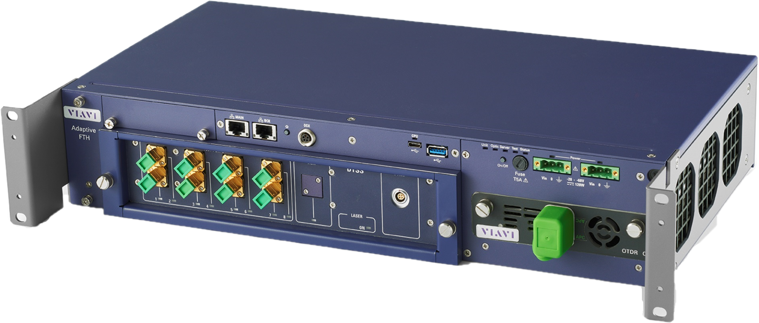



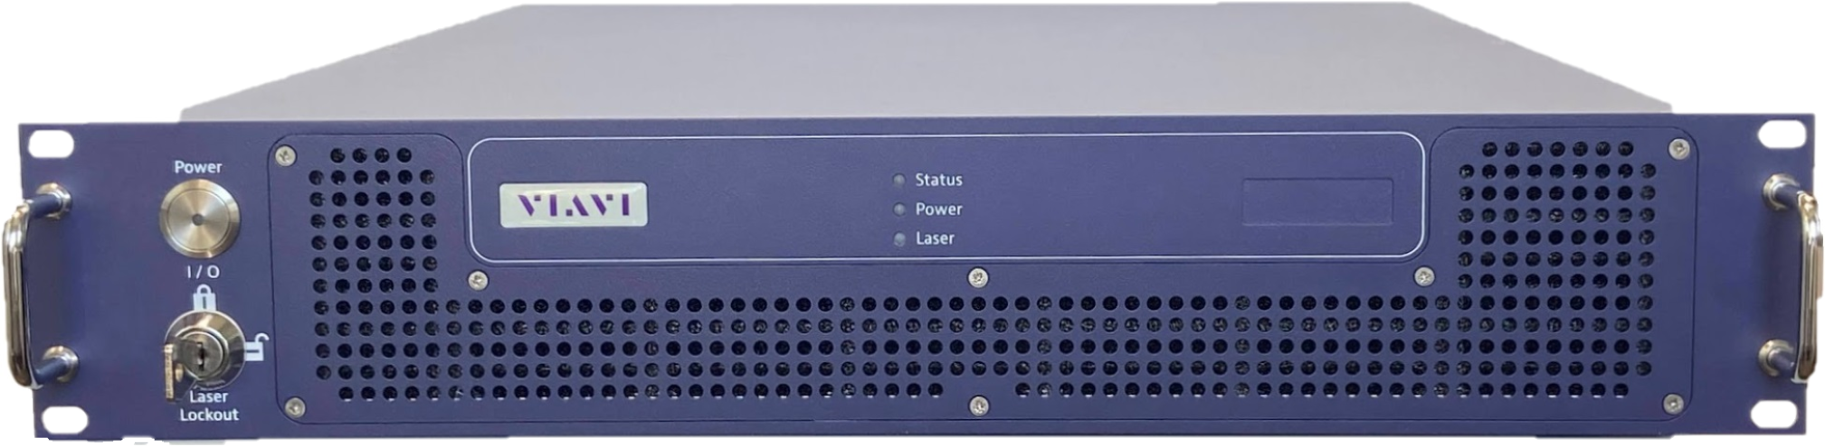













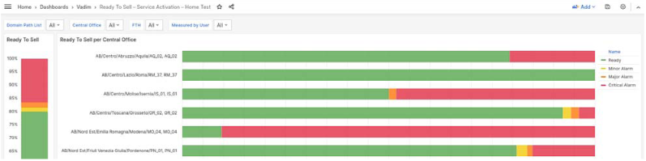
Fiber Monitoring & Sensing Systems
Holistic Data Strategy - Integrated ONMSi Platform
ONMSi
GIS
GIS
Capabilities
KML importation
GeoDesign
External GIS*
ONMSi
FTH-9000
(DTS & DTSS)
collector
Notifications & Integrations
Email
FTH-DAS
Basic
Authentication
SSO - Keycloak
Information Visualization
Dashboard Report
Fiber Analytics
REST
Features
SQL
Web Clients
Grafana dashboards
Mobile access
Domain, Users and Privileges Management
ONMSi Backup Server
VIAVI Restricted
Notes:
The main solution components are:
Fiber Test Heads such as FTH-9000 (DTS & DTSS), and FTH-DAS communicate securely to ONMSi server
ONMSi software: it is the central server solution
CLICK 1:
ONMSi has three different ways to add fault-on-map capability:
KML importation: Similar to SmartOTU (stand-alone) module
GeoDesign option is the fault-on-map tool for ONMSi.
3rd-party GIS integration through web services, or SNMP.
CLICK 2:
ONMSI Notifications can be delivered by SNMP traps or emails:
- ONMSi includes SNMP, Kafka and Web services for third-party integration projects.
CLICK 3:
Besides the Basic ONMSi Authentication with users and password, ONMSi also includes additional authentication modules to connect corporate users to ONMSi server.
CLICK 4:
ONMSi has important features such as:
Web client access. It supports main web browsers.
Mobile access for field technicians.
Domain, and user management
Finally, ONMSi has a reliable high-availability topology with offline or online backup server.
CLICK 5:
ONMSI also has an optional Fiber Analytics module to get deeper and better understanding of the fiber network.
The data can be extracted by REST API or SQL queries.

