Slide 1
Where the Traffic Goes Next: Romania, AI Load, and the Infrastructure that has to carry It
RONOG 2026
Olena Lutsenko
Business Development Director,
RETN Group

Slide 2
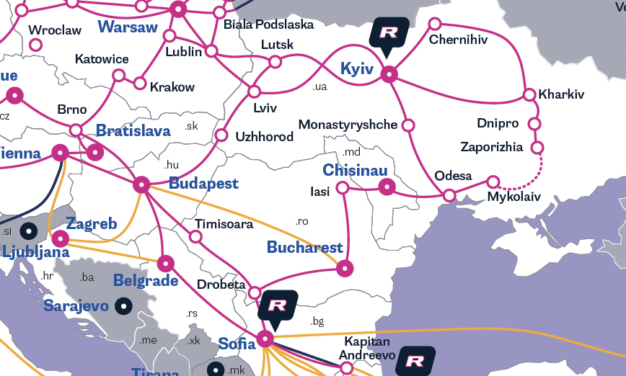
Telecom trends, challenges and risks
Where we are now
AI
More traffic, higher load peaks, and tighter latency requirements.
Resilience
Legacy systems and route consolidation reduce network flexibility.
New digital corridors
Not maps of possible routes — but infrastructure that is actually ready to carry AI, cloud, and critical service traffic.

Slide 3
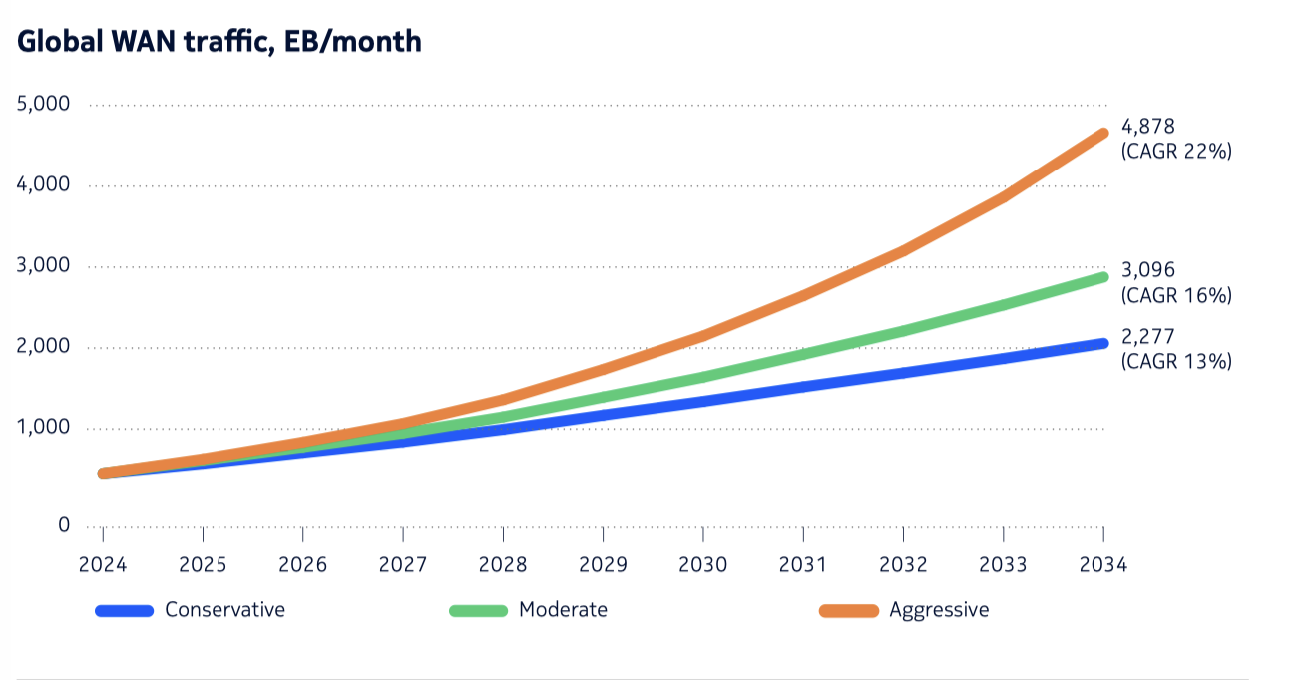
Global traffic distribution trend by Nokia* forecast through 2034
TOTAL GLOBAL WAN TRAFFIC IS PROJECTED TO GROW ROUGHLY 3 TO 7 TIMES
FROM
2 277 EB/month
UP
4 878 EB/month
Global demand for telecom bandwidth:
CAGR 13–22%
2024 - 2034
*Global network traffic report, Nokia, 2025

Slide 4



Resilience Is a Mandatory Requirement for Operators
ENGINEERING PRINCIPLES WHEN LIVES AND BUSINESS DEPEND ON YOU
Build with risk in mind
Geo, supplier, and infrastructure diversity.
Automated rerouting of NxTbps in under 6 hours. 3 independent physical routes as the minimum design baseline – not an option
Design smart, scale rationally
Unique cross-border optical paths
Low latency by design
Optimise efficiency
400Ge deployment
Vendor energy efficiency analysis
Low power consumption per Gbps

Slide 5
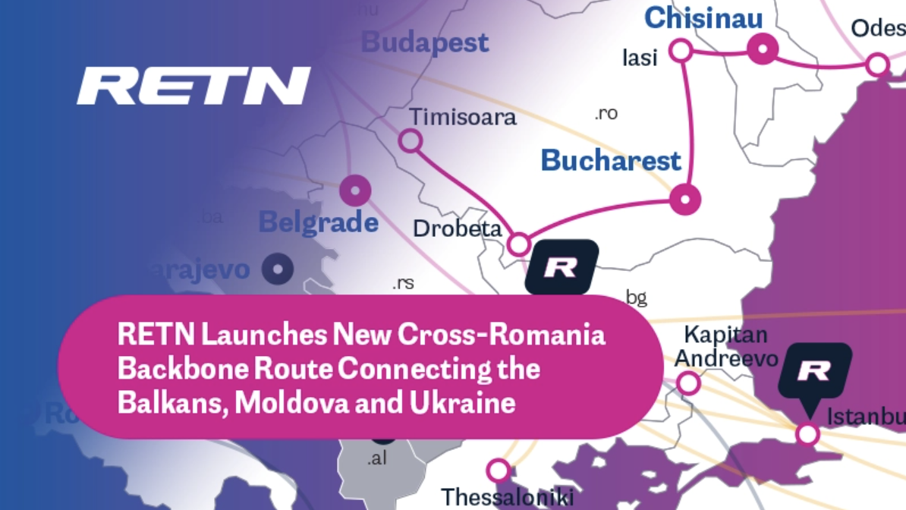
Diversity and network redundancy is a must
What else is needed?
Variety of vendors
Enough capacity
Smooth flow of operations
Agility to grow together or to keep up with your growth

Slide 6
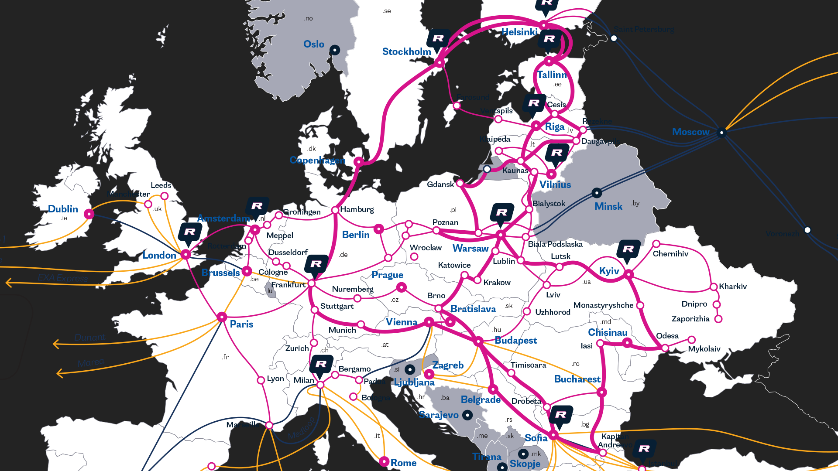
Romania: Gateway of the European – Middle East Digital Corridor
Notes:
it."

Slide 7
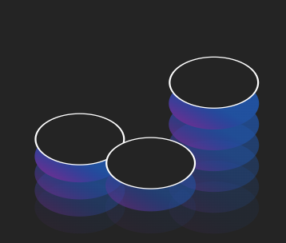





The Next 5 Years: What NSP Must Start Doing Today
MISSED OPPORTUNITY IS THE REAL RISK
Network diversity
3 independent physical routes
OTDR automation
Proactive fault response
No single-supplier dependency
New cross-border and unique optical routes
In-house engineering expertise
Combining AI-driven network intelligence with deep operational engineering
Deliberate multi-vendor strategy
Extended delivery lead times create new risks for rapid scaling
Diversified operational model
NOC 24x7 Riga & Hong Kong
Local teams

Slide 8
This is the Moment
THE CORRIDOR IS BEING BUILT. THE QUESTION IS WHO IS BUILDING IT.
LOW LATENCY
AI requests DC to DC connection
NETWORK DISTRIBUTION
Hyperscalers need regional partners. Federation beats competition.
RESILIENCE AS DESIGN
SLA engineered resilience. MTTR in hours, not days. Romania/MD cross-border as structural advantage.
SOVEREIGNTY VS GLOBALISATION
Regulatory fragmentation → regional AI hubs.

Slide 9
Reality check:
AI brings the traffic
Resilience keeps it moving
The corridor determines who carries it
Romania is already on the corridor
? Is your network ready to keep up?
9

