Slide 1
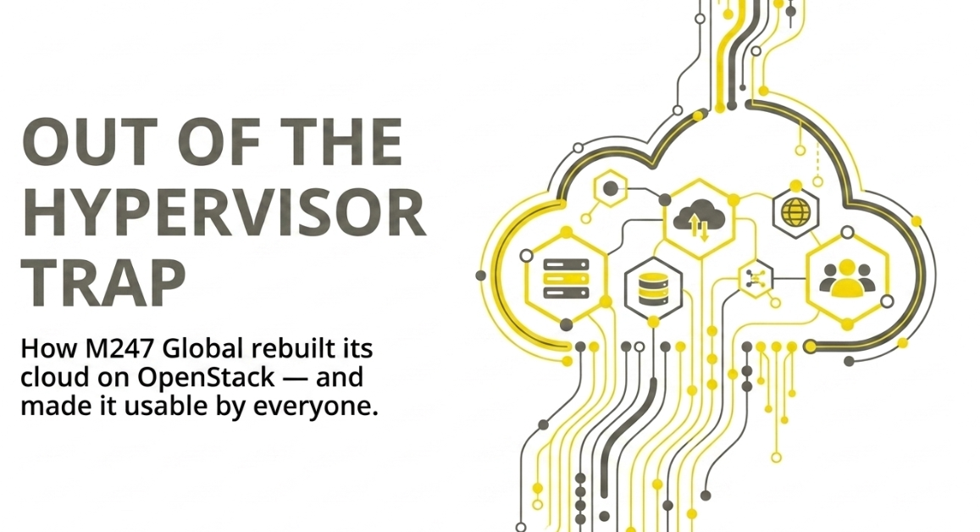
Notes:
Hi — Alin, M247 Global.
Quick show of hands: who here runs VMware in production? Keep your hand up if your last renewal quote was higher than the previous one. Keep it up if it was more than double.
Right. That's the talk.
We're an infrastructure provider — 55 data centres, 28 countries. We had the same problem you have, just multiplied by every customer we host. This is what we did about it, what worked, and what genuinely hurt.

Slide 2
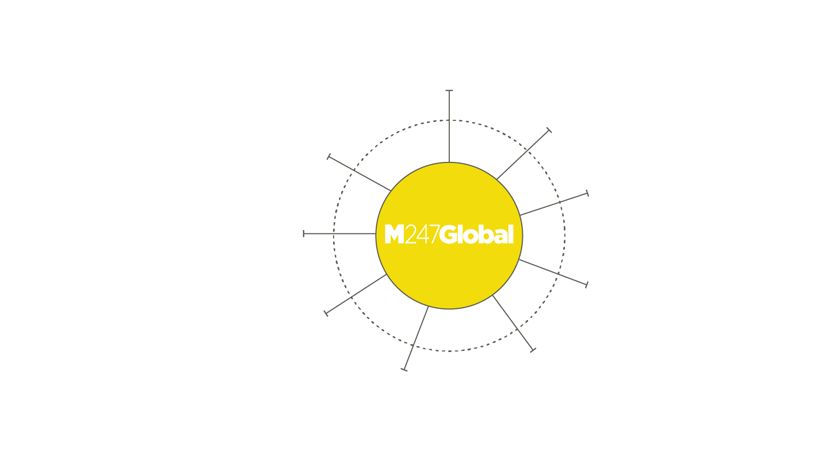
COLOCATION
Our services
Flexible Colocation Solutions
From shared to fully dedicated racks
With customizable power configurations
DEDICATED SERVERS
CONNECTIVITY
Performance, security & control for any business
M247 Global operates 56 Points of Presence (PoPs) worldwide, delivering high-speed, low-latency connectivity via 10–100 Gbps network backbones
M247 Global operates a global IP MPLS data transmission network with over 30 points of presence in 26 countries worldwide. Each point of presence is connected via at least two routes to ensure redundancy in case of failure
GLOBAL MEDIA & CONTENT STREAMING
CLOUD HOSTING
Be Everywhere
A global network for your global audience. Connected to all major national and regional Internet Exchanges to enhance content delivery
36 data centres. 32 cities. 26 countries
Up to 100 Gbps global cloud connectivity. Built-in DDoS protection, encryption & compliance. NVMe acceleration and hyper converged architecture
CYBERSECURITY & BUSINESS CONTINUITY SOLUTIONS
AI READY INFRASTRUCTURE
From cyber threats and data loss to system outages, our solutions help you stay in control with scalable, cloud-based protection backed by enterprise-grade tech and 24/7 support
Cloud AI Assessment
Configure NVIDIA GPU-powered nodes based on workload requirements. Integration with AI Frameworks
IoT INFRASTRUCTURE
GLOBAL STORAGE
However further configurations could solve generic issues with bare metal storage, PGW maintenance and service delivery
Global Accessibility & Performance
Data is accessible from anywhere in the world, allowing global teams and customers to access information with low latency

Slide 3
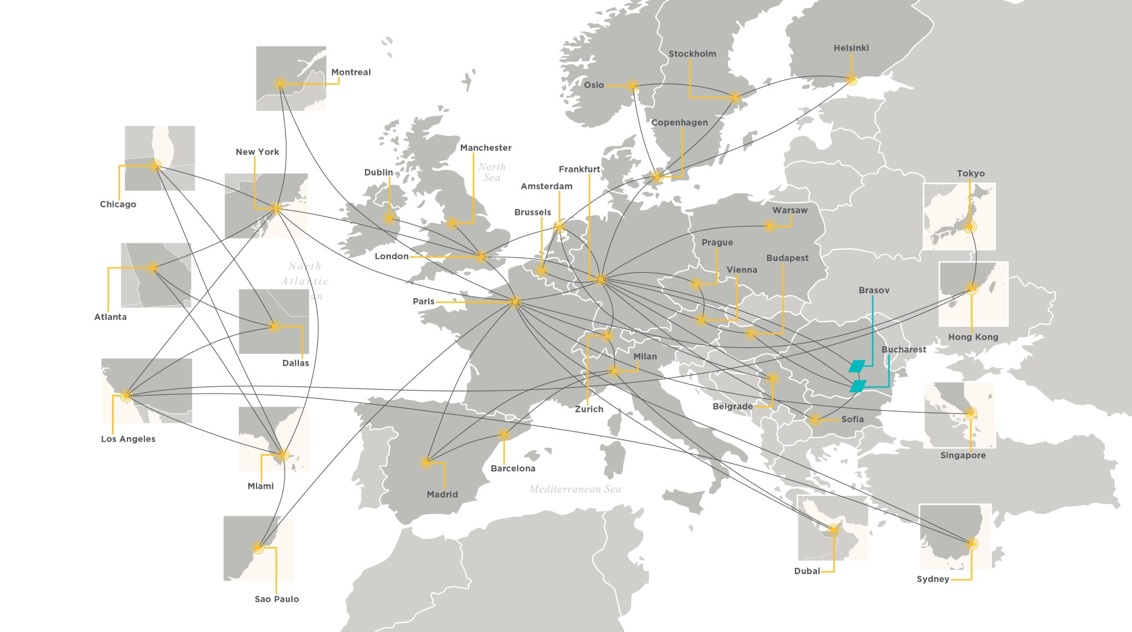

Slide 4
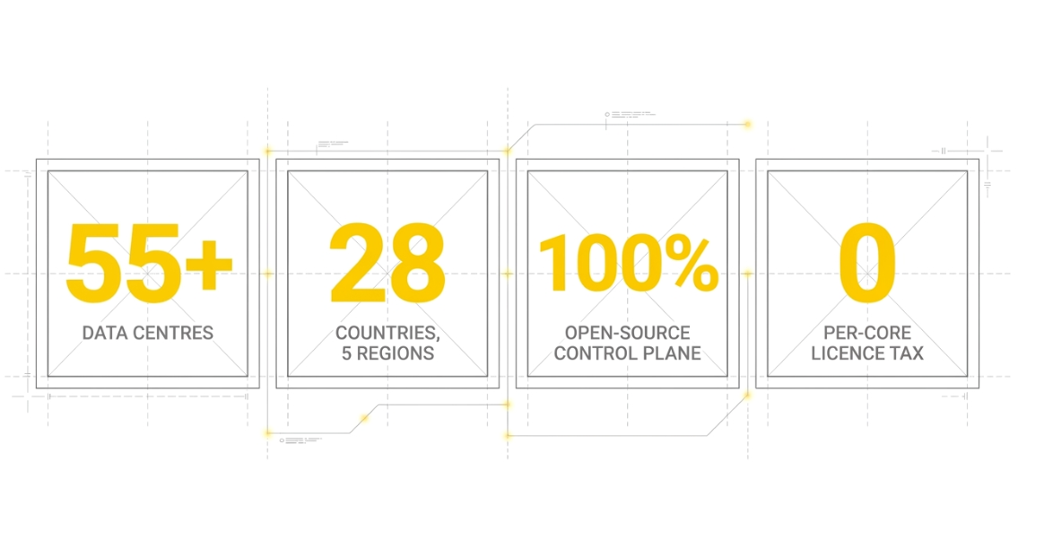

Slide 5
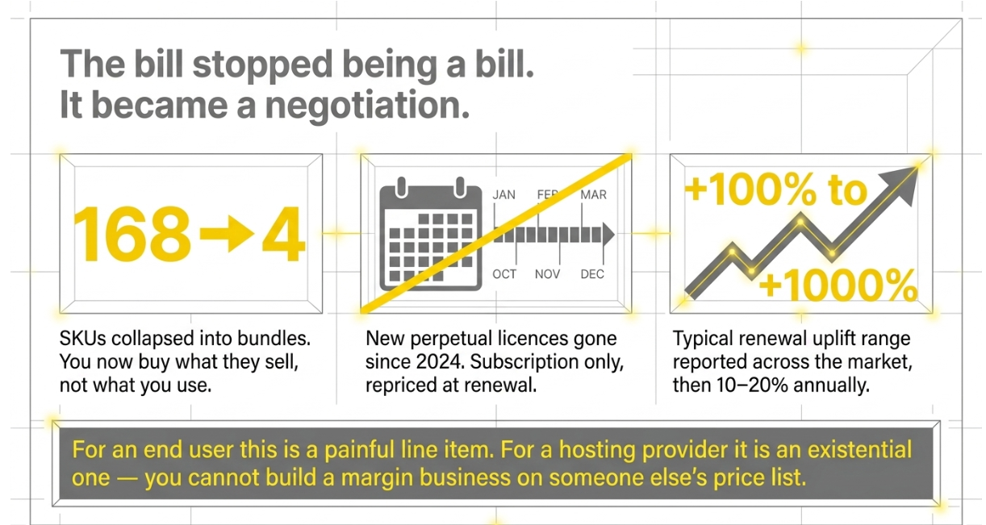
Notes:
Broadcom closed the VMware acquisition and did three things fast:
1. Cut 168 products down to four bundles. You stopped buying components and started buying whatever they decided to package.
2. Ended new perpetual licensing in 2024. Everything is subscription now, which means everything gets repriced at renewal.
3. Repriced. The public range in the market is wide — 100% at the mild end, four figures at the extreme. AT&T's dispute was reported around 1050%.
Say it plainly: for a customer this is a bad quarter. For us — a provider reselling that platform to thousands of customers — it's an existential question about whether our business model still works.

Slide 6
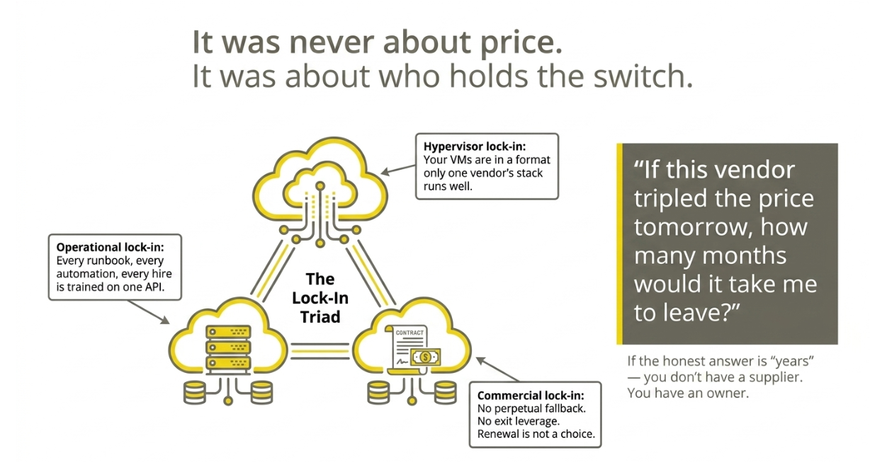
Notes:
THE REAL PROBLEM
I want to be careful here, because "VMware got expensive" is a boring talk and half of you have already given it internally.
The price is the symptom. The disease is that we had built ourselves into a position with no leverage at three layers — the VM format, the operational knowledge, and the commercial terms.
Here's the test I'd offer you. Not "is it expensive" — that's a budget question. Ask: if this vendor tripled the price tomorrow, in how many months can you leave?
We ran that test on ourselves in 2024. The answer was years. That's not a supplier relationship.

Slide 7
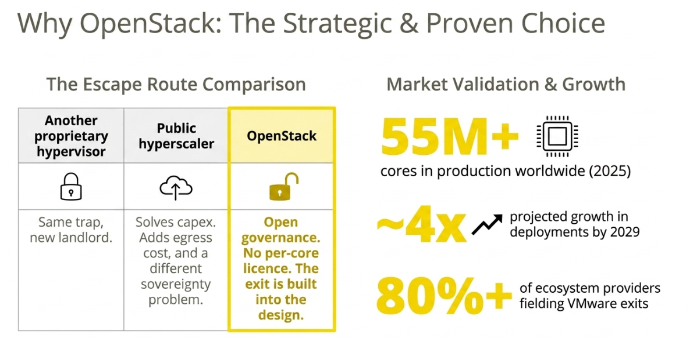
Notes:
WHY OPENSTACK
Three doors out of the room.
Door one: a different proprietary hypervisor. Nutanix, Hyper-V, whatever. That fixes this year's invoice and rebuilds the exact same dependency. Same trap, new landlord.
Door two: hand it to a hyperscaler. Legitimate for some workloads. But you trade a licensing problem for an egress-cost problem and, for a lot of European customers, a jurisdiction problem.
Door three: OpenStack. Open governance, no per-core tax, and crucially the exit path is part of the design — images and volumes are in open formats.
And it isn't a fringe bet. 55 million cores in production. The ecosystem projects roughly 4x growth by 2029, driven precisely by VMware migrations.

Slide 8
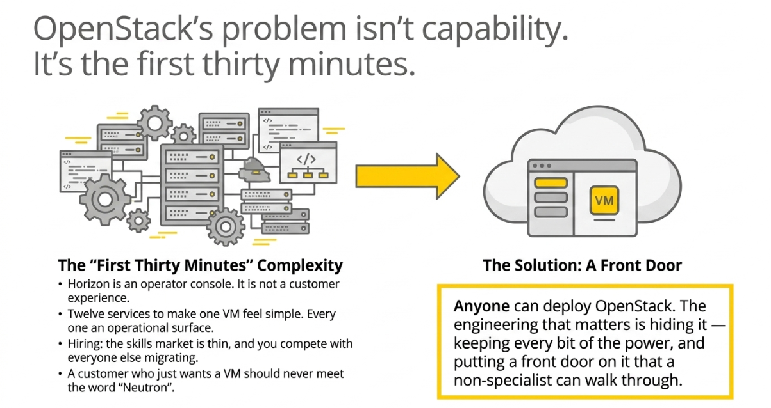
Notes:
THE HONEST PART
This is the slide where I stop selling.
OpenStack is not a drop-in replacement, and anyone telling you that has not run it. Three things bit us.
Horizon. It's a fine operator console. It is not something you put in front of a paying customer who runs a logistics company and wants one VM.
Complexity surface. Keystone, Nova, Neutron, Cinder, Glance, Octavia, Ceph... each one is a thing that can page you at 3am.
And people. The skills market is thin, and everyone migrating off VMware is bidding for the same engineers.
So we reframed the project. Deploying OpenStack is not the achievement — you can do that in a lab this weekend. The achievement is concealing it. Full power underneath, and a front door that a non-specialist can actually walk through.
That's what the rest of this talk is.

Slide 9
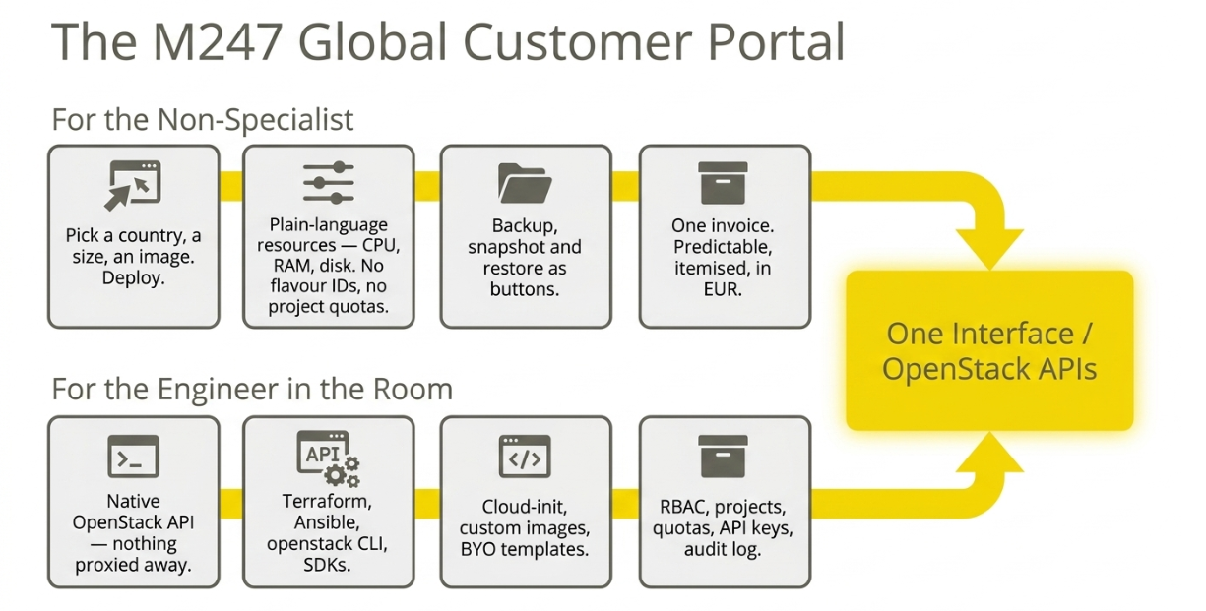
Notes:
THE PORTAL
Most providers pick a side. You either get a simple panel that hides so much it's useless to an engineer, or you get raw OpenStack and a wiki link.
We refused the trade-off, because both customers are in our book.
Top side — the customer who is not an infrastructure person. They pick a country, a size, an image, and they get a machine. They never see a flavour ID. Backups are a button, not a Cinder workflow. One invoice, in euros, itemised.
Bottom side — you. Native OpenStack API underneath, not a proxy that swallows half the calls. Terraform provider, Ansible, the openstack CLI you already know. Cloud-init, your own images, proper RBAC and audit logging.
Same platform. The portal is a lens, not a wall.

Slide 10
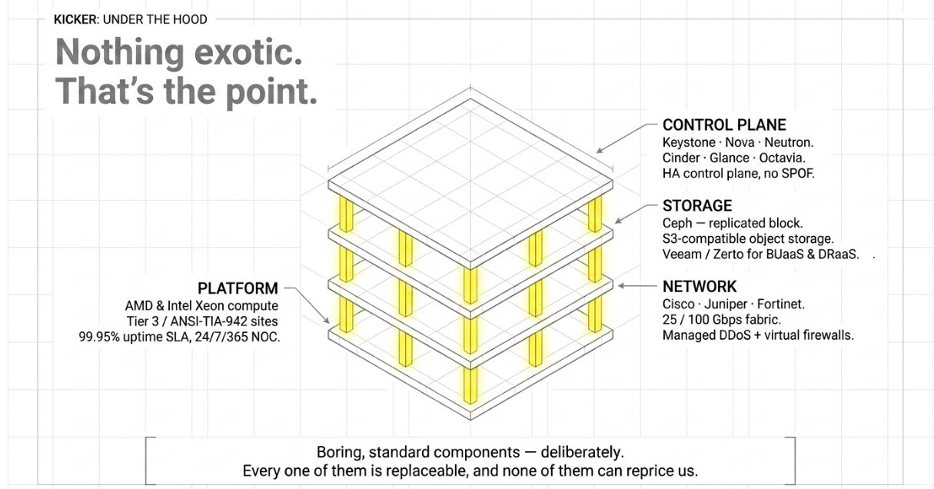
Notes:
UNDER THE HOOD
Standard OpenStack control plane, made HA. Ceph for block, S3-compatible object storage, Veeam and Zerto for backup and DR. The network is the same Cisco, Juniper and Fortinet kit we already run — 25 and 100 gig. Tier 3 facilities, 99.95% SLA, our own NOC, never outsourced.
The point of this slide isn't that any of it is clever. It's that none of it is. Every component here is boring, standard, and replaceable — and not one of them is in a position to send us a 400% renewal quote.

Slide 11
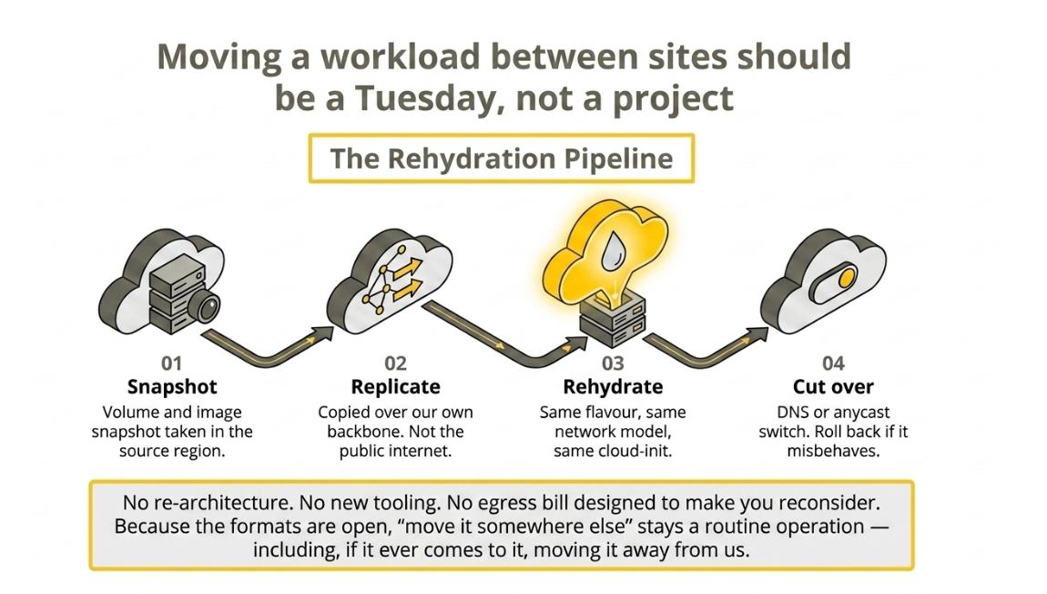
Notes:
PORTABILITY
This is the part I'd argue is the actual product.
Four steps. Snapshot the volumes and image. Replicate across our own backbone — our network, not the public internet, which is the difference between hours and days. Rehydrate on the far side with the same flavour, same network model, same cloud-init. Then cut over, and keep the source until you're happy.
What is NOT in that list: re-architecting the application. Learning a new toolchain. And an egress bill engineered to make you think twice.
And I'll say the uncomfortable part out loud, because this is RONOG and you’d call me on it otherwise — that same property means you can move away from us. Open formats cut both ways. We think that's the right trade. If we're only keeping customers because leaving is painful, we've built the wrong thing.

Slide 12
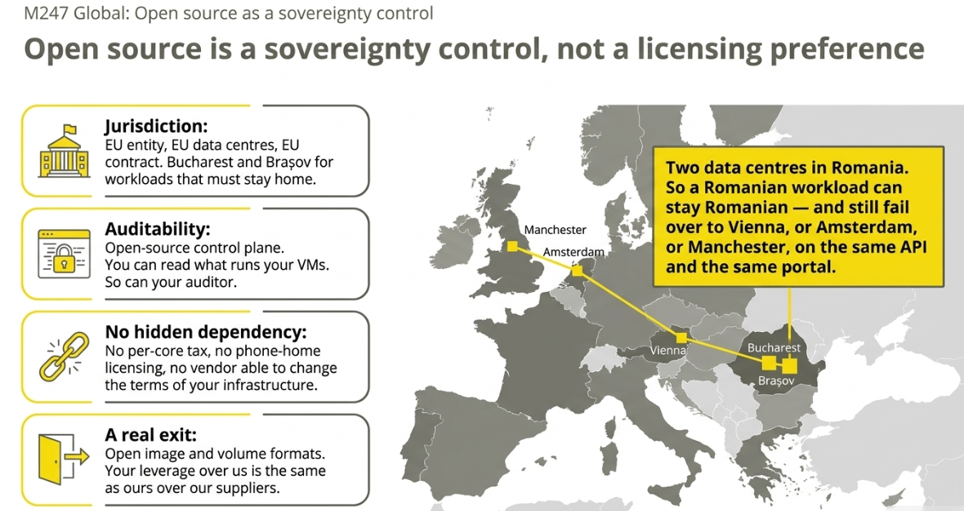
Notes:
SOVEREIGNTY
Sovereignty has become a marketing word, so let me define it as four concrete controls rather than a slogan.
Jurisdiction — EU entity, EU facilities, EU contract law. Two Romanian sites if in-country is a hard requirement for you.
Auditability — the control plane is open source. When a regulator asks what runs your workload, "it's proprietary, trust us" is not an answer. Here it is.
No hidden dependency — nothing phones home, nothing counts your cores, and no third party can unilaterally reprice the platform you're standing on.
And a real exit. If our formats are open, your leverage over us is genuine. I’d rather compete on service than on switching cost.

Slide 13
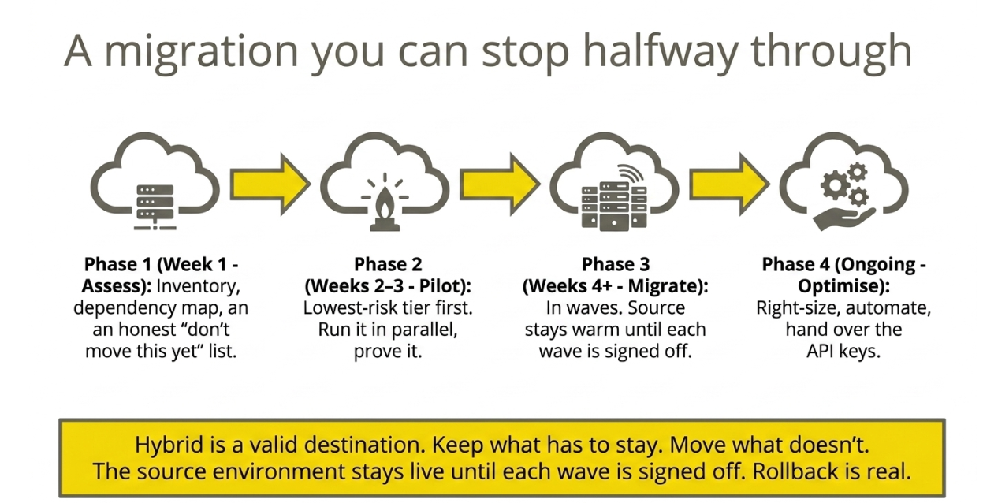
Notes:
MIGRATION PATH
Briefly, because the shape matters more than the detail.
Assess — including the honest list of things that should not move yet. There’s always something.
Pilot — lowest-risk tier, run in parallel, prove it before anyone commits.
Migrate in waves, and the source environment stays warm until each wave is signed off. Rollback isn't a paragraph in a contract, it's an actual button.
Optimise — right-size, automate, hand over the API keys.
Two things I want on the record. Hybrid is a legitimate end state, not a failure — if something genuinely belongs where it is, leave it. And you can stop this process halfway through. Any migration plan that only works if you complete it is not a plan, it's a hostage situation.

Slide 14
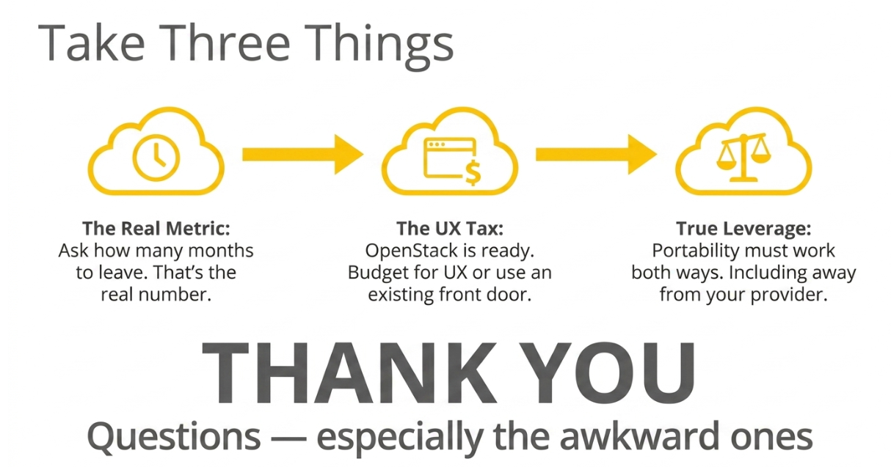
Notes:
CLOSE
Three things to take away.
One — the renewal quote is the symptom, not the disease. Go back and ask the real question: how many months would it take us to leave? Whatever that number is, that's your actual risk position.
Two — OpenStack is production-ready and has been for years. The user experience is not free. Either budget for building the front door, or use someone who already has.
Three — portability only means something if it works in both directions. Ask your provider, including us, how you'd leave. If they get uncomfortable, that’s your answer.
Happy to take questions — and the awkward ones are more useful than the polite ones. Come find me afterwards if you'd rather.

Slide 15

Thank You!
CONTACT: Alin Ștefănescu​ - alin.stefanescu@m247.eu​

